Slide 1
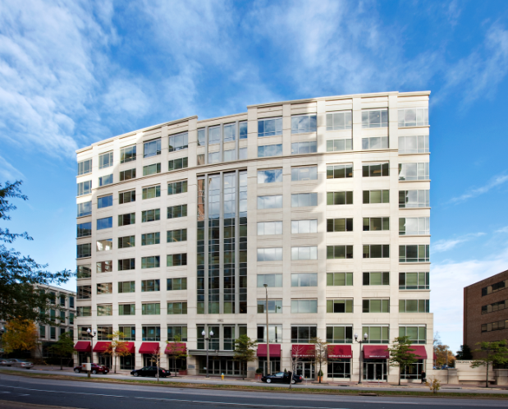
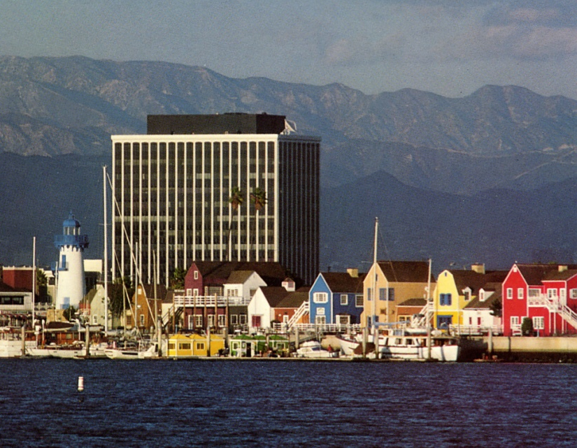

Arlington, VA
Marina del Rey, CA
Information Sciences Institute
“We are the ‘&’ in R&D
Information Sciences Institute
Institute Overview & Status
Presentation to:
Presented by:
Dr.John J. Granacki
USC’s Information Sciences Institute
Director Advanced Systems
Marina del Rey, CA
1

Slide 2

ISI Summary
Organization: large, vibrant, research-sponsored Institute:
  Part of USC’s Viterbi School of Engineering located in “Marina Tech Campus” (Marina del Rey).
  >$75M per year in funding from a diversified base of sponsors.
  >330 people mostly research staff.
  Facilities to conduct ITAR, classified and unclassified research.
Mission: traditional basic and applied research combined with education and building real systems:
  Projects - small, medium, and large.
  Staff - mix of faculty, students, and full-time research personnel.
Technology: broad research profile across computer sciences, mathematics, engineering, and applied physics.
Sponsors: DoD research agencies, intelligence community, NIH, DOE technical offices, and industrial/commercial entities.
RESEARCH
ACADEMIC
INDUSTRIAL
PROFESSIONAL
EDUCATE
BUILD & USE
> 35-year track record of performing world-class research while
deploying prototypes that address important customer problems
2
2
Notes:
2

Slide 3
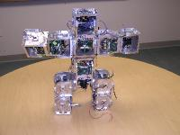
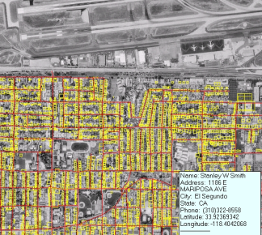
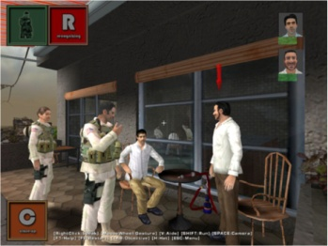

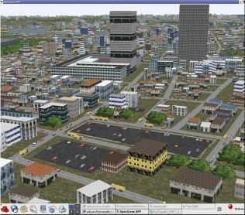
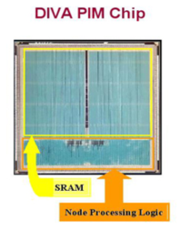
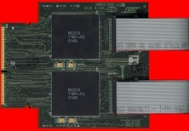
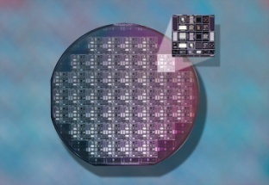
Core Competencies
Intelligent Systems
Natural language
Education, training and cognitive development
Knowledge representation/acquisition, and data mining
Robotics and virtual humans
Informatics, Networking, and Computing Systems
Networking principles, architectures and protocols
Information technologies, security strategies, and infrastructure
Cloud & Grid computing, distr. workflows, and decision-support systems
Health-informatics, medical records, and energy-informatics
Advanced Electronic Systems
Scalable and low-power embedded systems
VLSI and System-on-a-Chip (SoC) technology & MOSIS
Trusted/reliable electronics/systems
Bio-mimetic, medical electronics, and bio-inspired systems
Space applications (electronics & small platforms)
3
Notes:
3

Slide 4
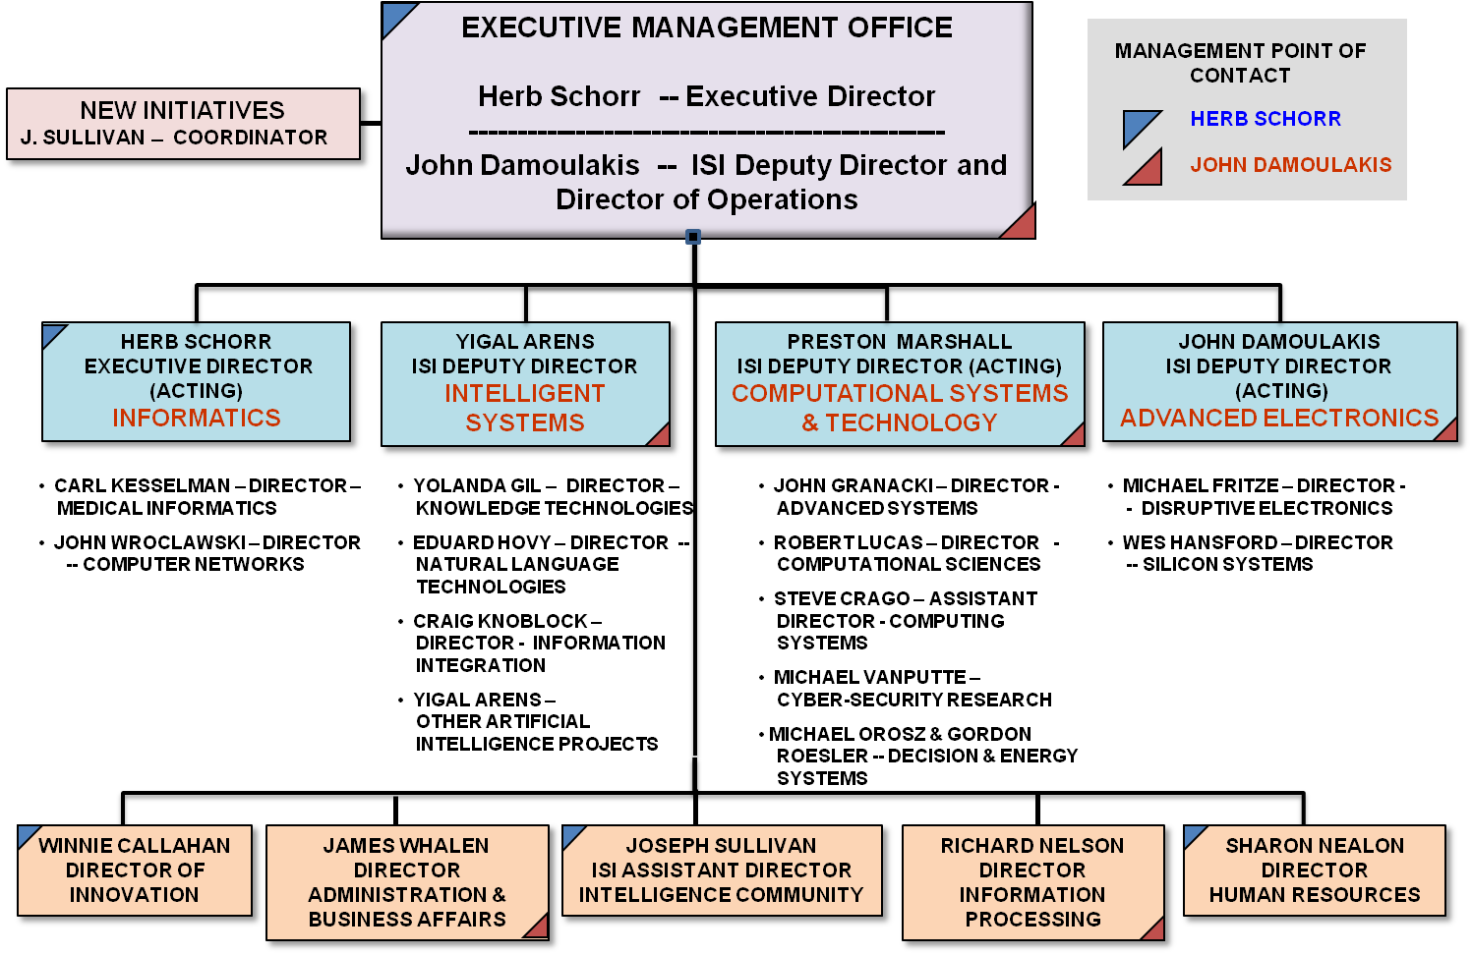
ISI’s Current Organizational Structure
Notes:
4

Slide 5
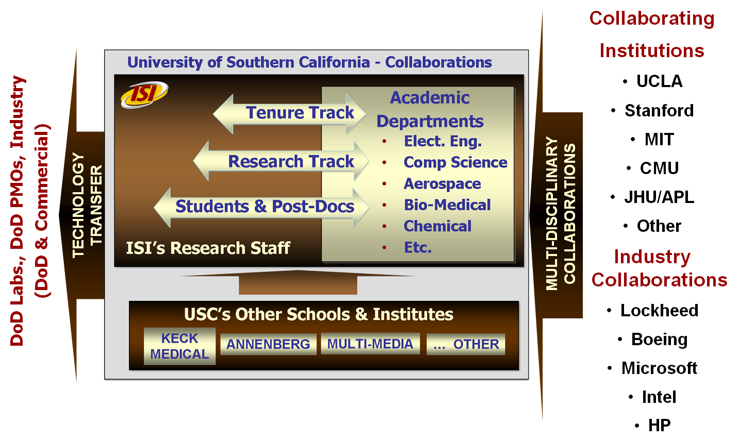
ISI’s Mode of Operation
Nation-wide collaborations strengthening its technical skills
5

Slide 6
Brief History & Diversification
ISI was formed almost as a captive organization to DARPA.
For many years, DARPA was almost the sole supporter of ISI:
  MOSIS
  Internet
  Natural language and A.I.
Over last decade, ISI sought new sources of research sponsorship, technologies, and new research disciplines:
  Developed ties to IC community, DOE, NSF, NIH, etc.
  MOSIS became self-sufficient,
  Developed internal capability to foster and advocate innovative, visionary solutions.
ISI has come-out of this process more diversified, more aware of broad areas of research, suited to end-to-end program goals and deliverables, and developed a vibrant technology-agile staff
6

Slide 7
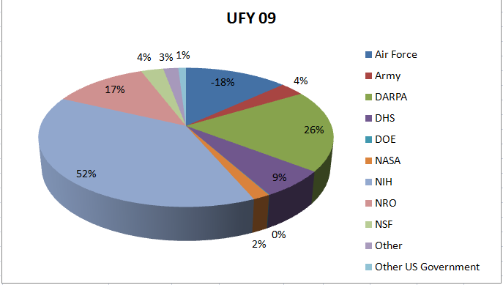
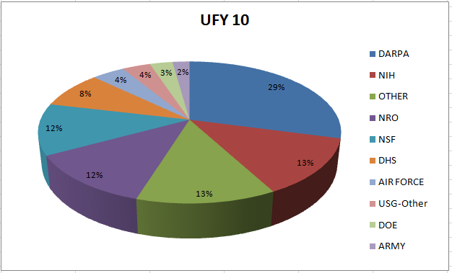
Funding Distribution by Source
DARPA
DARPA
NIH
NIH
REMARKS
-- UFY -10 total funding $77M; UFY-2011 total funding >$82M (Estimated)
-- UFY-2010 Distribution: DARPA 29%, NIH 13%, NRO 9%, NSF 19%, Other 33%
-- Technology portfolio is balanced among the various funding sources
-- Dramatic shift from the 90’s and early 2000’s where DARPA was >75% --
7

Slide 8
Sample of Major DARPA-awarded Recent Programs
ISI in last 4 years (2007 – 2010) awarded over $60M from DARPA mostly in the areas of micro-electronics, networking, and artificial intelligence
Trusted Electronics
  MTO – Developing methods to ensure operational trust of DoD electronics
MONARCH
  IPTO - Developed an ASIC in 90nm technology of more than 280M cells for DoD
  applications
Statistical Machine Translation
  IPTO - Developing automatic translation of human languages
Brain-implementable Bio-mimetic Electronic
  DSO - Developed chips to by-pass damaged brain regions and restore cognition
Training Superiority: Tactical Iraqi
  IPTO - Developed training tools to speed-up language and culture learning

Slide 9
Sample of Non DARPA-awarded Recent Programs
ISI in last 4 years (2007 – 2010) awarded over $140M from other sources (CY-2009: $43M) mostly in areas of informatics, health, energy, and intelligence.
Fusing Geospatial Data with Online Sources to Analyze and Label Imagery
  OGA – Mapping overhead imagery to on-line sources to determine location.
Defense Technology Experimental Research Laboratory Testbed (DETER)
  DHS – Distributed across U.S. testbed to emulate and study cyber attacks.
Energy-Informatics
  DOE – Systems for demand-response and security for smart grid.
Computational Infrastructure for Biomedical Research
  NIH – Collect health data and provide taxonomies to aid bio-medical research.
Health-informatics
  INDUSTRY - Understanding health data to aid physicians to make better decisions.
ISI’s staff is constantly engaged with government’s DoD and Civil S&T organizations helping to evaluate promising ideas.

Slide 10
ISI’s New Initiatives
ISI is investing in new initiatives that potentially have a strong impact on DoD and the nation at large.
Their solutions require technology development, or maturation of emerging technology.
Typical and critically important initiatives include:
  MOSIS - Plus
  Medical Electronics
  Manufacturing Informatics
  Wireless Networks & Security
  Alternative Sources for Energy Harvesting beyond Wind and Solar
  K-12 STEM Education
These ISI initiatives are ideas generated from its own staff– sponsored by ISI’s internal investment.

