Slide 1

Practical Adiabatic Quantum Computing:
Implications for the Simulation Community
Robert F. Lucas
USC – Lockheed Martin Quantum Computing Center
Co-Authors
David R. Pratt
Gene Wagenbreth
John J. Tran
Dan M. Davis

Slide 2
Presentation Outline
Digital Computing Growth Limits
Quantum Computing
Adiabatic Quantum Annealing
Potential Simulation Implementations
Conclusions
.

Slide 3
Computing Paradigms
The limits of transistor-based CPUs
Moore’s Law postulated eventual end of transistor density
Power and size constraints are slowing capability growth
Simulation community has grown to expect growth
Quantum Computing: seen as new capability
In 1982, Richard Feymann advanced the concept
Not based on transistor switching digital computing
Significant technical difficulties have prevented development
Adiabatic form of quantum computing
One producer has found a shorter path, albeit not as universal
By using super cooled devices, they have a working annealer
This device has been running at USC for more than a year

Slide 4
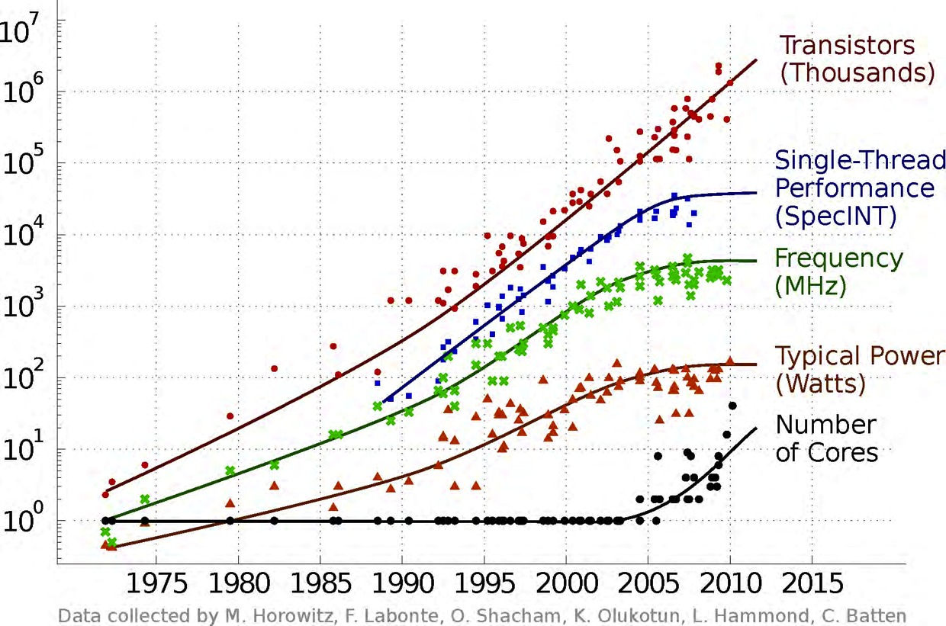
The End of Dennard Scaling

Slide 5
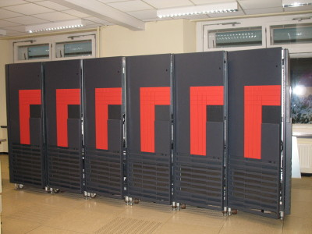
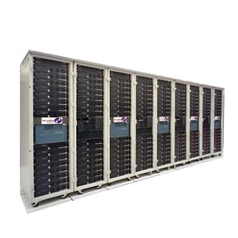
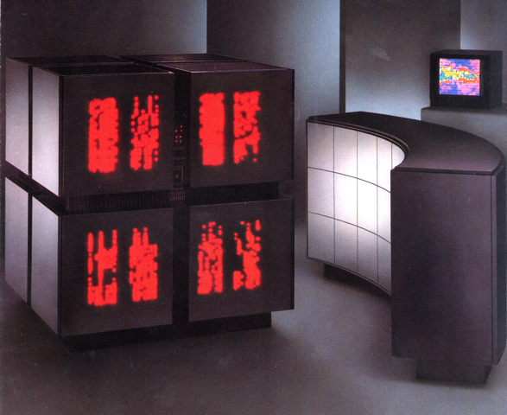
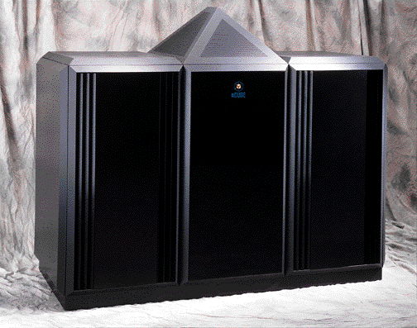
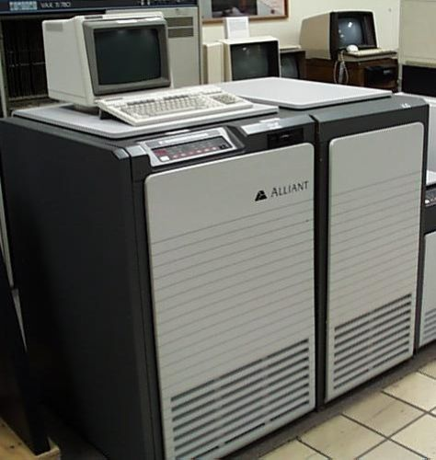
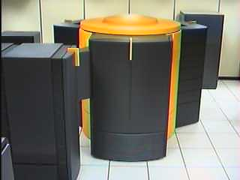
In the past, Digital Computing faced an uncertain future
BBN TC-2000 NUMA
Denelcor HEP multithreaded
Intel Touchstone Delta
TMC CM-2
Alliant FX/8
KSR-1
Cray T3D/E
J-Machine
Ncube
Cray C90
UIUC/CSRD Cedar

Slide 6
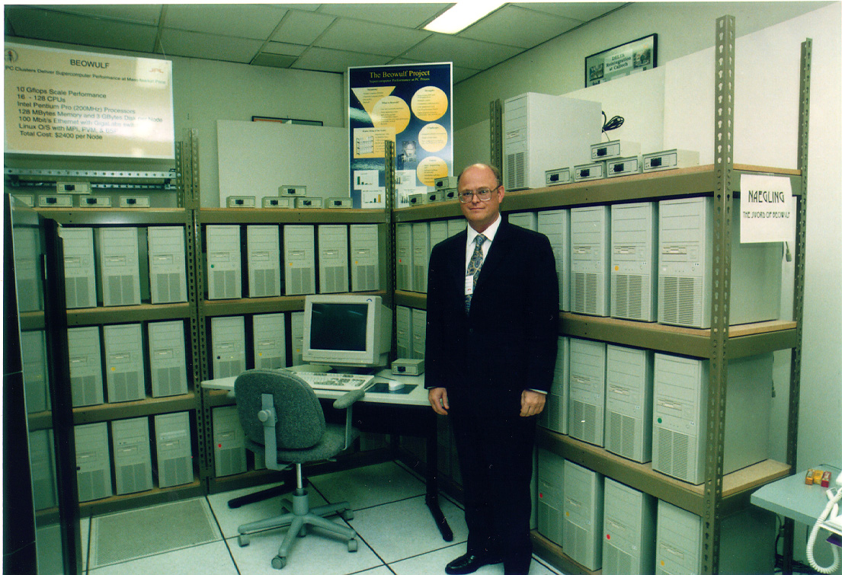
Simulation Community has used Cluster Computing
  COTS Components
  Leverage mainstream commercial processors
  Cache-based hierarchical memories
  Distributed Memory Architecture
  Familiar software on processors (Fortran, C, and C++)
  Message Passing Interface (MPI)
  Evolving for two decades
  Beowulf is the epitome
  All off-the-self
  PC components
  Ethernet networks
  Linux
  gcc
Summary | X

Slide 7
Many Challenges Still need More Analytic Power
Grand Challenges in Simulation
• Augmentation of multi-agent path planning | • Production of coherent parametric data
• Facilitation of entity inter-visibility | • Abstraction of data to evaluate goal achievement
• Generation of environmental weather models | • Promulgation of realistic intelligence reports
• Acceleration of weather radar modeling | • Instantiation of human networks and populations
• Implementation of better sonar weather modeling | • Creation of realistic intelligence backgrounds
• Injection of Master Scenario Entity List (MSEL) | • Elimination of role players
• Production of scenarios for preordained MSELs | • Stimulation of players with interaction mechanisms
• Data-reduction of multiple-source data
Summary | X

Slide 8
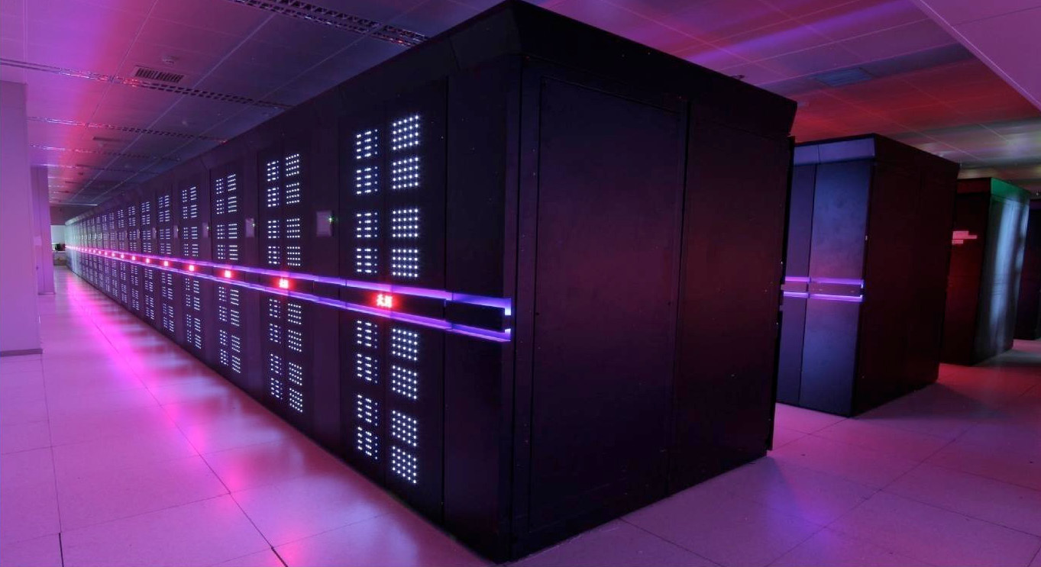
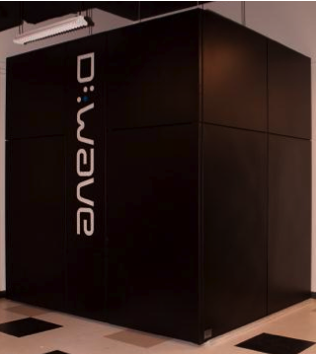

Capability Answers
Massive Scaling
Tianhe-2 (3M cores)
Exploit a New Phenomenon
D-Wave Quantum Annealer
Application Specific Systems
D.E. Shaw Research Anton
Introduction | 2

Slide 9
Quantum Computing
Based on Quantum Physical properties, not transistor switches
Some authors have touted quantum computing as “magic”
Quantum computers use a different way to encode information
Digital computers represent information with transistor-based switches
They have states of 0 or 1, labeled bits
Basic unit of quantum computer: a quantum bit or qubit
It can exist simultaneously as 0 and 1
The probability of each is given by a numerical coefficient,
So called “superposition”
Quantum computer can act on all these states simultaneously

Slide 10
Simulated Annealing
Annealing is a well-studied and much-used heuristic
for optimization problems
Simulated annealing efficiently locates good
approximations of optima
It is much faster than rigorous enumeration of
possible explicit solution
In multi-dimensional search spaces, it is often
the only practical path to useable solutions
Many issues in military simulation can effectively
use this technique

Slide 11
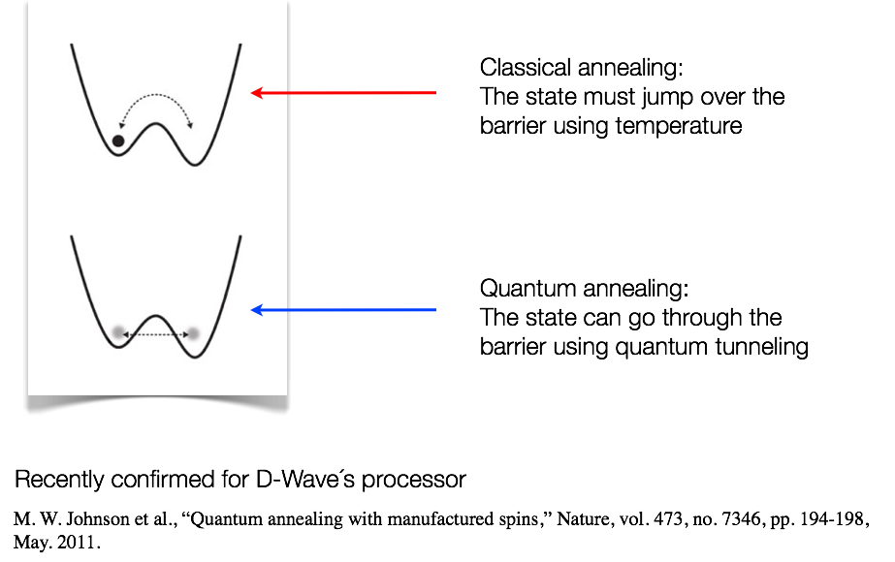
Quantum Annealing vs. Classical Annealing
Ongoing Research | X

Slide 12
D-Wave Quantum Annealer
D-Wave is a small Canadian company
Makes an adiabatic quantum annealer
Operates at a temperature of below 20 milliKelvin
Technical papers are to be found at:
http://www.dwavesys.com/en/publications.html
2007, D-Wave demonstrated an operating 28 qubit machine
2011, D-Wave announced the 128 cubit D-Wave One
USC – Lockheed Martin acquired one, located at USC
Now a D-Wave Two, 512 qubit system
503 working qubits
This size is capable of generating interesting results
Not yet big enough to set world records against huge clusters

Slide 13
What Might be Amenable to Adiabatic Quantum Computing?
Proposed Uses of Quantum Annealing
Data Mgt. | Behaviors | Analysis
Labeling Images | Extracting News Stories | Creating/ Testing Hypotheses
Scanning Data for Correlations or Anomalies | Natural Language Performance | Object Detecting in Imagery
Correlating Bio-Informatics | Factor Analysis of Intelligence | Verifying Computer Codes

Slide 14
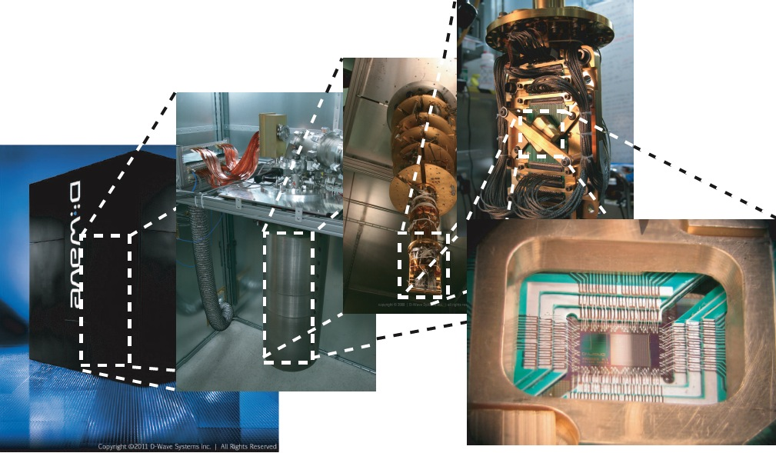
Look Beyond CMOS
D-Wave System Collage

Slide 15
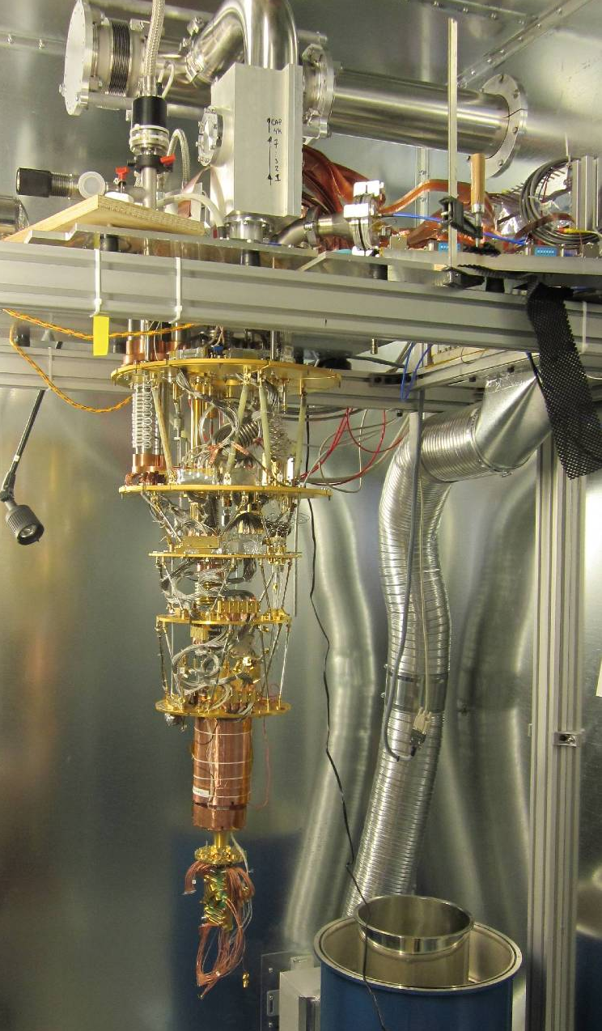
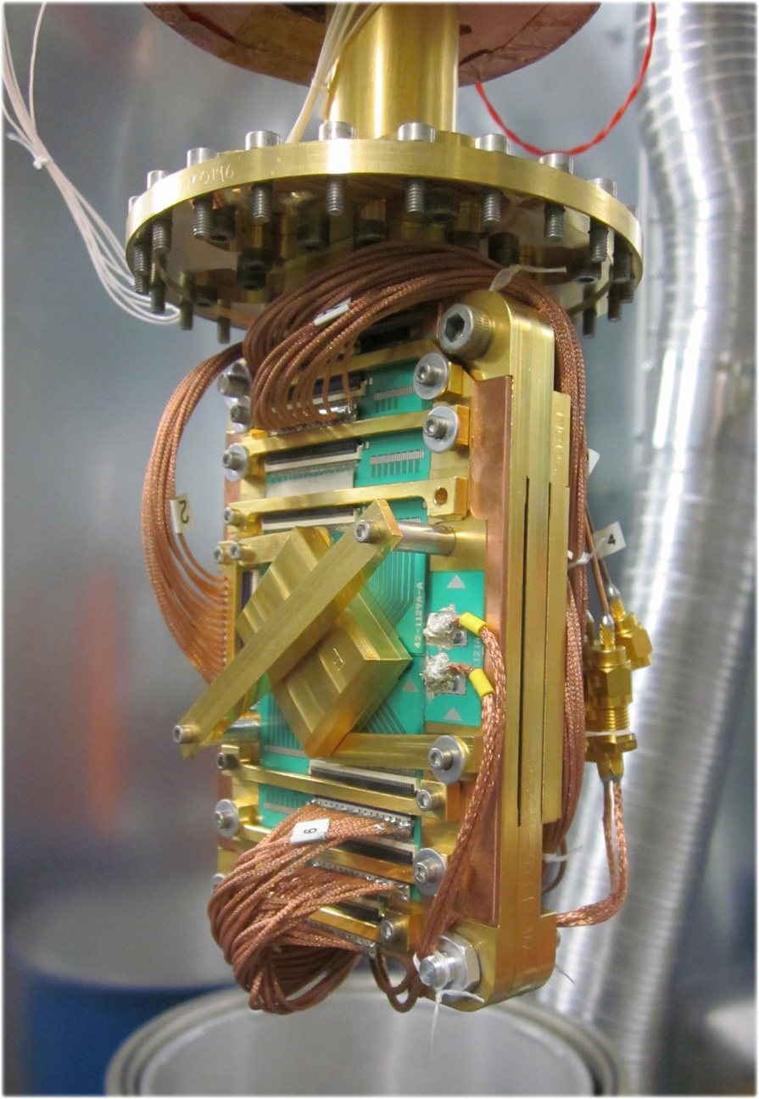
77K
4K
1K
300mK
20mK
Quantum Annealing
Occurs
In Here
Processor
15 © Copyright 2012-2013 D-Wave Systems Inc. Confidential D-Wave Systems Inc.

Slide 16
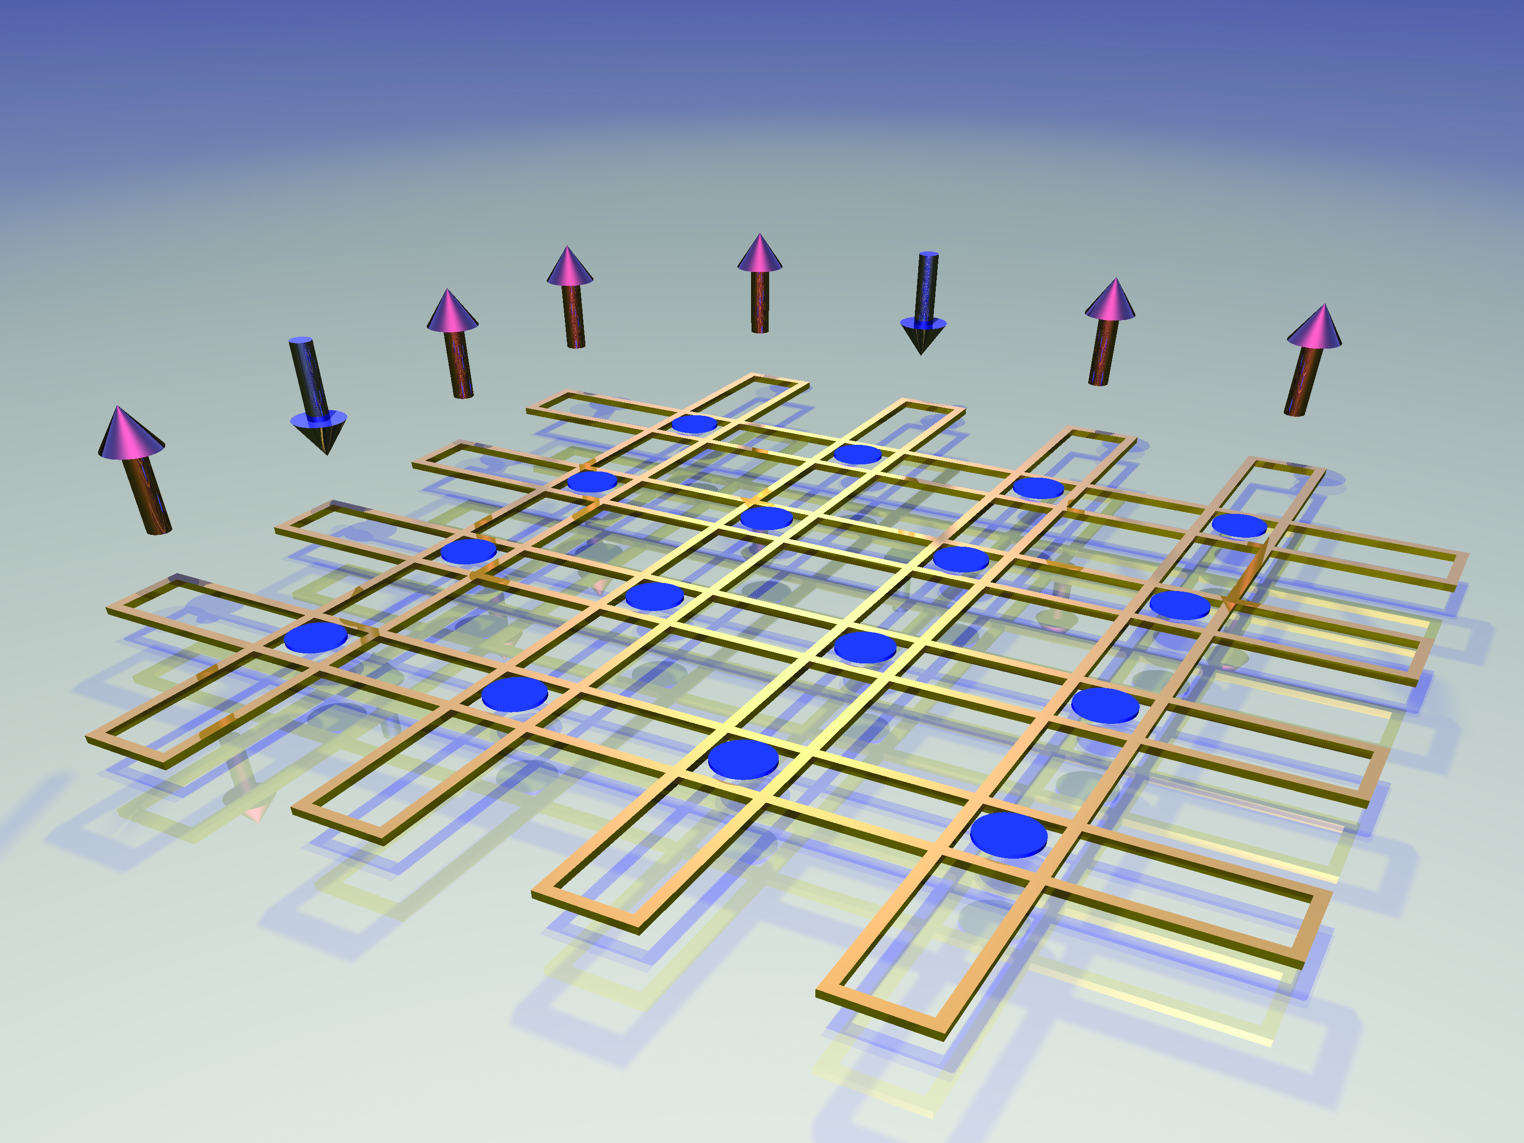
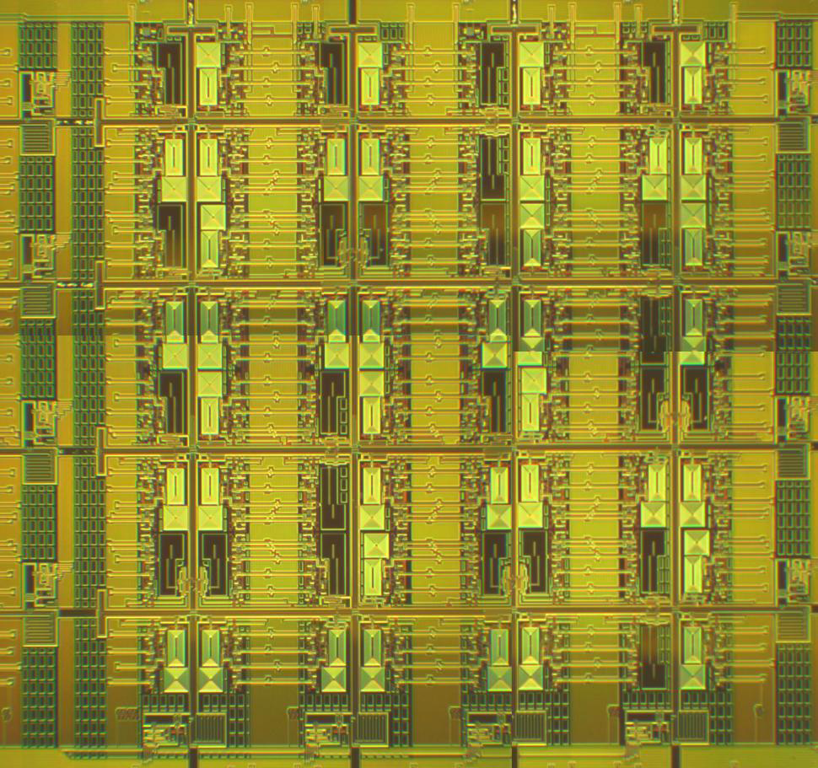
D-Wave Eight Qubit Unit Cell
Images courtesy D-Wave

Slide 17
D-Wave Chimera Graph Topology
The topology of the D-Wave Two at the USC – Lockheed Martin Quantum Computing Center.
503 of 512 qubits calibrated and mapped.
D-Wave | X

Slide 18
Potential Future Graph
Paper discusses possible use of Quantum Annealing for Potential Future Graph analyses
Plan Horizon 1
Plan Horizon 2
Task Name
Activity
Resources
Precondition
Stopping Condition
Est. Duration
Percent Compete
Next Task(s)
Task Name
Activity
Resources
Precondition
Stopping Condition
Est. Duration
Percent Compete
Next Task(s)
Task Name
Activity
Resources
Precondition
Stopping Condition
Est. Duration
Percent Compete
Next Task(s)
Most Probable Future
Task Name
Activity
Resources
Precondition
Stopping Condition
Est. Duration
Percent Compete
Next Task(s)
Task Name
Activity
Resources
Precondition
Stopping Condition
Est. Duration
Percent Compete
Next Task(s)
Task Name
Activity
Resources
Precondition
Stopping Condition
Est. Duration
Percent Compete
Next Task(s)
Task Name
Activity
Resources
Precondition
Stopping Condition
Est. Duration
Percent Compete
Next Task(s)
Task Name
Activity
Resources
Precondition
Stopping Condition
Est. Duration
Percent Compete
Next Task(s)
Task Name
Activity
Resources
Precondition
Stopping Condition
Est. Duration
Percent Compete
Next Task(s)
Task Name
Activity
Resources
Precondition
Stopping Condition
Est. Duration
Percent Compete
Next Task(s)
Task Name
Activity
Resources
Precondition
Stopping Condition
Est. Duration
Percent Compete
Next Task(s)
Task Name
Activity
Resources
Precondition
Stopping Condition
Est. Duration
Percent Compete
Next Task(s)
Task Name
Activity
Resources
Precondition
Stopping Condition
Est. Duration
Percent Compete
Next Task(s)
Task Name
Activity
Resources
Precondition
Stopping Condition
Est. Duration
Percent Compete
Next Task(s)
Task Name
Activity
Resources
Precondition
Stopping Condition
Est. Duration
Percent Compete
Next Task(s)
Task Name
Activity
Resources
Precondition
Stopping Condition
Est. Duration
Percent Compete
Next Task(s)
Task Name
Activity
Resources
Precondition
Stopping Condition
Est. Duration
Percent Compete
Next Task(s)
Task Name
Activity
Resources
Precondition
Stopping Condition
Est. Duration
Percent Compete
Next Task(s)
Task Name
Activity
Resources
Precondition
Stopping Condition
Est. Duration
Percent Compete
Next Task(s)
Task Name
Activity
Resources
Precondition
Stopping Condition
Est. Duration
Percent Compete
Next Task(s)
Probable Future
Task Name
Activity
Resources
Precondition
Stopping Condition
Est. Duration
Percent Compete
Next Task(s)
Task Name
Activity
Resources
Precondition
Stopping Condition
Est. Duration
Percent Compete
Next Task(s)
Task Name
Activity
Resources
Precondition
Stopping Condition
Est. Duration
Percent Compete
Next Task(s)
Task Name
Activity
Resources
Precondition
Stopping Condition
Est. Duration
Percent Compete
Next Task(s)
Task Name
Activity
Resources
Precondition
Stopping Condition
Est. Duration
Percent Compete
Next Task(s)
Least Probable Future
Task Name
Activity
Resources
Precondition
Stopping Condition
Est. Duration
Percent Compete
Next Task(s)
Task Name
Activity
Resources
Precondition
Stopping Condition
Est. Duration
Percent Compete
Next Task(s)
Task Name
Activity
Resources
Precondition
Stopping Condition
Est. Duration
Percent Compete
Next Task(s)
Task Name
Activity
Resources
Precondition
Stopping Condition
Est. Duration
Percent Compete
Next Task(s)
Task Name
Activity
Resources
Precondition
Stopping Condition
Est. Duration
Percent Compete
Next Task(s)
Desirable States
Task Name
Activity
Resources
Precondition
Stopping Condition
Est. Duration
Percent Compete
Next Task(s)
Task Name
Activity
Resources
Precondition
Stopping Condition
Est. Duration
Percent Compete
Next Task(s)
Borderline States
Task Name
Activity
Resources
Precondition
Stopping Condition
Est. Duration
Percent Compete
Next Task(s)
Undesirable States

Slide 19
D-Wave’s Version of “Moore’s Law”
D-Wave | X

Slide 20
Scalable Quantum Signature
Reference: arXiv:1304.4595

Slide 21
Quantum Annealing vs. Simulated Annealing
D-Wave 2 vs. Eight-core Pentium (USC & ETH)

Slide 22
Quantum Annealing vs. Simulated Annealing
D-Wave 2 vs. Nvidia Kepler GPU (USC & ETH)

Slide 23
What General Problems Might be Amenable?
Problem | Application
Traveling salesman | Logistics, vehicle routing
Minimum Steiner tree | Circuit layout, network design
Graph coloring | Scheduling, register allocation
MAX-CLIQUE | Social networks, bioinformatics
QUBO | Machine learning
Integer Linear Programming | Natural language processing
Sub-graph isomorphism | Cheminformatics, drug discovery
Motion planning | Robotics
MAX-2SAT | Artificial intelligence
NP-complete problems from Wikipedia
Ongoing Research | X

Slide 24
Theory Predicts Quantum Speed-Up

Slide 25
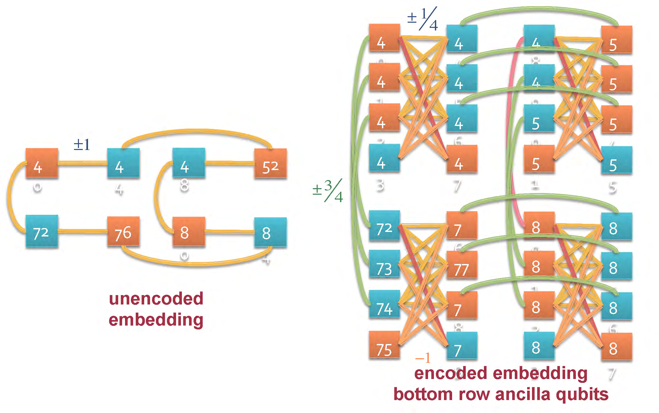
Error Correction
In preparation

Slide 26
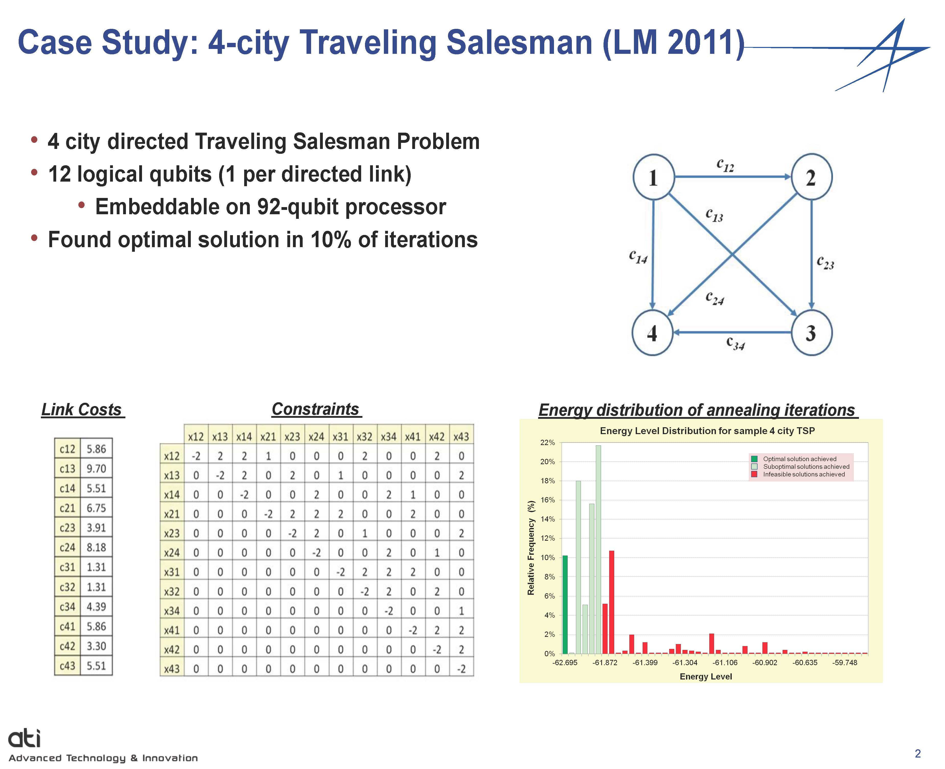
Case Study: 4-City Traveling Salesman (LM 2011)
Slide Courtesy of Steve Adachi, Lockheed Martin
Early Research | X

Slide 27
On-Going Applications Research
Software Verification and Validation
Applying Machine Learning
Collaboration with Lockheed Martin
Optimization of System Design
Collaboration with Lockheed Martin
Image Processing
Image registration at D-Wave
Image recognition at Google
Organic photovoltaic triage at Harvard
Missile Defense
Sensor assignment
Tracking

Slide 28
Progress and Future Research
  After little over a decade, adiabatic quantum annealing is moving from theory to practice.
  Today’s D-Wave system raises a variety of research questions that USC, Lockheed Martin, and our colleagues are jointly investigating
  Future D-Wave systems might soon be the most powerful on Earth for a range of problems of interest to the military simulation community.
  What those might be and how to program to solve them are still open research problems.
Summary | X

Slide 29
Open Research Problems
  Why does the D-Wave even work?
  Its an open system
  How much quantum speedup will there be?
  Any? If so, on what problems?
  What applications will it ultimately solve?
  We’ve had half a century to find competing heuristics
  How can an M&S professional program it?
  Specifically excluded from recent research programs
  What should the topology be?
  Reduce critical scaling limitation
  All adiabatic quantum systems will face these as well.
  These questions are all bigger than just D-Wave
Summary | X

Slide 30
  We are entering a period of great uncertainty about the future of computing in this community
  This creates great challenges and opportunities for M&S Community computational scientists

