Slide 1

Advanced Technologies to Enable Simulation of
Life-Cycle Sustainment of Weapon Systems
CAPT Lynn J. Petersen, USN (Ret.)
for his Co-authors
CAPT Daniel P. Burns, USN (Ret.),
Dan M. Davis, and Ke-Thia Yao
2016 Simulation Innovation Workshop

Slide 2
Major and Minor Theses
System engineering (SE) of life-cycle sustainment of weapons systems and simulation of those systems are interconnected and co-dependent.
The two communities should collaborate in providing their insights to each other and using the other’s capabilities to enhance their own
New technologies will enable both and facilitate increased collaborative efficiencies.

Slide 3
System Engineering Life-Cycle Sustainment for the DoD
Weapon Systems are increasingly expensive, vital and fragile
Planning is required for sustaining these systems
Math models used: Markov, hidden Markov and martingale
Effective and validated M&S can significantly reduce the cost of the “Design-Build-Test Repeat until right” scenarios
SE and Modeling and Simulation (M&S) should collaborate:
  SE should make use of large-scale simulations to improve their system design and sustainment planning
  Simulators should integrate sustainment functions and impacts into their simulations

Slide 4
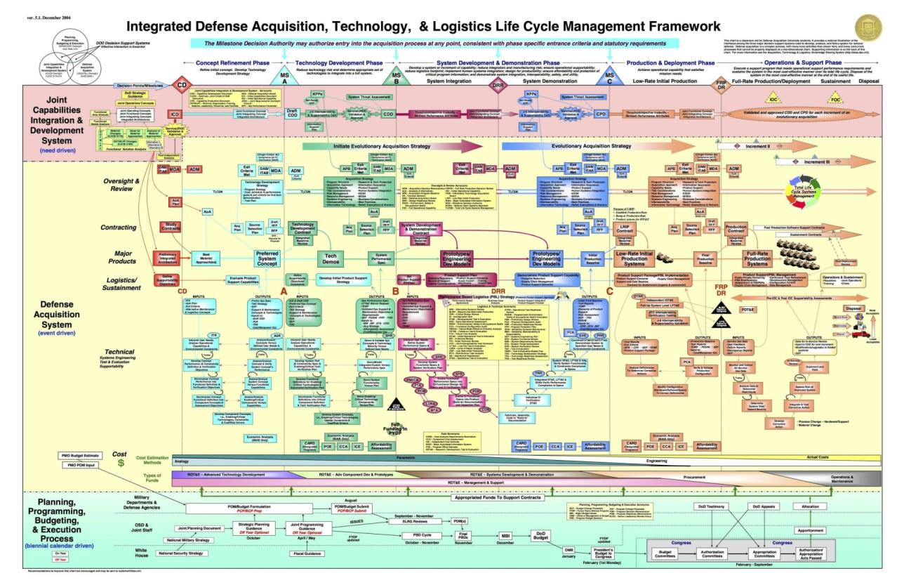
Life-Cycle Framework

Slide 5
System Engineering and Simulation
It is an accepted rule of thumb in the analysis community that more than four parameters require formalization
Some parameterization of the problem becomes necessary
Various forms of linear algebra analysis were done by hand
Advent of computer simulation gave vast improvement
Reconsider the flow chart on the previous slide and contemplate its need for machine assistance in analysis

Slide 6
Simulation and System Engineering
Battlefield simulation has been accused of being too idealized
Live “blue forces” don’t always follow doctrine
Asymmetric “Red forces” don’t always act as expected,
Failing to incorporate all of the parameters and sustainment functions identified by SE’s introduces invalid tendencies
Simulators have the computer power to properly implement the insights from the SE community

Slide 7
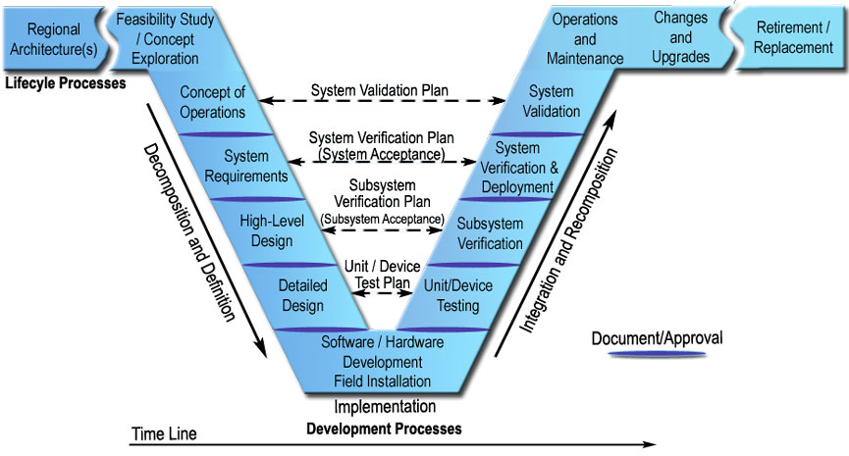
Systems Engineering “V” Model
Sustainment
Source: http://ops.fhwa.dot.gov/publications/seitsguide/section3.htm

Slide 8
Life-Cycle Sustainment Analyses
Degradation of systems and cost of operations often left out of many battlefield simulations
External factors have exacerbated the constraints on battlefield commanders
SE’s find that two thirds of a system’s cost are in operations and maintenance: these could be simulated
Inversely, proper M&S will help the SE community plan better, ergo reduce total expenditures
SEs’ forte is risk identification and mitigation
The staffing of maintenance personnel would be improved

Slide 9
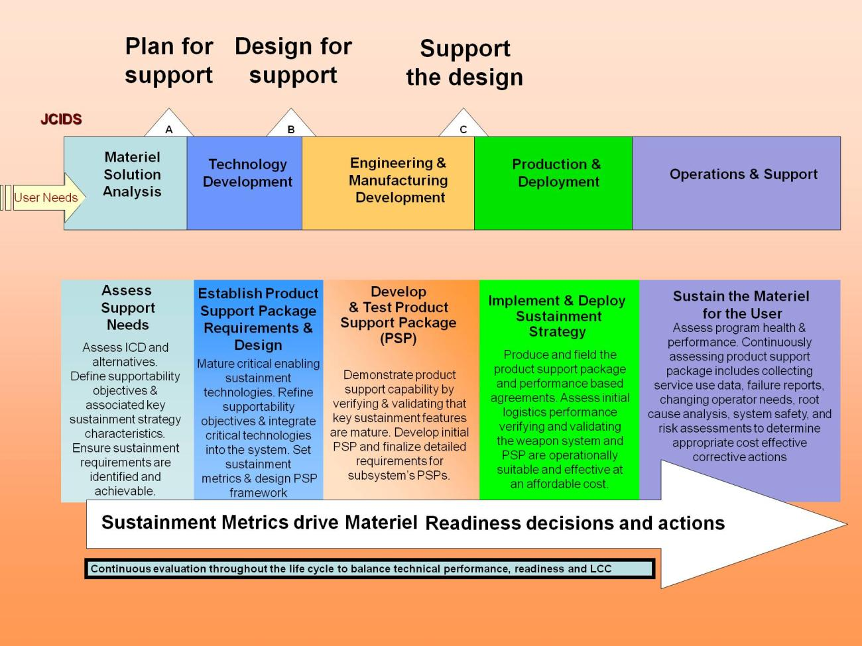
Simulation Important at Every Stage
From 5.1.2. Life-Cycle Sustainment and the DoDI 5000.02 Acquisition Environment

Slide 10
Markov, Hidden Markov & Martingale
Markov analyses posit the existence of a chain of events in which each even is independent of previous events
A germane instance is the fall of an artillery round within the trajectory dispersion ellipse
Hidden Markov posits that the chain of event has some observable result, but the state itself is not observable
An instance of this might be the knowledge that some unobservable units never attack in the observable rain
Martingale chains posit that the mean of all previous states eventually equals the current and future states
The fall of all of the rounds within the trajectory ellipse

Slide 11
Markov and Martingale Analyses
There are well-developed formulae and algorithms for all of the Markov and martingale processes (details in paper)
Depending on the topic in issue, programming these functions into simulations should be straightforward
Significant differences of opinion do exist about which live processes are best described by which process model

Slide 12
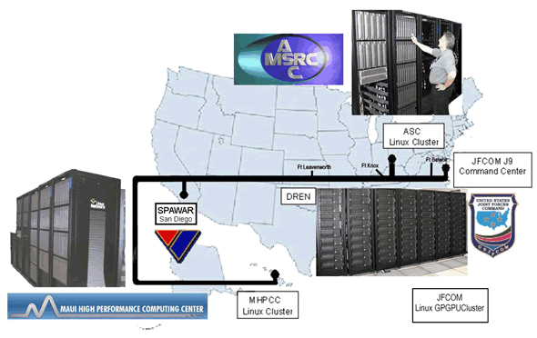
Enabling Technologies - Clusters
Moving simulation from the war game table to today’s simulations did require the advent of computers
Advancing it simulation to global scales required large, dispersed and powerful computer clusters
JFCOM’s Project
Joint Experimentation on Scalable Parallel Processor s running JSAF transcontinentally

Slide 13
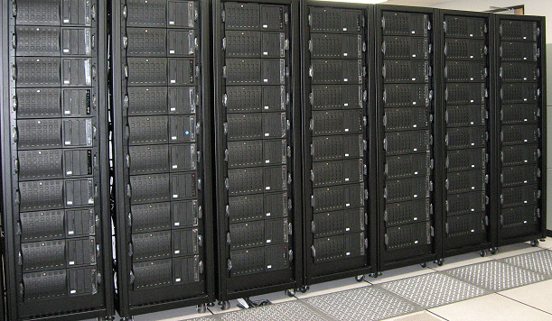
GPGPU Acceleration
Power and cost constraints were addressed by adding efficient General Purpose Graphics Processing Units to each node
The DoD’s High Performance Computing Modernization Office provided the machine which was installed in Norfolk
Joshua – JFCOM’s Cluster 256 nodes, 1025 AMD Santa Rosa Cores, 256 NVIDIA 8800 GPUs, 18 GB RAM
The GPUs more than doubled the compute power

Slide 14
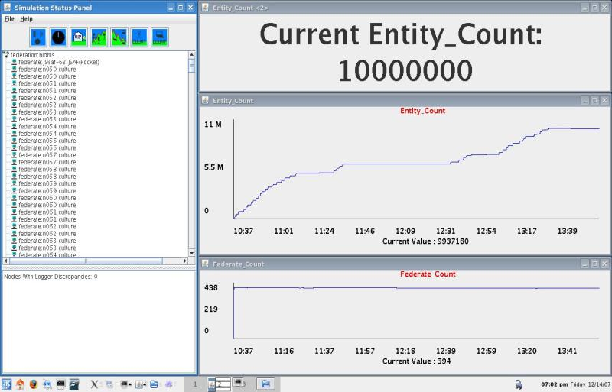
Performance Gains
GPGPU’s provided enough power to radically extend the simulation using JSAF to model Baghdad
Also modeled demographically correct populations and infrastructure along with red and blue forces
A total of ten million entities were easily displayed with no suggestion that scalability was limited at all

Slide 15
Emerging Quantum Capability
Richard Feynman of Caltech proposed the unfathomable power of a “Quantum Computer” in the 1980’s
Instead of a binary switch with a value of one or zero, the units would be a “cubit” with a quantum range of values.
General purpose quantum computing is still the stuff of speculation and vociferous argument.
D-Wave has delivered a few quantum annealers, one to USC
Another is Google’s and is in the San Francisco Bay Area
They operate at a rather chilly 0.0015K (15 milikelvins)

Slide 16
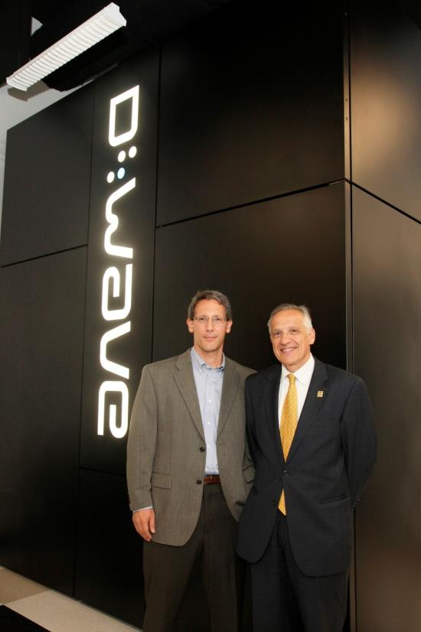
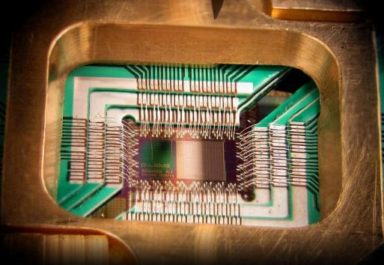
USC’s D-Wave Quantum Annealer
D-Wave 2
~ 1,000 cubits
(stable after cooling)
Six way connectivity
Marina del Rey California

Slide 17
D-Wave Quantum Annealer
Quantum Annealing (QA) is the analog of simulated annealing, i.e. a very effective optimization process
Instead of optimizing by repeated iteration of binary parameters, QA can optimize by virtually limitless representations of parameters by the cubit’s quantum state
Like classic Christensen disruptive technologies, quantum annealing has its detractors and suffers from growing pains
Most now agree that it is showing consistent and reliable quantum computing, but has not yet shown anticipated computational advantage over large digital clusters

Slide 18
Future for QA, Simulation and SE
Expectation is that continued programming advances will see the exponential power growth anticipated
Current machine has 2,200 cubits, with half turned off, so doubling power is immanent
Six-way connectivity may limit number of parameters to be considered during optimization; there are plans to grow
Both M&S and SE have repeated and large optimization functions that are inherent in their activities.
QA should provide a new tool in overcoming these hurdles

Slide 19
Conclusions
SE and M&S could both benefit by closer collaborations
Just the act of parameterizing the functions often is insightful
Coding challenges in implementing known M&S and SE function in the Quantum Annealer should be possible
The capabilities of the D-Wave and subsequent quantum computing devices remains to be seen
Current progress in QA is expected to continue
The costs of applying SE principles to simulation would be justified by the increase validity of the data

Slide 20
eMail Addresses for Authors
CAPT Daniel Burns – Life-cycle sustainment
daniel.p.burns@homeportsolutions.net
CAPT Lynn Petersen – Systems Engineering
lynn.j.petersen@navy.mil
Dan Davis – Large Scale Simulations
dmdavis@acm.org
Ke-Thia Yao – Quantum Annealing
kyao@isi.edu

Slide 21
Disclaimer
The views expressed in this slide presentation are the authors' own and do not necessarily reflect the views of their
military organization, their service branch, the
Department of Defense, or the
U.S. government.

