Slide 1
Patent Law and Defense Technology:
Original Intent and Current Practice
Mark C. Davis, PhD
Co Authors: Douglas Robinson,
Dan Davis and Nicholas Kaimakis

Slide 2
Major Thesis – Patents Use is Vital
In this century, technology ascendancy has become an even more
vital part of defense
posture of this nation, therefore, encouraging, protecting and strategically disseminating emerging capabilities is as much a central function of national security as size of the armed forces. For centuries governments have sought to optimize innovation by
protecting the rights of the creators
of new products and methods, but these efforts may not have produced a system which is optimal for this era. The authors maintain that
a reevaluation
of the current patent system by the defense establishment is warranted
2

Slide 3
Historical Underpinnings
U.S. Constitution, Article I, Section 8, Clause 9:
“To promote the Progress of Science and useful Arts, by securing for limited Times
to Authors and Inventors the exclusive Right to their respective Writings and Discoveries;”
Important enough to justify inclusion in the Constitution
As early as the 1400’s, governments protected inventors
Traded short term (~ decade) protection for later use
Intended to encourage trade and foster commerce
Founding Fathers adopted British tradition
Left to the legislative branch to fully define and enable
3

Slide 4
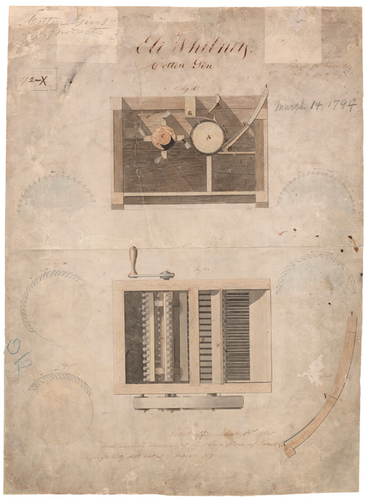
The Early Years
First Attempt: Patent Act 1790
Secretary of War part of review
Led to Patent Act of 1793
Very few applications filed
Mainly oriented to agriculture
Secretary of State and AG issued
This act was in force 43 years
Eli Whitney's Cotton Gin was granted a patent under this act
Industrial revolution began
Patent drawing of Eli Whitney Cotton Gin 1794 USPTO
4

Slide 5
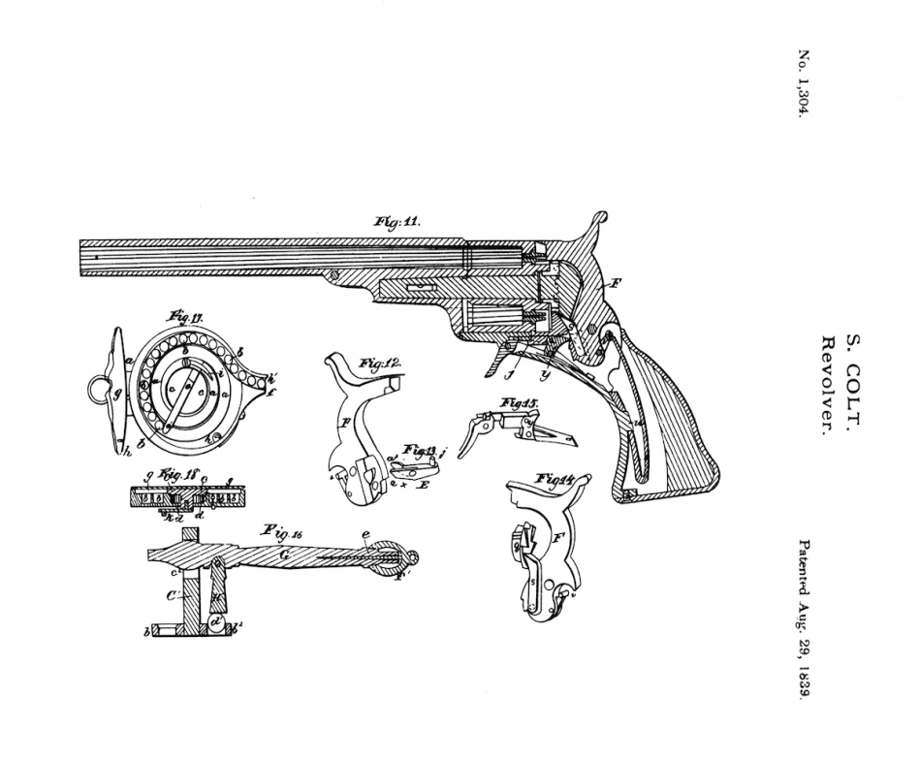
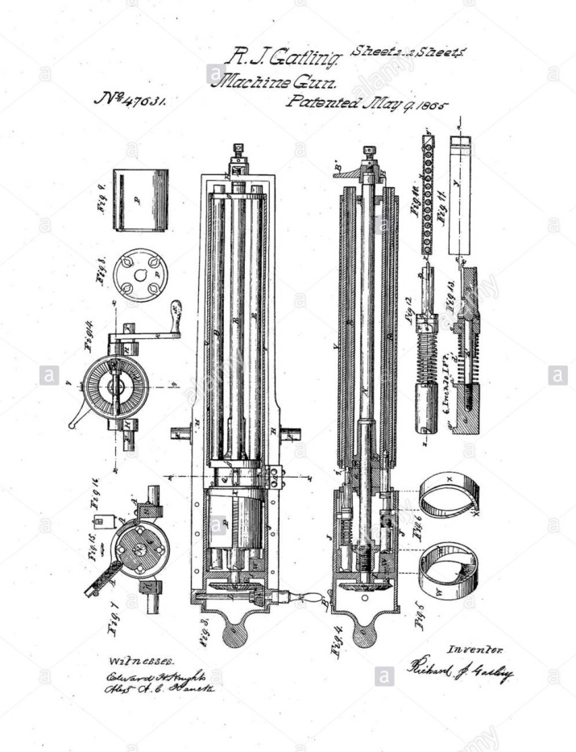
The Industrial Revolution
Patent Act of 1836
Established Patent Office
In the Department of State
Growth of Patent applications was making it onerous on Sect of State.
This act was in force 43 years
Many famous weapons patented under this act
Industrial revolution was transforming nation
Patent drawing for the Colt Paterson
1839 USPTO drawing.
Dr. Richard Gatling’s gun, patented during the Civil War
1865 USPTO Drawing.
5

Slide 6
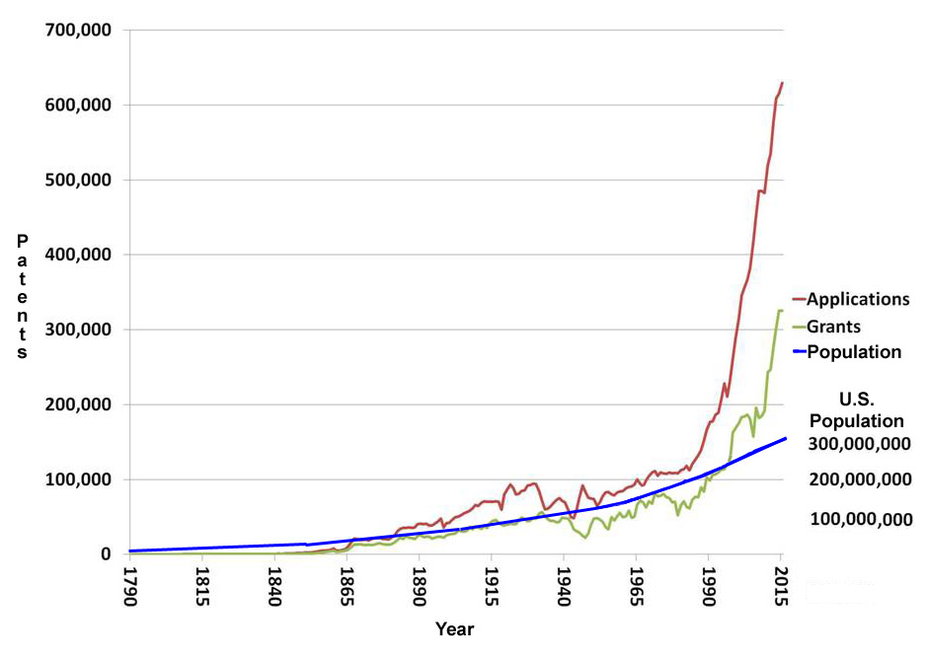
The Growth of Patents 1790 - Present
6

Slide 7
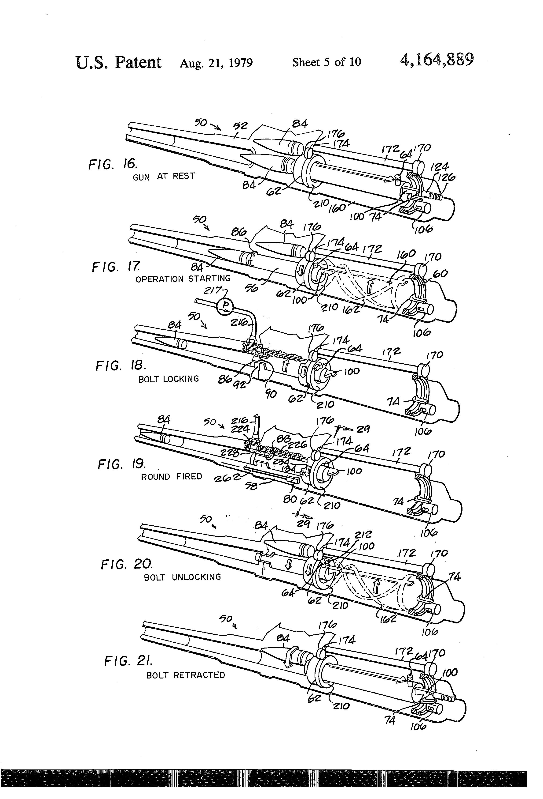
20th Century Patent Issues
1925: Patent Office moved to Department of Commerce
1952: U.S. Patent and Trademark Office (USPTO) established
Growth remains about same as growth in population until 1980
Major reason for filing still to protect inventor from other’s use
One famous case: Ford and Seldon on rights to automobile in 1911
Seldon precursor to patent trolls
Barrel and chamber design:
Vulcan weapons systems
1979 USPTO Drawing
7

Slide 8
Adjustments to 20th Century Reality
The complexity of modern technology began to burden the various court systems
Few lawyers are trained in the technical fields and even those are often constrained by their educational “silo”
1982: Court of Appeals for the Federal Circuit created to hear special cases from all circuits, including patents
Jurisdiction includes several special issues ranging from Veterans’ to Postal Service Claims, as well as Patents
Judges and clerks are all technically trained and experienced in intellectual property law
The Executive and Judicial Branches are active in patent law
8

Slide 9
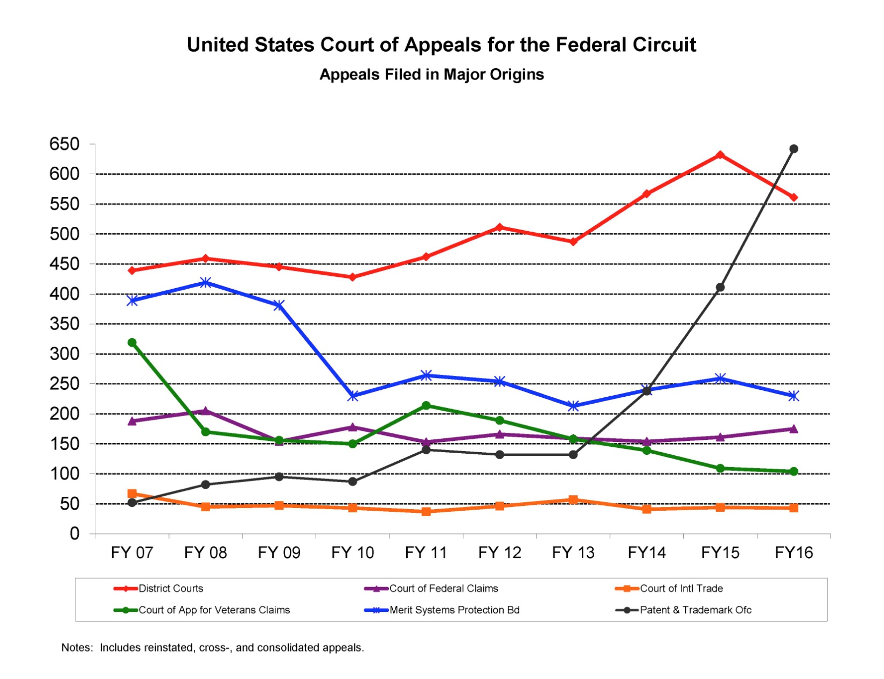
Patent Cases taking over Courts
Both are nearly all Patent Law Cases
9

Slide 10
Current Practice
A patent: background, and the claims
  Claims describe the important aspects of the patented device
  Discoveries and algorithms are not patentable
  New substances can’t be patented; a process to make them can
  Claim language: very precise, usually written by a patent attorney
A smart phone could have tens of thousands of patents
Oracle vs Google : Application Programming Interfaces (API’s) can be copyrighted and only Oracle’s code could implement API’s.
  Google had written reverse-engineered code to do same thing
  The jury found that this was fair use (still under appeal,)
Litigations is expensive ($20 to $30 million)
10

Slide 11
Change in Use by Public
No longer protecting the individual inventor
Patent “Trolls” file patents and sue original inventors
Manufactures take defensive stance:
  Patent every conceivable innovation
  Support consortia to set licensing terms
Perversion of the original intent is debilitating
  Filing’s growth is burdensome on government & inventors
  No current sanction for this destructive technique
Reliance on industrial security is no defense against trolls
Some legislative attempts to reduce this practice
  Little effect in practice so far
11

Slide 12
Impact on the Defense of the Nation
Three major impacts
  IP protection is a mainstay of the economic strength of the country, upon which defense must rely
  In an economy where innovation largely comes from private sources, patent rights encourage invention
  Patent enforcement may have a curtailing effect of delaying adoption of technologies by others
Without these the economy (GDP) will suffer
New inventions are necessary to maintain technical ascendency on the battlefield
Lack of innovation advantage will harm the U.S. Warfighters
12

Slide 13
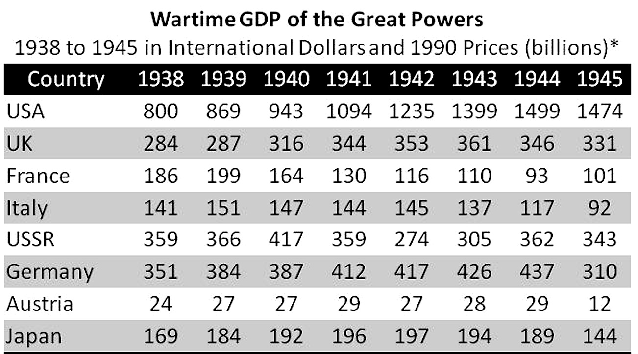
Impact of Nation’s Industrial Power
National strength measured as much by GDP as troop, tank, ship and aircraft numbers.
Some argue defense strength depends on a system that fosters economic and technical growth
13

Slide 14
Defense, Patents and Offset Theories
Importance of intellectual property is “Defense Offsets”
  Reliance on Nuclear Weapons to offset numerically superior foes during the Cold War
  Reliance on better intelligence and precision weapons to offset several asymmetric foes
  Targets information superiority and security, robotics, and collaboration with the civilian sector to offset the increasing technology of foes
All of these depend on technology advantage
  benefit from a more efficient patent law implementation
  Suffer from a continuing protection rather than innovation
14

Slide 15
Moves to Mollify Negative Impacts
Control information flow
  Classify more work and disseminate it as “need to know”
  Publish material early to preclude later patents by trolls
  Establish new USPTO site for registering protected ideas
Set new standards requiring showing concept origination
Get DoD experts on government patent law committees
Enact and enforce punitive damages against trolls, including inducements to strictly enforce current rules.
Reexamination of the First to File/First to invent
  Optimize the granting to the actual inventor
15

Slide 16
Conclusions
Patents have evolved to conflict with national security
  Patent purpose migrated to corporate economics
  The temporary protection of inventor is irrelevant to security
  Military technology advantage harder to protect
Recommendations
  Increase awareness of impact on procurement systems
  Policy changes to consider:
    Legislation to address non-practicing entities
    Accommodating classified inventions
Making progress is important:
  Alternative: revised military strategy without technical advantage
16

Slide 17
Acknowledgements
The authors wish to thank the Honorable Garth D. Baer, Administrative Patent Judge with the U.S. Patent and Trademark Office for his encouragement and willingness to respond to many procedural and practice questions for some of the authors who have virtually no experience with the practice at the USPTO or at the CAFC level, where Judge Baer clerked for the Honorable Raymond C. Clevenger III, Circuit Judge. While all of the authors sought counsel from many in this field, the opinions expressed herein are the authors’ own and do not necessarily represent opinions or positions of their employers, their colleagues or the experts from whom they sought assistance, nor should they be construed as being the official views of any military service in which the authors may have served.
17

Slide 18
Temporary Resting Place for Text
Patents and other IP protection must be a major consideration for national defense. Although the original goals of the patent system do not appear to conflict with the security goals of the Nation, the current implementation degrades the Warfighters’ use of technology as an advantage. This occurs because the current patent system promotes sharing information that is critical to a nation’s security and disincentivizes the innovator. Consequently, policy makers should be aware of the impact on developers. The authors recommend addressing non-practicing entities (“trolls”) and facilitating and accommodating classified inventions. The alternative may be to give up on the “offset strategy” and have U.S. warfighters fight future conflicts on an unnecessarily reduced-advantaged playing field
.
18

Slide 19
19

Slide 20
20

Slide 21
21

