Slide 1
Patent Law and Defense Technology:
Original Intent and Current Practice
Mark C. Davis, PhD
Co Authors: Douglas Robinson,
Dan Davis and Nicholas Kaimakis

Slide 2
Major Thesis
In this century, technology ascendancy has become an even more vital part of defense posture of this nation, so encouraging, protecting and strategically disseminating emerging capabilities is as much a central function of national security as force structure. For centuries governments have sought to optimize innovation by protecting the rights of the creators of new products and methods, but these efforts may not have produced a system which is optimal for this era. A re-evaluation of the current patent system by the defense establishment is warranted
2

Slide 3
Historical Underpinnings
U.S. Constitution, Article I, Section 8, Clause 9:
“To promote the Progress of Science and useful Arts, by securing for limited Times
to Authors and Inventors the exclusive Right to their respective Writings and Discoveries;”
As early as the 1400’s, governments protected inventors
Traded short term (~ decade) protection for later use
Intended to encourage trade and foster commerce
Founding Fathers adopted British tradition
Important enough to justify inclusion in the Constitution
Left to the legislative branch to fully define and enable
3

Slide 4
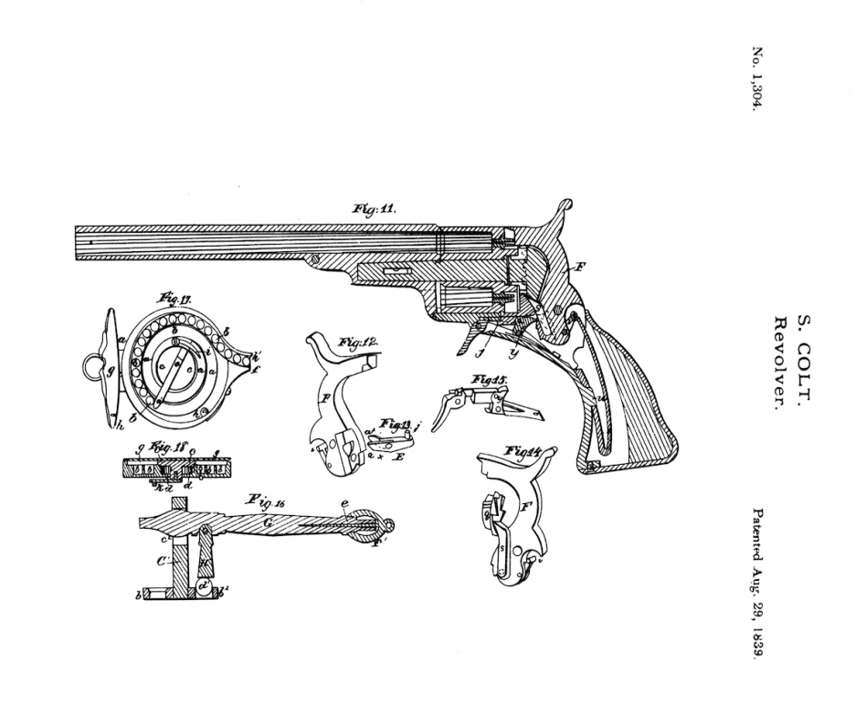
The Early Years
First Attempt: Patent Act 1790
Secretary of War part of review
Led to Patent Act of 1793
Very few applications filed
Mainly oriented to agriculture
Secretary of State and AG issued
This act was in force 43 years
Eli Whitney's Cotton Gin was granted a patent under this act
Industrial revolution began
Patent drawing for the Colt Paterson
1839 USPTO drawing.
4

Slide 5
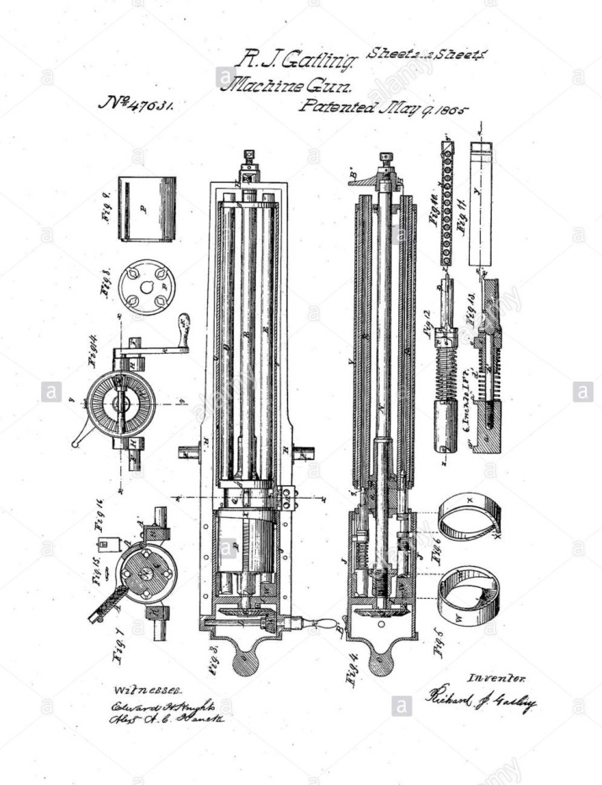
The Industrial Revolution
Patent Act of 1836
Established Patent Office
In the Department of State
Growth of Patent applications was making it onerous on Sect of State.
This act was in force 43 years
Many famous weapons patented under this act
Industrial revolution was transforming nation
Dr. Richard Gatling’s gun, patented during the Civil War
1865 USPTO Drawing.
5

Slide 6
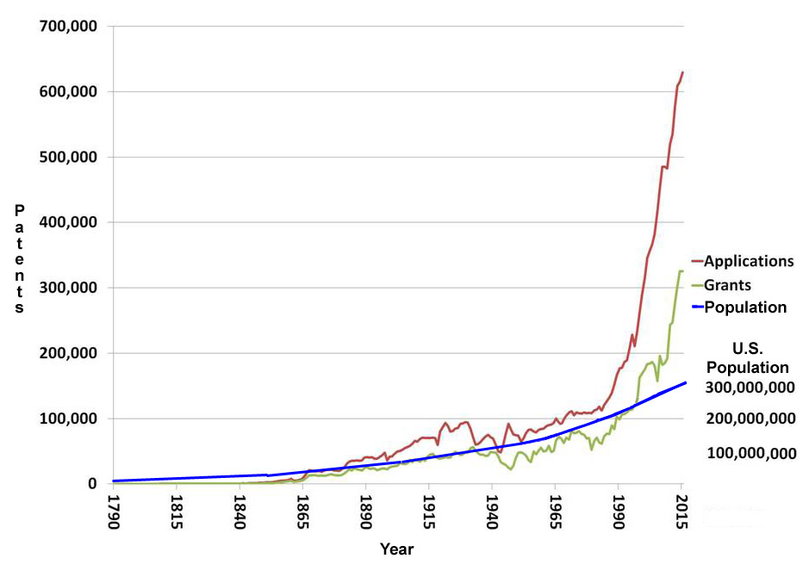
The Growth of Patents 1790 - Present
6

Slide 7
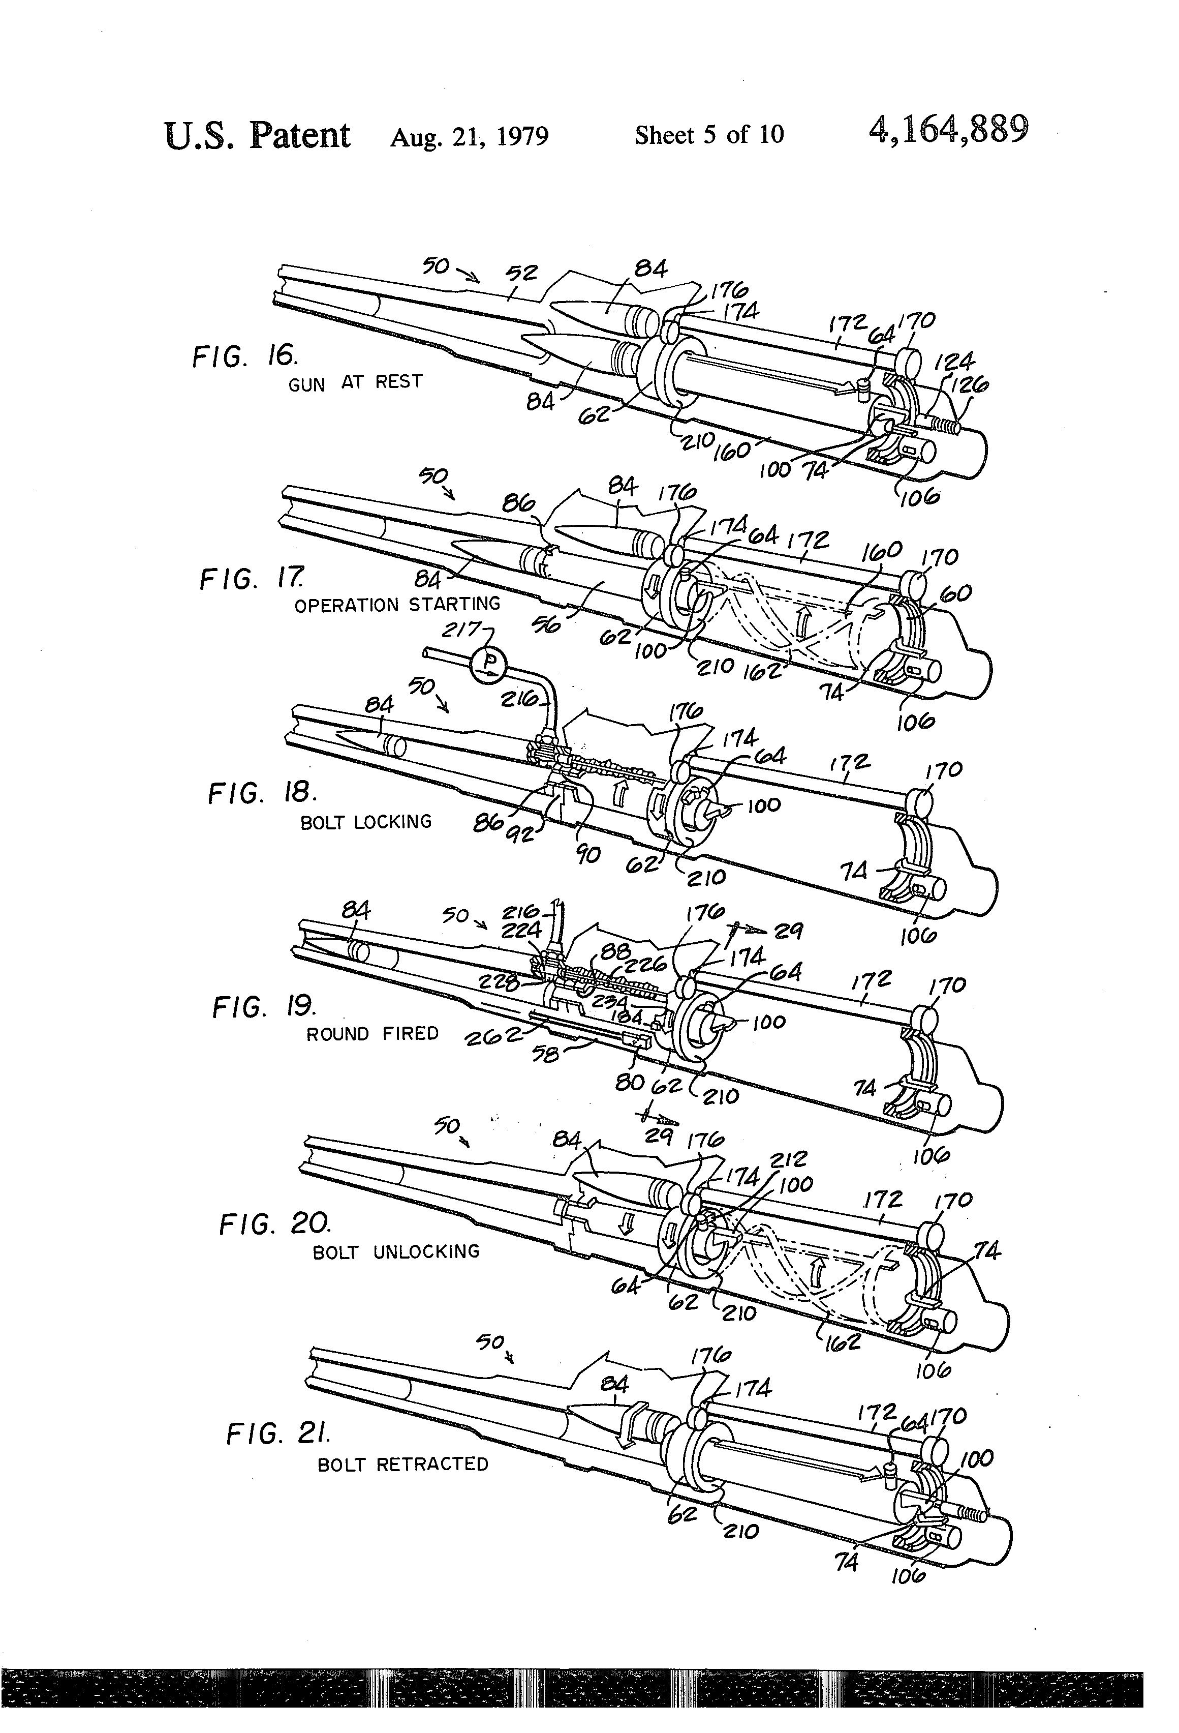
20th Century Patent Issues
1925: Patent Office moved to Department of Commerce
1952: U.S. Patent and Trademark Office (USPTO) established
Growth remains about same as growth in population until 1980
Major reason for filing still to protect inventor from other’s use
One famous case: Ford and Seldon on rights to automobile in 1911
Seldon precursor to patent trolls
Barrel and chamber design:
Vulcan weapons systems
1979 USPTO Drawing
7

Slide 8
The Age of Litigation
The complexity of modern technology began to burden the various court systems
Few lawyers are trained in the technical fields and even those are often constrained by their educational “silo”
1982: Court of Appeals for the Federal Circuit created to hear special cases from all circuits, including patents
Jurisdiction includes several special issues ranging from Veterans’ to Postal Service Claims, as well as Patents
Judges and clerks are all technically trained and experienced in intellectual property law
The Executive and Judicial Branches are active in patent law
8

Slide 9
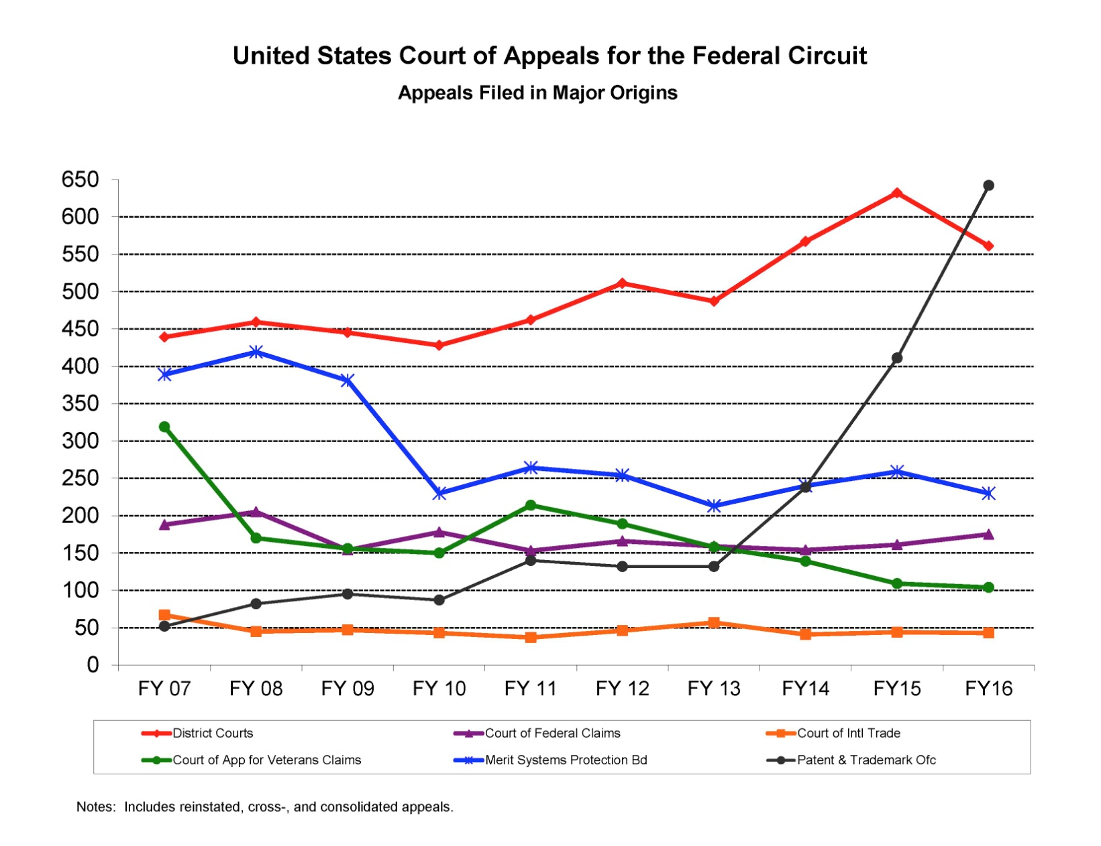
Patent Cases taking over CAFC
Both are nearly all Patent Law Cases
9

Slide 10
Current Practice
A patent: background, and the claims
Claims describe the important aspects of the patented device
Discoveries and algorithms are not patentable
New substances can’t be patented; a process to make them can
Claim language: very precise, usually written by a patent attorney
A smart phone could have tens of thousands of patents
Oracle vs Google : Application Programming Interfaces (API’s) can be copyrighted and only Oracle’s code could implement API’s.
Google had written reverse-engineered code to do same thing
The jury found that this was fair use (still under appeal,)
Litigations is expensive ($20 to $30 million)
10

Slide 11
Change in Use by Public
No longer protecting inventor
Patent “Trolls” file patents and sue original inventors
This forces large firms to patent every conceivable innovation, incurring wasteful administrative expenses
Explosive growth of filings is burdensome on government, inventors and public
Perversion of the original intent is debilitating
No current sanction for this destructive technique
Reliance on industrial security is no defense against trolls
Legislative attempts to reduce this practice have been touted and lauded, but have had little effect in practice.
11

Slide 12
Impact on the Defense of the Nation
Three major impacts{
  IP protection is a mainstay of the economic strength of the country, upon which defense must rely
  In an economy where innovation largely comes from private sources, patent rights encourage invention
  Patent enforcement may have a curtailing effect of delaying adoption of technologies by others
Without these the GDP will suffer
New inventions are necessary to maintain technical ascendency on the battlefield
Lack of innovation due to litigious barriers will harm the U.S. Warfighters
12

Slide 13
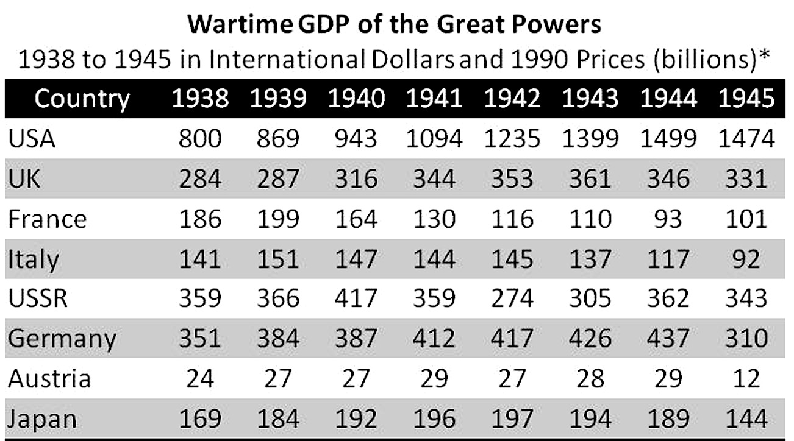
Impact of Nation’s Industrial Power
National strength measured as much by GDP as troop, tank, ship and aircraft numbers.
Some argue defense strength depends on a system that fosters economic and technical growth
13

Slide 14
14

Slide 15
15

Slide 16
16

Slide 17
17

Slide 18
18

Slide 19
19

Slide 20
20

Slide 21
21

