Slide 1
Systems Engineering: Optimizing Creation of Virtual Conversational Human Agents
Daniel P. Buns CAPT, USN-Ret Home Ports Solutions, LLC Los Angeles, California | Dan M. Davis & Julianne M. Nordhagen Univ. of Southern California Los Angeles, California

Slide 2
Major Theses
Personnel & funding constraints are limiting mentoring
Computer-generated conversational agents address this
Complex implementation issues are problematic
System Engineering (SE) tools are available and useful
These can often be applied by researchers and users
Optimizing Virtual Humans with SE has shown success
A quick introduction to those tools will be helpful

Slide 3
Existing Problem
Declining budgets and demanding Ops Schedules
Burgeoning need for more mentoring and technicians
Virtual Conversational Humans can fill the need
Good mentors available 24/7 anywhere net reaches
Research and implementation expensive & complex
SE tools not in widespread use in academia and DoD
Situation not likely to improve in foreseeable future

Slide 4
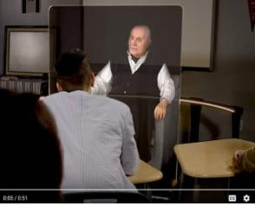
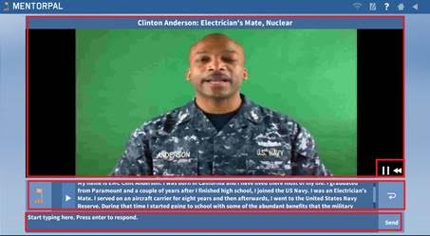
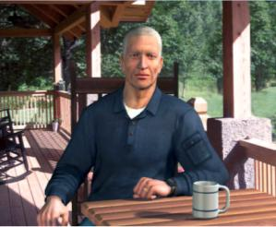
Research in Virtual Humans (VH)
Three USC VH programs
New Dimensions in Testimony – Holocaust memories preserved
MentorPal – Advising STEM students on career paths
SimCoach – Counseling PTSD Veterans via internet
All complex and difficult to implement efficiently

Slide 5
SE Optimization
Staffing, processing, and producing a deliverable item
Especially useful to help organize several systems
SE Goals
  Design, develop, implement and operate systems
  Forecast behaviors in various environments
  Deliver intended functions in sustainable fashion
Can be utilized by journeyman researcher/user
Helpful even at elementary level of implementation

Slide 6
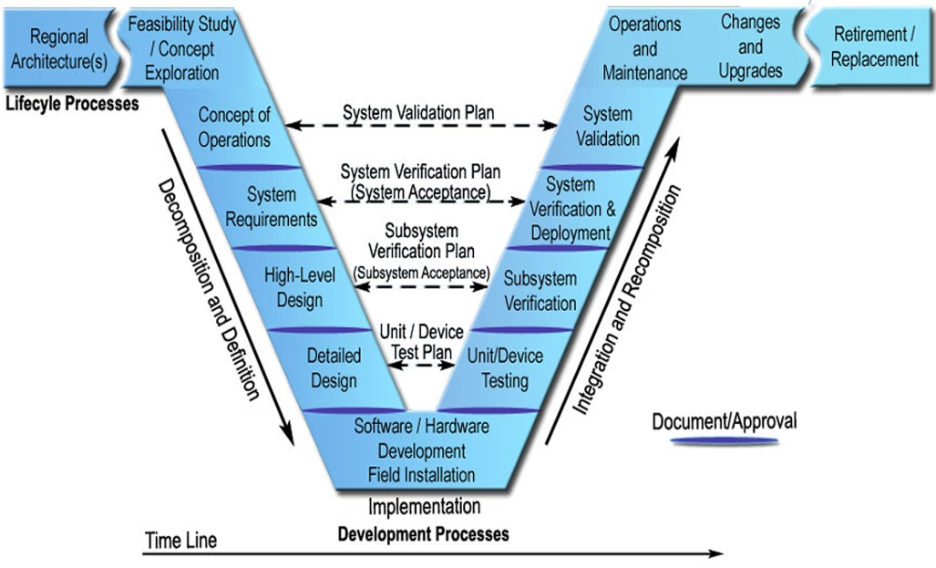
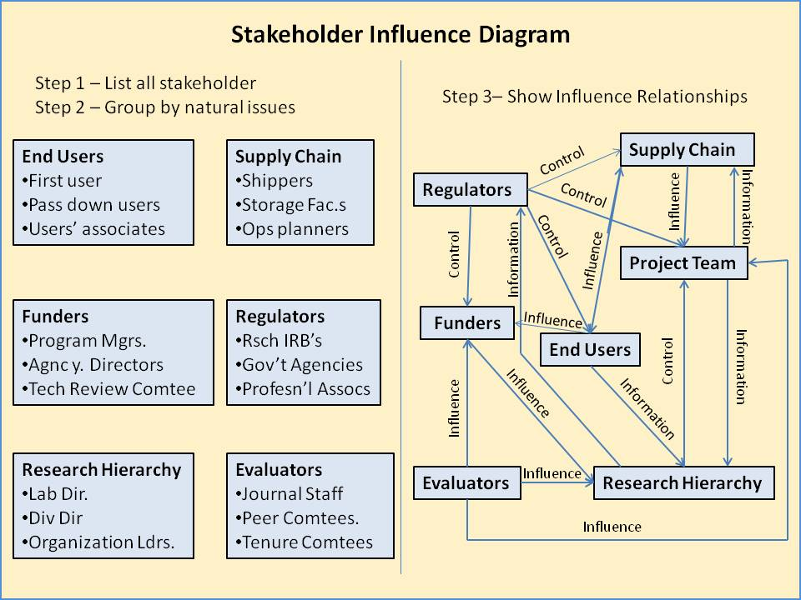
Commonly Used SE Tools
V-Model – reminds user that for every stage of development, there is a corresponding evaluation
Stakeholder Diagram – a formalization of recognizing all of the entities who have and interest in the initiative

Slide 7
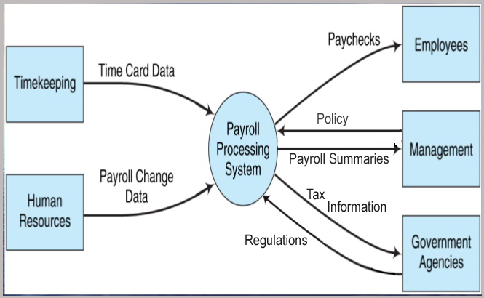
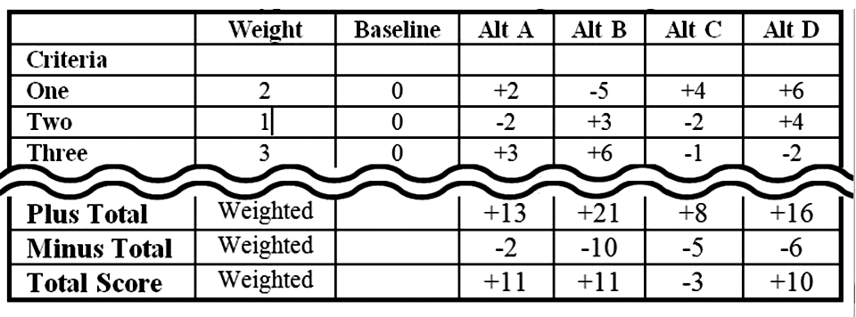
SE Tools Continued
Context Diagram – examines and documents environment in which the system will operate
Interfaces, boundaries, …
Pugh Matrix – plots design satisfaction vs. implementation options
Numerical analysis of various paths to goal

Slide 8
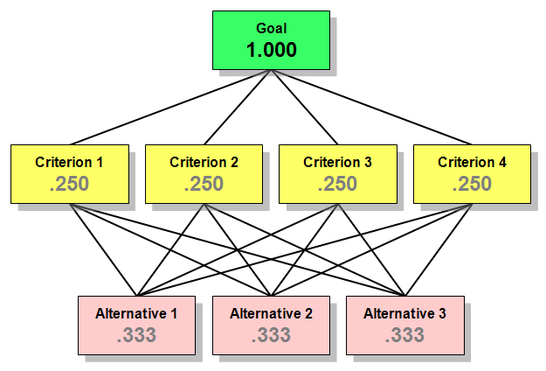
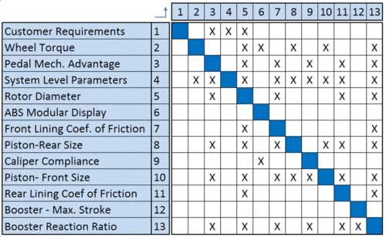
More SE Tools
Analytic Hierarch Process – Quantifies the decision making process
Quantitative analysis by assigning numerical values to components
Design Structure Matrix – ID’s subsystems and interfaces
X indicates connectivity and origin

Slide 9
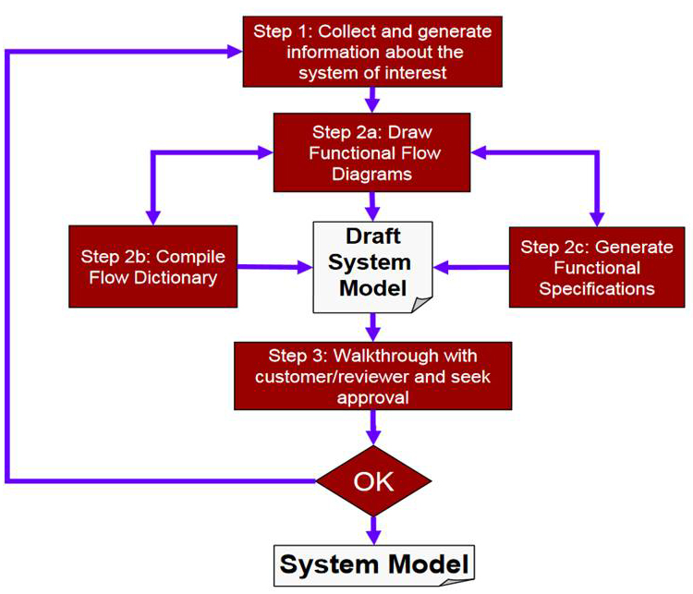
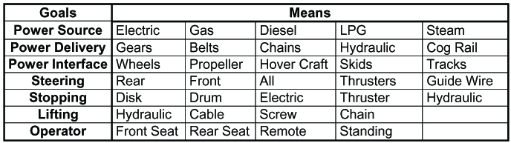
Two SE Tools
Functional Modeling – identifies and documents functionality and critical interconnection
Breaks model down into small sub-systems for better comprehension and analysis
Implementation Means Analysis - a second way to look at alternative paths to goal
Not quantified, but shows choices

Slide 10
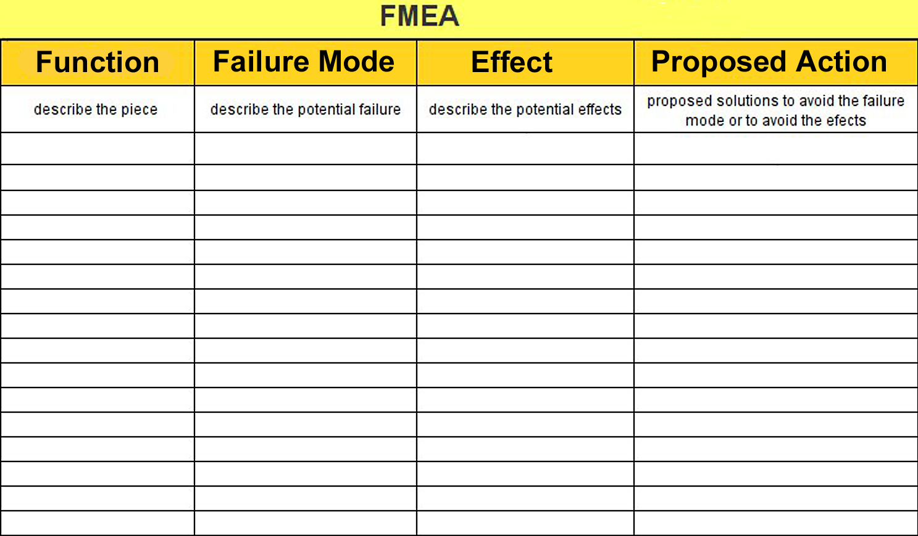
Last SE Tools
Failure Mode & Effects Analysis -
Paging became a disruptive factor in MentorPal
Loading data required five minutes on boot up
Time delays were observed to quickly and invariably destroy student engagement

Slide 11
Approaches
Previous work on this topic
  Dimensionally based
  Parameter based
  Resolution based
Analyzed trade-offs & avoided redundant information
Linear transformation: map vectors to fewer features
Pruning: eliminating less important features; better
Bit truncation: reducing descriptions till degradation
Results: bit truncation was best method

Slide 12
New Approach
Goal: minimum memory with minimum impact
Two schemes implemented were reduction by:
  Word frequency
  Domain relevance
Word frequency and Zipf’s law
Discard words based on frequencies in Google News
Relevance – compare language model with corpus
Cosign similarity measures angle between vectors
Kept high scores, deleted rest

Slide 13
Results from Minifying Effort
Measured by leave-one-out paraphrase test
Best fit or most productive; may be different
More sophisticated testing was not supported by funding and would be constrained by schedule
Data generated was nevertheless useful
Future training is anticipated to generate better response rates without impacting data sizes
Data on next slide represents various cosign values
Represents 382 leave-one-outs

Slide 14
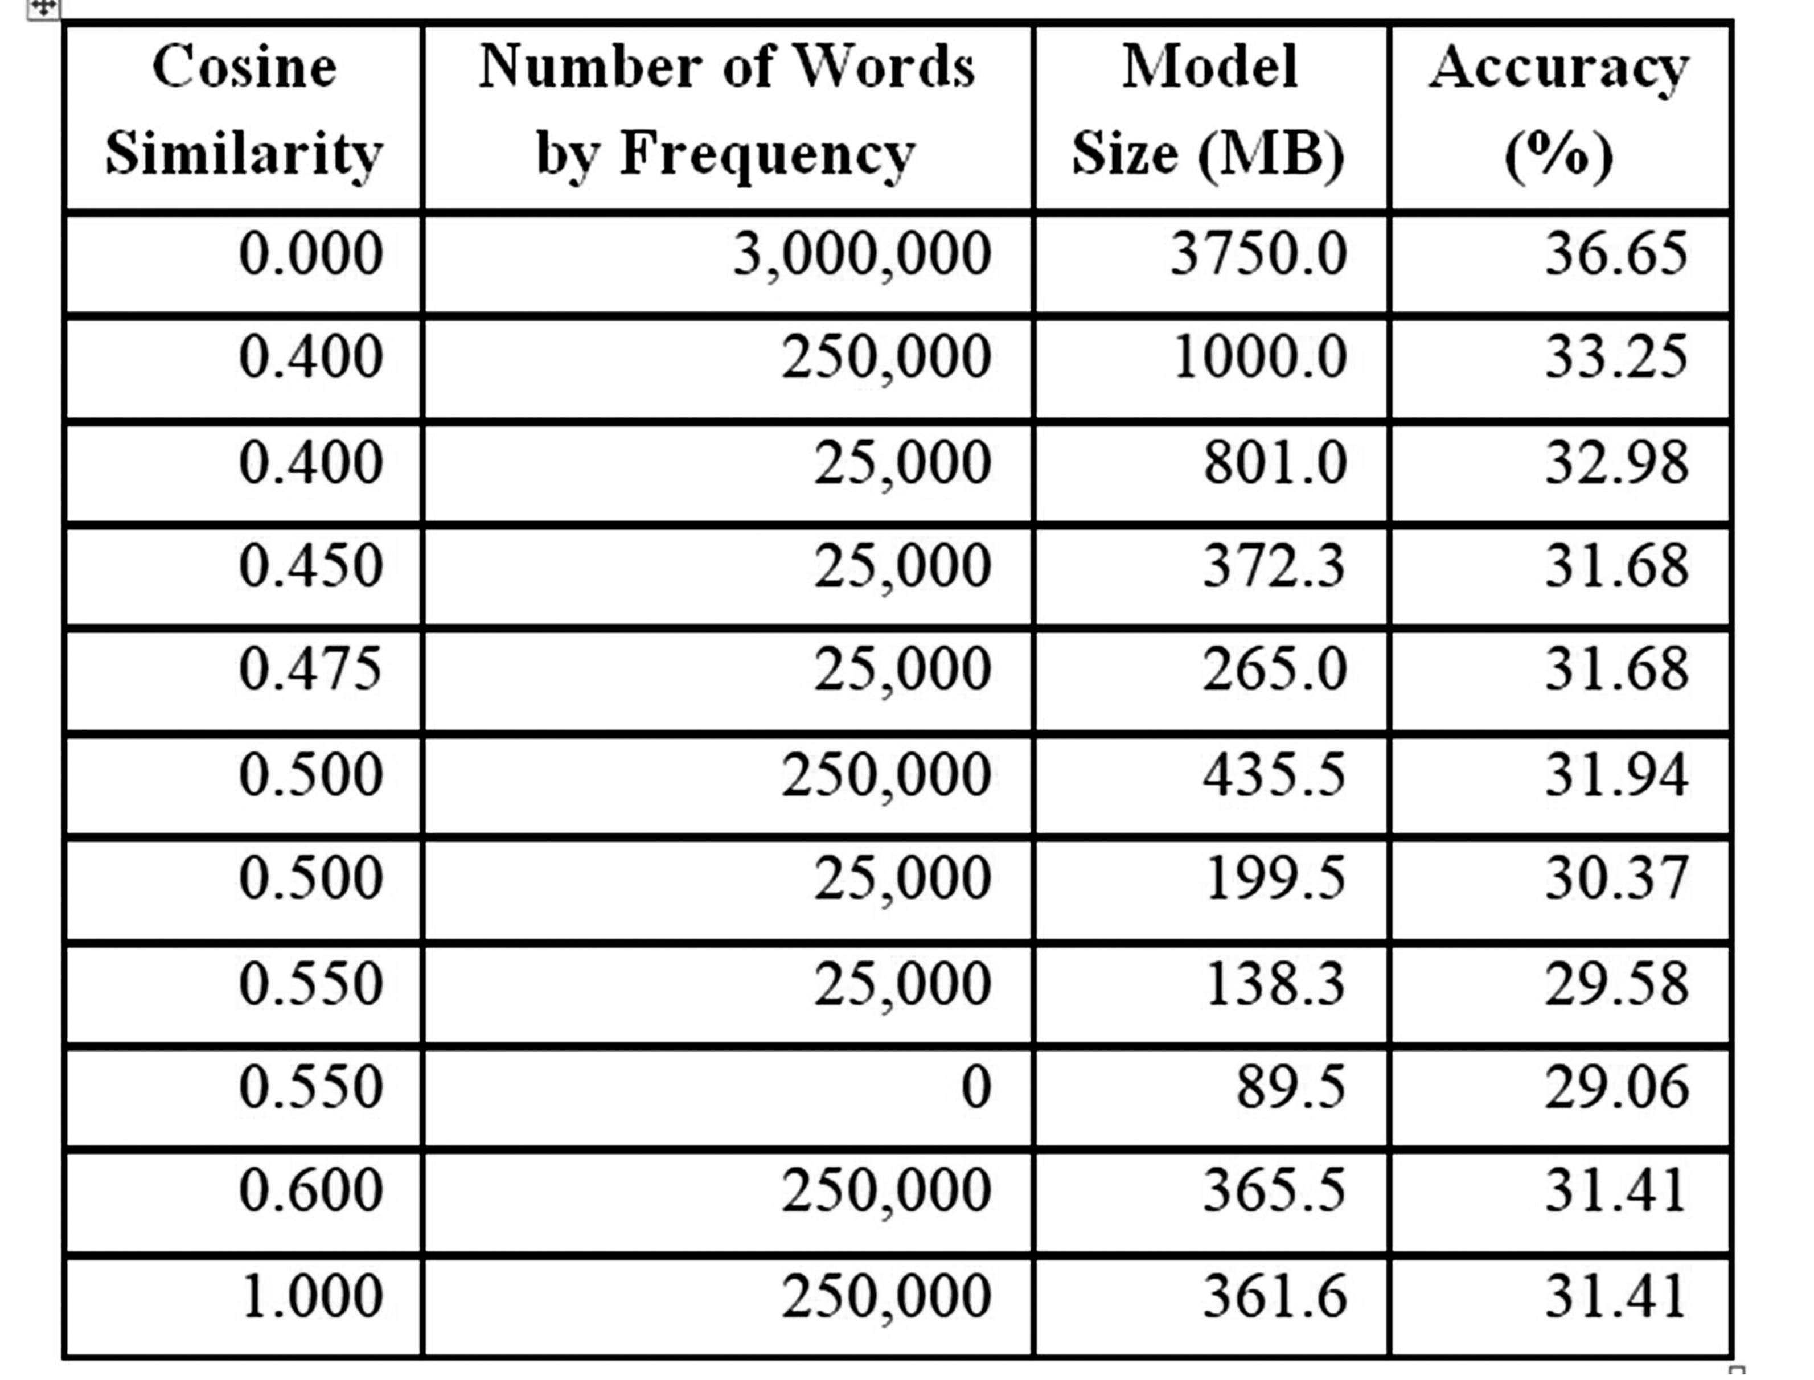
Performance by Cosign Similarity and Frequency Reduction

Slide 15
Analysis
0.45 to 0.475 reduction results in a model size reduction from 372.3 MB and 265 MB respectively
Smallest model generated, retained words: threshold was a cosine similarity >0.55
Yielded a 89.5 MB model and ~7 percent decrease in perfect matching accuracy
Need more research in varying models
Hampered by training time for each new model
Will seek point where accuracy drops exponentially

Slide 16
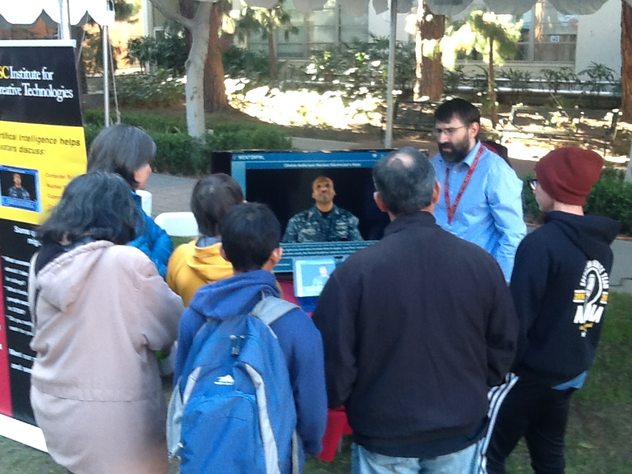
Demonstration of Program

Slide 17
Further Impacts
Should directly impact success of MentorPal
Extensible to other uses of virtual conversationalist
Kubrick and Clarke had fully conversational computers projected for “2001’s” HAL and “Star Trek’s” Computer!; students want similar interfaces
Current Chatbots are proliferating
ICT projects have found uses from Holocaust survivor archiving to PTSD treatment therapies
All will need minified data sets.

Slide 18
Future Research
Assessing utility of FaceBook’s FastText
  Trains is seconds, rather than in days
  FastText uses approaches similar to the ones above
Multi-lingual databases are looming and problematic
  A bi-lingual MentorPal will surely be critical
  Commercial firms working this issue
Applying this approach to other programs which are plagued by size and time constrains may bear fruit
This is a new field of optimization

Slide 19
Conclusions
Virtual conversations are burgeoning and vital
Minification of databases are necessary for success
Minification has been shown to be possible
Degradation has been tolerable or trivial
Large data sizes are disruptive and cause paging
Needs will only increase and demands for smaller device sizes will only become more urgent
This work should be extensible to other areas

Slide 20
Acknowledgements & Caveats
Much of the work described above was conducted in response to a Office of Naval Research contract named MentorPal: Growing STEM Pipelines with Personalized Dialogs with Virtual STEM Professionals, N00014-16-R-FO03. The opinions expressed herein are the authors’ own and do not necessarily reflect those of the Department of the Navy, the Department of the Army or the U.S. Government.

