Slide 1
Critical Thinking Training: Proven New Technologies for Engaging DoD Personnel
Dan M. Davis & Nicholas J. Kaimakis Univ. of Southern California Los Angeles, California | Howard Spaulding Training Consultant Arlington, Texas

Slide 2
Central Thoughts
Critical Thinking is not well taught
Our 19th Century Education approach teaches students what to think, not how to think
Critical thinking is vital to DoD success
There are known methods of improving critical thinking
Most assume/require individual mentoring
DoD lacks personnel resources to implement this
Virtual conversational humans can enable this training

Slide 3
Current Situation
Current education practices are criticized by iconoclasts like John Taylor Gatto
There are several approaches to remedying this
Old techniques like the Socratic method work well
Newer theories like constructivism also show promise
Most of these approaches are personnel intensive
DoD operations do not provide sufficient blocks time for training of this nature

Slide 4
Critical Thinking Defined
Critical thinking is:
  Purposeful
  Reasoned
  Goal directed
The human tendency is to eschew all of those
Behavioral economist have led the research showing that personnel at all levels are irrational
Ariely points out the foibles of human irrationality, emotion, prejudice and mysticism

Slide 5
Terminology
Training and education – focused learning vs. general improvement in knowledge
Important in any discussion on improving critical thinking in the DoD
Meta-cognition – higher order intellectual process examining one’s own thought processes
Major proponent is Professor Tetlock isolated these skills as a sine qua non of successful thinkers

Slide 6
History Replete with Examples
Great moments frequently from critical thinking
Great failures & horrendous losses from lack thereof
Pace of advances is accelerating
Asymmetric warfare generates more needs for facile thinking and inventive approaches
All ranks are now tasked with challenging issues
Histories are written by the victors, but the passing decades often identify the impact of ingenuity
Enhancing that quality not only produced victories, it also reduced losses.

Slide 7
Training for Critical Thinking
Authors cannot resolve issue of nurture vs. nature
If the former, training can enhance it
If the latter, the nature can be identified and selected
In both cases, the approaches described could be implemented in global system operating on the net
Three main methods:
  Application of mechanistic rubric
  Education via Socratic method
  Constructivists approach of self-discovery

Slide 8
Mechanistic Rubric
Tetlock found that successful critical thinkers developed a set of rules or steps for analysis
Studies have show that these can be reduced to instructions
These are intended to counteract the human tendency toward emotional or mystical decisions
Subsequent research showed both the durability of the technique and the benefits of periodic booster training to reinforce behaviors

Slide 9
An Socratic Method Education
The Socratic Method is less amenable to training
Its approach is more long term and education oriented
Rather than didactic lectures, a series of questions is posed to the students, challenging them to think
Commonly used today in U.S. law schools, cf. The Paper Chase.
Requires an almost antagonistic aggression in the instructor and is rarely comfortable for the students
Not particularly amenable to virtual human implementation or to DoD environments

Slide 10
Constructivist Theories
With a genesis in Piaget, it is the friendlier version of the Socratic Method
Exemplified by John Taylor Gatto, it functions by identifying a goal, then providing opportunity and support
This gives the student the room to optimize their talents
Motivates attaining mastery, not just rote memory
Not as dependent on personality of the instructor
More interruptible than the Socratic Method, an important feature for a DoD program
Medium amenability to distributed computing approach

Slide 11
Impact of SE on Previous Work
Significant investments in SE help control costs.
NASA Study showed as much as 12x return for every dollar spent (Stutzke, R. D. (2005). Estimating software-intensive systems: projects, products, and processes. Pearson Education.)
Savings in time and in honoring delivery dates is also significant
No funding is available to asses impact on MentorPal with precision
At an estimated $40K per mentor, a little SE could be justified

Slide 12
SE Tools Applicable to MentorPal
V-Model
Context Diagram
Stakeholder Diagram
Articulating Requirements
System Requirement Model
Implementation Mean Analyses
Failure Mode and Effects Analysis

Slide 13
Training Methodologies
Didactic Lectures
Small Group Exercises
Text Book Exposition
Model Analyses
Socratic Dialogues
Most require physical presence of instructor or mentor
Many are dependent upon the skill and personal attractiveness of that leader

Slide 14
Using Computer-Aided Instruction
Significant advances in computer virtual human interfaces
Based on new advances in artificial intelligence and natural language processing
Can be implemented and distributed internationally via the internet
Today’s students are comfortable in this environment
Recent fielding of chatbots has made them used to interacting with avatars

Slide 15
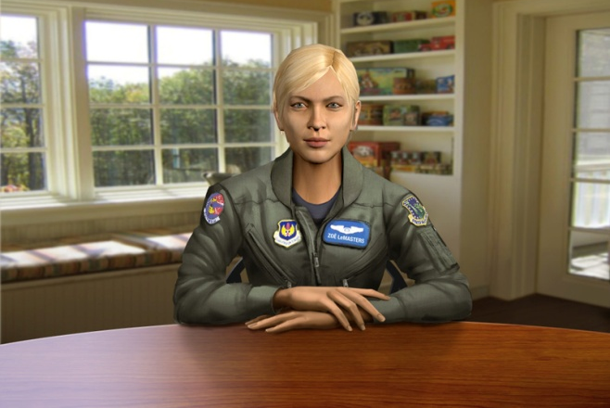

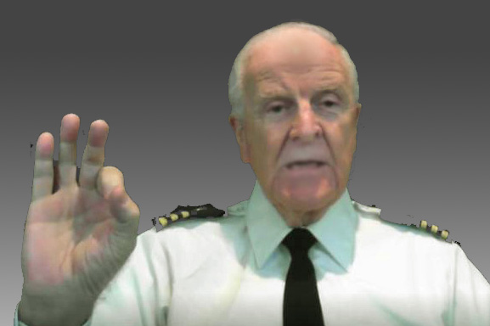
Programs Showing VH Uses
Interactive Virtual Humans are effective and available 24 x 7
SimCoach – Counseling PTSD Veterans via internet
New Dimensions in Testimony – Holocaust memories preserved
Can be 3D-hologram display for room or museum use
MentorPal – Advising STEM students on career paths
Gives compelling answers to education/career questions via conversational interface

Slide 17
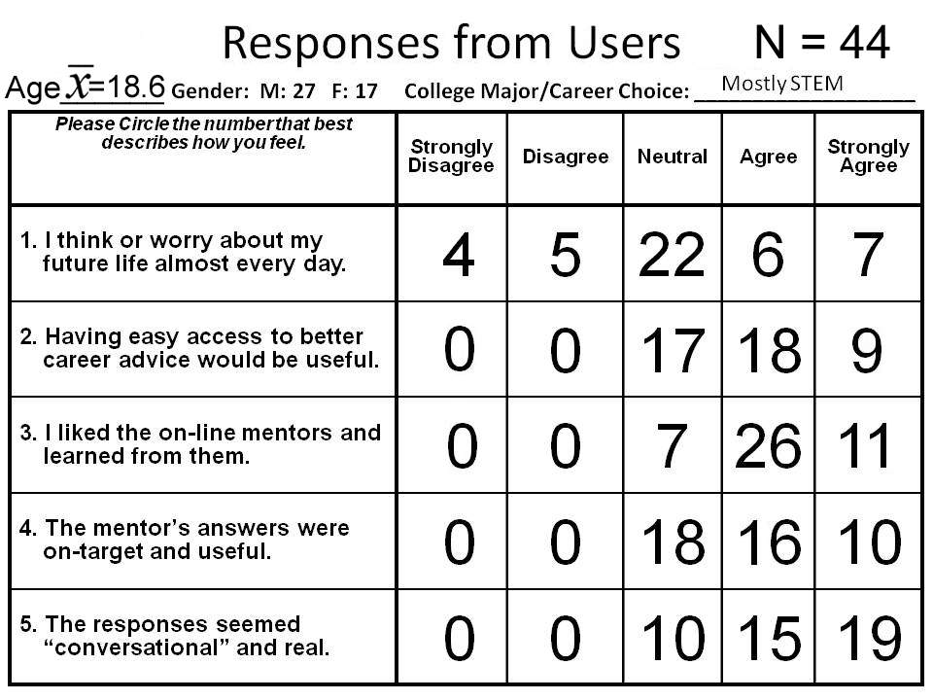
MentorPal Results

Slide 19
System Design
Introduction given to Critical Thinking and Meta-Cognition
Rubric for steps given and explained
Simulation of battlespace to test skills presented
Problem identified and log kept of student inputs
Virtual Human would query student to probe depth of analysis
Evaluative report given and remedial training provided as necessary

Slide 20
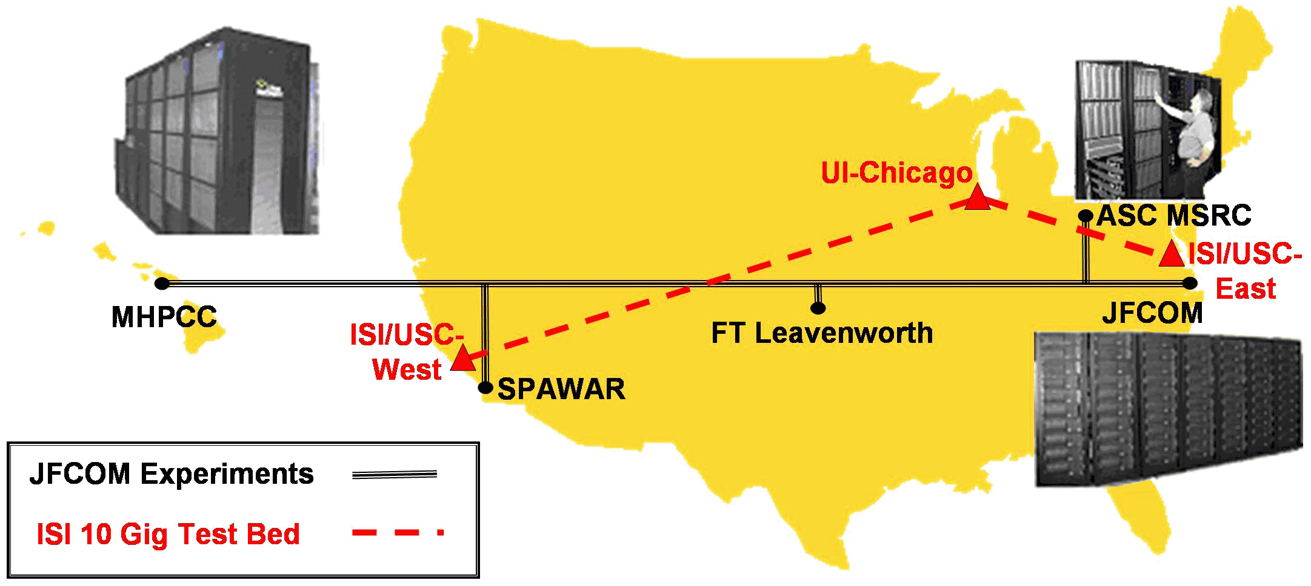
Long Haul Communication Issues
Major disruptive issue is latencies that interrupt speech
Humans can tolerate ~500 msec without objection
Network below exhibited latencies of ~ 200 msec

Slide 21
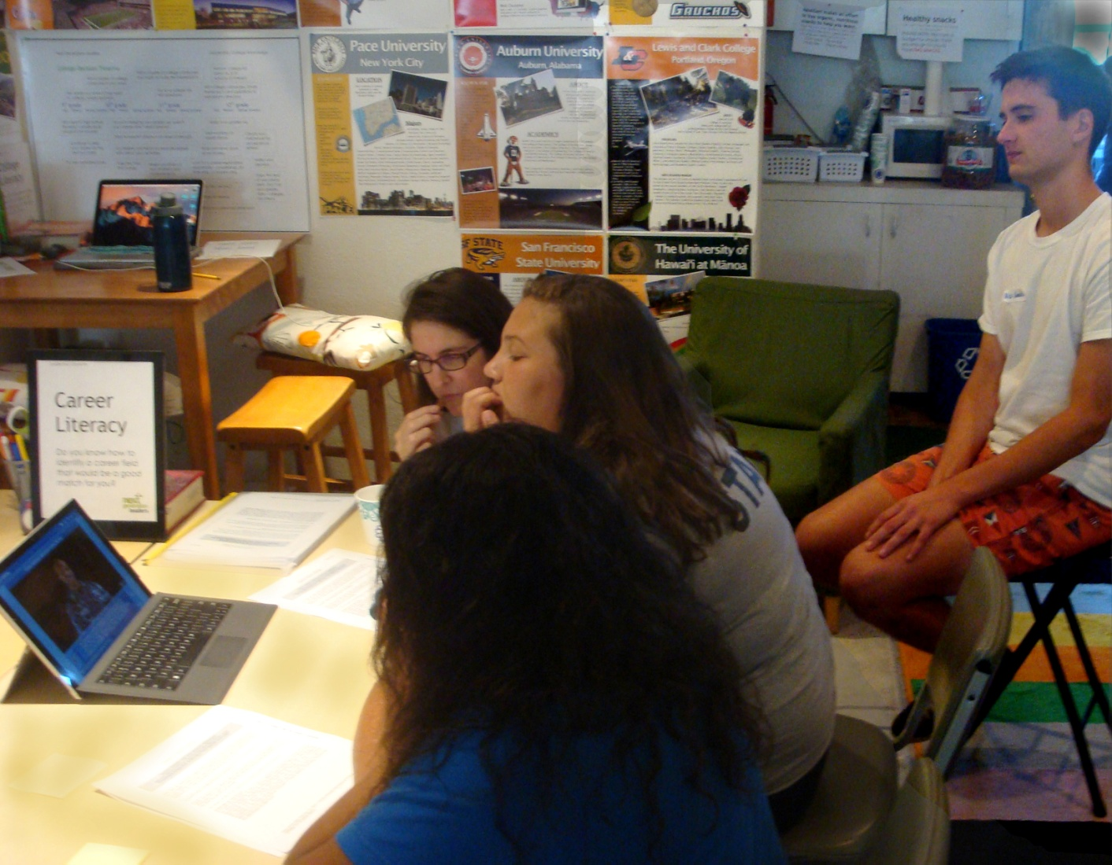
Testing Student Acceptance
Students converse with MentorPal system
USC RA monitors their actions and reactions

Slide 22
Conclusions

Slide 23
Acknowledgements & Caveats
Much of the work described above was conducted in response to a Office of Naval Research contract named MentorPal: Growing STEM Pipelines with Personalized Dialogs with Virtual STEM Professionals, N00014-16-R-FO03. The opinions expressed herein are the authors’ own and do not necessarily reflect those of the Department of the Navy, the Department of the Army or the U.S. Government.

