Slide 1
Domain-Specific Reduction of
Language Model Databases:
Overcoming Chatbot Implementation Obstacles
Nicholas J. Kaimakis, Samuel Breck, & Benjamin D. Nye Institute for Creative Technologies Univ. of Southern California | Dan M. Davis HPC-Education & USC

Slide 2
Major Thesis

Slide 3
Existing Problem

Slide 4
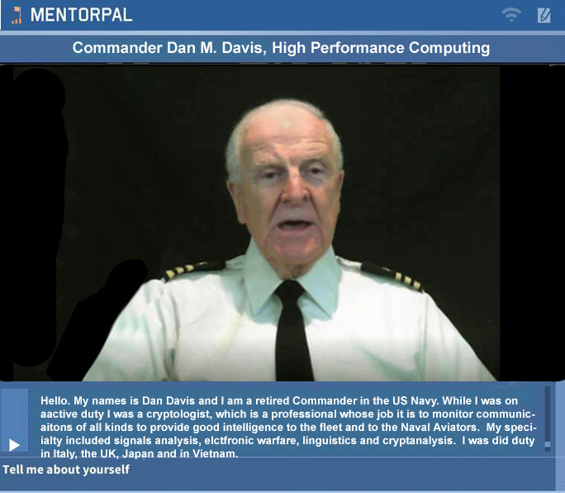
Current Research

Slide 7
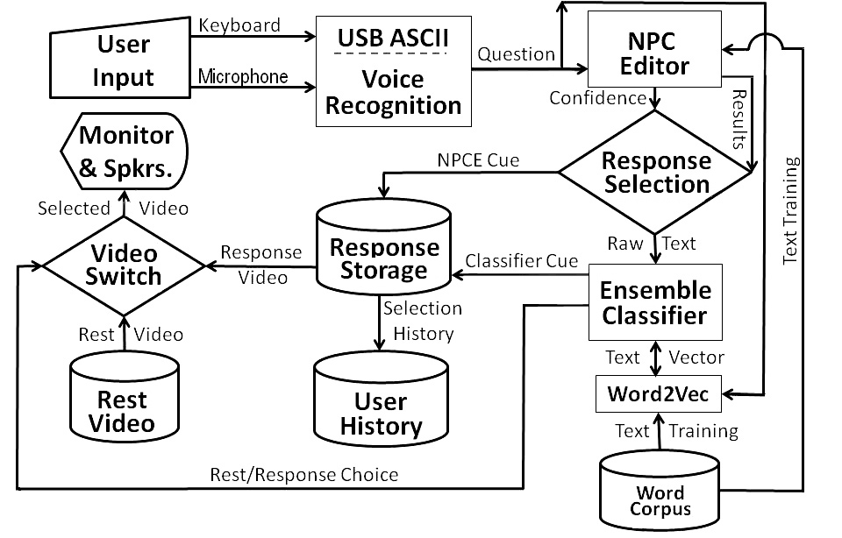
Notional Flow Chart

Slide 12
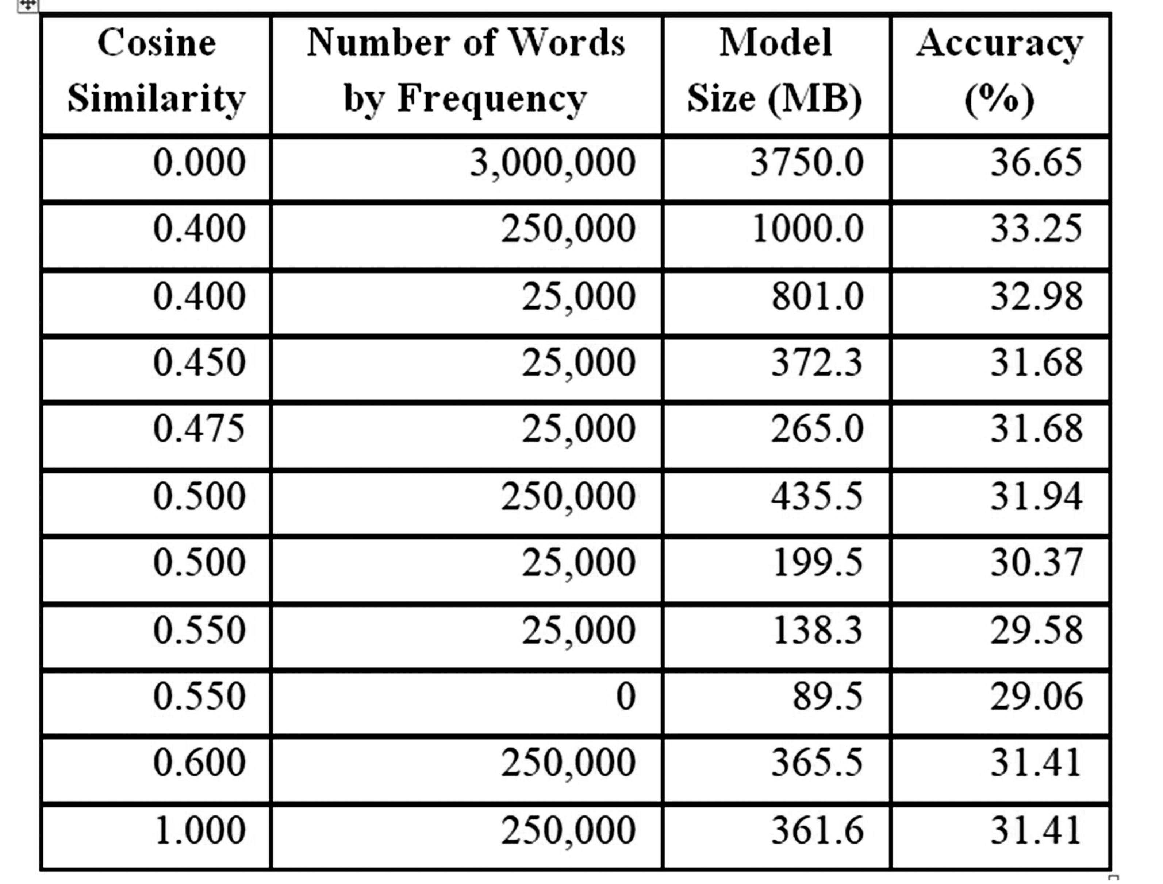
Performance by Cosign Similarity and Frequency Reduction

Slide 16
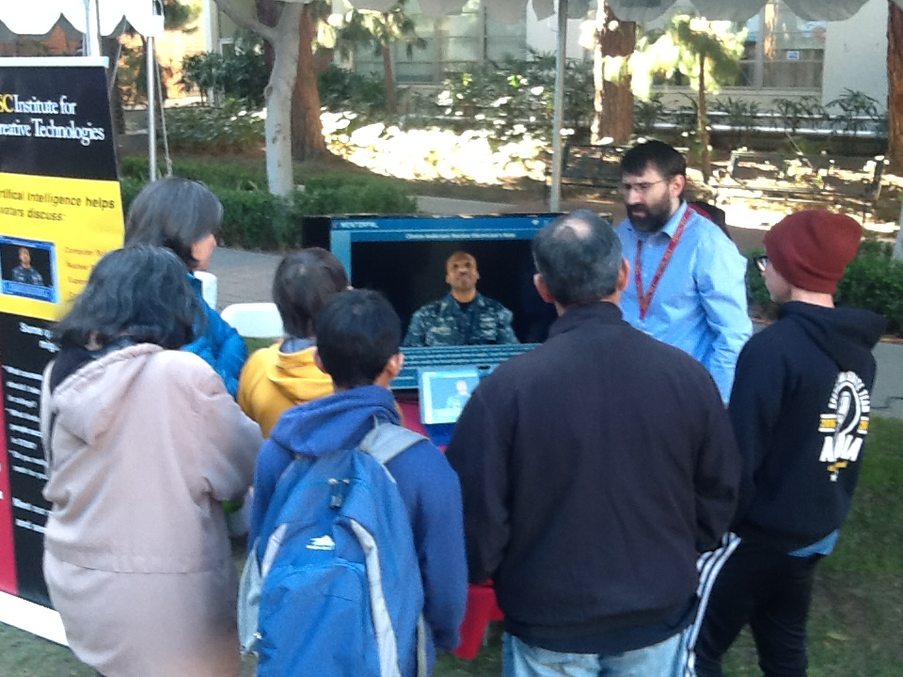
Demonstration of Program

Slide 20
Acknowledgements & Caveats
Much of the work described above was conducted in response to Office of Naval Research contract: MentorPal: Growing STEM Pipelines with Personalized Dialogs with Virtual STEM Professionals, N00014-16-R-FO03 as well as NPCEditor and PAL3, under Army contract W911NF-14-D-0005. The opinions expressed herein are the authors’ own and do not necessarily reflect those of the Department of the Navy, the Department of the Army or the U.S. Government.

