Slide 1
Domain-Specific Reduction of
Language Model Databases:
Overcoming Chatbot Implementation Obstacles
Nicholas J. Kaimakis, Samuel Breck, & Benjamin D. Nye Institute for Creative Technologies (ICT) Univ. of Southern California (USC) | Dan M. Davis HPC-Education and USC

Slide 2
Major Thesis
Chatbot technology is proliferating
Computer generated and sustained virtual conversation is central to these programs
Most of the capabilities depend on language data
Efficiently creating, storing and using this data is critical
Minimizing data merits research and optimization
Improvement in this area would be a valuable contributor to this and other technologies

Slide 3
Existing Problem
Personnel costs and other communication frictions make computer-generated conversations attractive
These capabilities depend on Artificial Intelligence (AI) and Natural Language Processing (NLPP
Exacerbating the issue is the trend to smaller devices
ICT/USC is working on programs in this area
Any advances made here would likely be extensible into many similar areas where they are needed

Slide 4
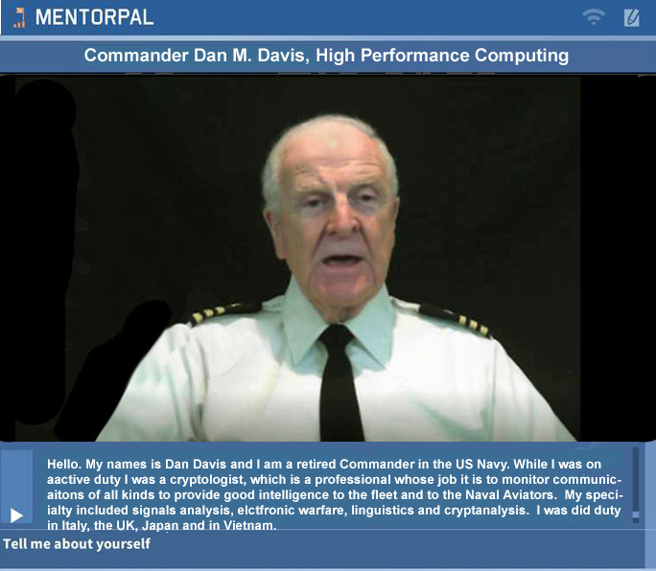
Current Research
One USC program is MentorPal
Computer-generated conversation is use to counsel students
Responses must be rapid, germane and engaging to retain student interest

Slide 5
Steps in Creating MentorPal
Hand generation of germane question list (5-1.5K)
Appropriate personnel are recruited to respond
About 20 hours of taping is required for basic questions
Responses are then machine transcribed, hand edited and carefully analyzed for utility and appropriateness
Many of these steps require machine evaluation and analysis using language data bases
Size, speed, and access are all important parameters

Slide 6
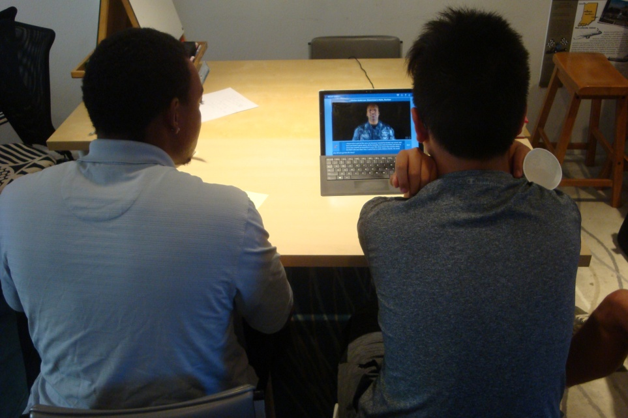
Evaluating Progress
Program is then tested on students
Subjects are monitored to assess “issues”
Issues of concern:
  Responsiveness of mentor
  Conversational quality
  Student interest
  New questions
Students have trouble formulating good questions
Major issue still is speed of data retrieval & responses

Slide 7
Data Flow Through System
Students enter question or picks from list
Either ASCII from keyboard or voice recognition from Microphone is input into system
Submitted to ICT’s NPC Editor and to Word2Vec
Input analyzed for critical central points
Word corpus is engaged to parse out meaning
Response program compares input to answers
MentorPal data is activated to cue up video clip
All steps have to be accomplished in < 500 msec

Slide 8
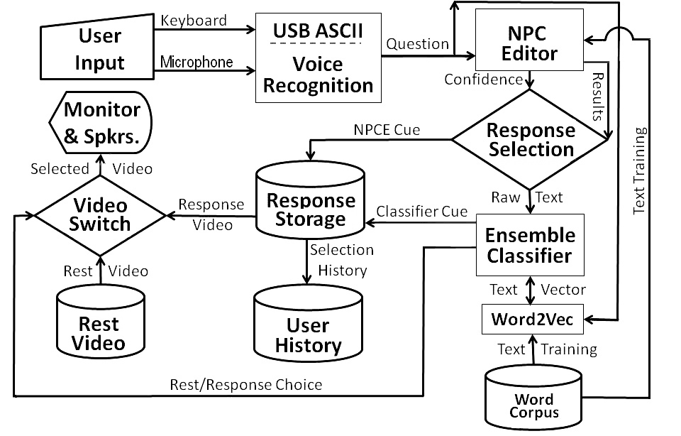
Notional Flow Chart

Slide 9
Limitations and Challenges
Basic limitation categories
  Size (especially critical for small devices)
  Time (input, access, and retrieval)
Limitations are synergistic, impacting each other
Further constrained by physical size and cost issues
Classifications systems used in MentorPal
  combined logistic regression
  long short-term memory
  skip gram
  Word2Vec

Slide 10
Word Corpus
Word2Vec: 3M words out of Google 100B word data
Vector data size: 3.4 GB
Paging became a disruptive factor in MentorPal
Loading data required five minutes on boot up
Time delays were observed to quickly and invariably destroy student engagement
Mandated investigation into optimizing system by reducing data size and response times
Would address both time and size constraints

Slide 11
Approaches
Previous work on this topic
  Dimensionally based
  Parameter based
  Resolution based
Analyzed trade-offs & avoided redundant information
Linear transformation: map vectors to fewer features
Pruning: eliminating less important features; better
Bit truncation: reducing descriptions till degradation
Results: bit truncation was best method

Slide 12
New Approach
Goal: minimum memory with minimum impact
Two schemes implemented were reduction by:
  Word frequency
  Domain relevance
Word frequency and Zipf’s law
Discard words based on frequencies in Google News
Relevance – compare language model with corpus
Cosign similarity measures angle between vectors
Kept high scores, deleted rest

Slide 13
Results from Minifying Effort
Measured by leave-one-out paraphrase test
Best fit or most productive; may be different
More sophisticated testing was not supported by funding and would be constrained by schedule
Data generated was nevertheless useful
Future training is anticipated to generate better response rates without impacting data sizes
Data on next slide represents various cosign values
Represents 382 leave-one-outs

Slide 14
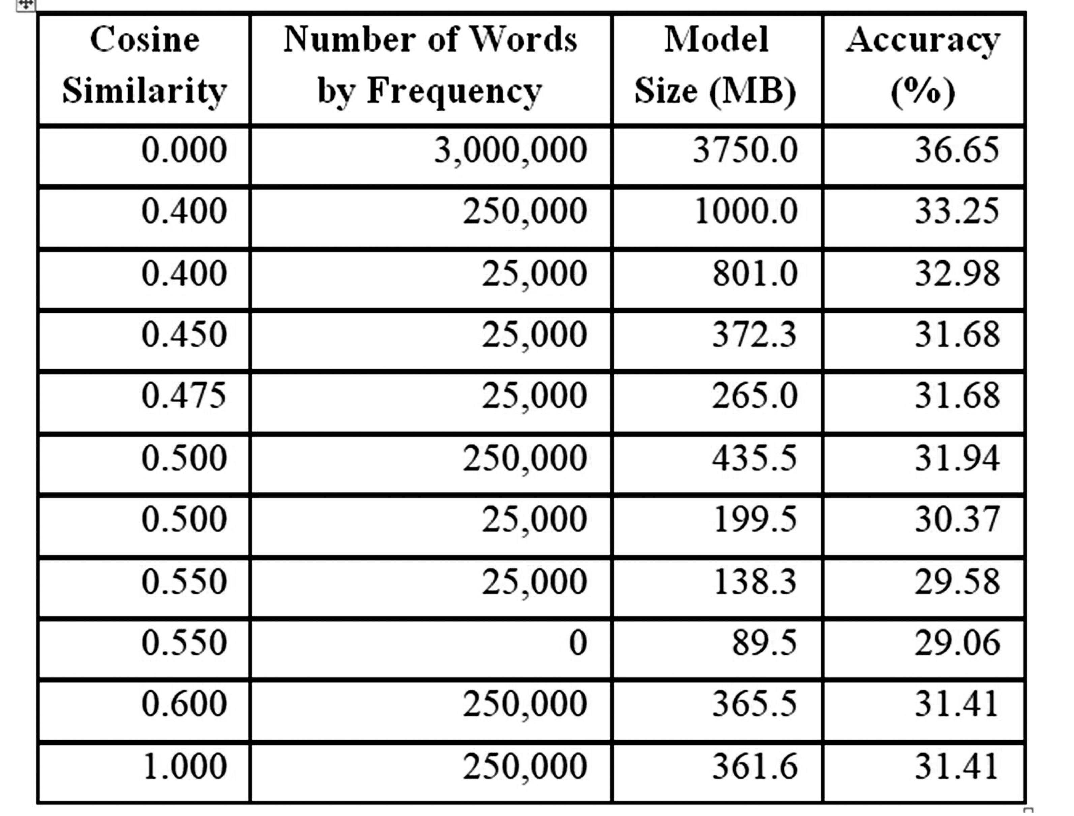
Performance by Cosign Similarity and Frequency Reduction

Slide 15
Analysis
0.45 to 0.475 reduction results in a model size reduction from 372.3 MB and 265 MB respectively
Smallest model generated, retained words: threshold was a cosine similarity >0.55
Yielded a 89.5 MB model and ~7 percent decrease in perfect matching accuracy
Need more research in varying models
Hampered by training time for each new model
Will seek point where accuracy drops exponentially

Slide 16
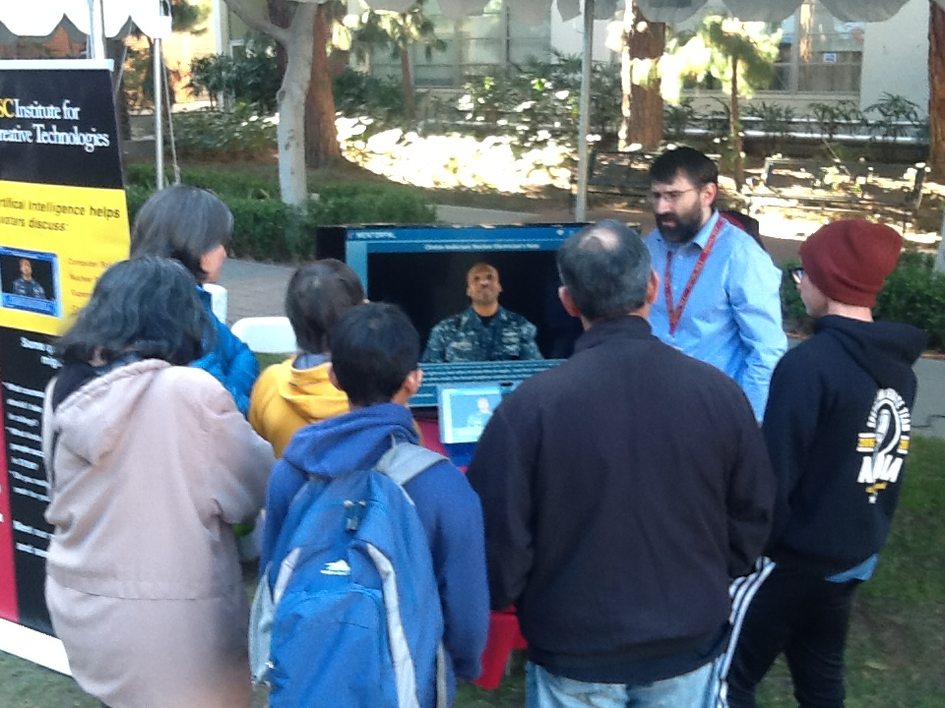
Demonstration of Program

Slide 17
Further Impacts
Should directly impact success of MentorPal
Extensible to other uses of virtual conversationalist
Kubrick and Clarke had fully conversational computers projected for “2001’s” HAL and “Star Trek’s” Computer!; students want similar interfaces
Current Chatbots are proliferating
ICT projects have found uses from Holocaust survivor archiving to PTSD treatment therapies
All will need minified data sets.

Slide 18
Future Research
Assessing utility of FaceBook’s FastText
  Trains is seconds, rather than in days
  FastText uses approaches similar to the ones above
Multi-lingual databases are looming and problematic
  A bi-lingual MentorPal will surely be critical
  Commercial firms working this issue
Applying this approach to other programs which are plagued by size and time constrains may bear fruit
This is a new field of optimization

Slide 19
Conclusions
Virtual conversations are burgeoning and vital
Minification of databases are necessary for success
Minification has been shown to be possible
Degradation has been tolerable or trivial
Large data sizes are disruptive and cause paging
Needs will only increase and demands for smaller device sizes will only become more urgent
This work should be extensible to other areas

Slide 20
Acknowledgements & Caveats
Much of the work described above was conducted in response to a Office of Naval Research contract named MentorPal: Growing STEM Pipelines with Personalized Dialogs with Virtual STEM Professionals, N00014-16-R-FO03, as well as NPCEditor and PAL3, under Army contract W911NF-14-D-0005. The opinions expressed herein are the authors’ own and do not necessarily reflect those of the Department of the Navy, the Department of the Army or the U.S. Government.

