Slide 1
Domain-Specific Reduction of
Language Model Databases:
Overcoming Chatbot Implementation Obstacles
Nicholas J. Kaimakis, Samuel Breck, & Benjamin D. Nye Institute for Creative Technologies (ICT) Univ. of Southern California (USC) | Dan M. Davis HPC-Education and USC

Slide 2
The Problem
2
Virtual mentors for high school age students, scaled
Certain demographics lack access to informed conversations
Mentors and teachers time is limited
Quality mentorship is difficult to come by
In person interaction is not scalable
Notes:
We have all been to a career fair or networking event at some point in our lives
But imagine you are a child in a lower income area and you come from a family of Trade workers and your parents never went to college
You want to break the cycle, but you have no idea where to start
Your underfunded public school does not have the resources to prepare you for a different life
What do you do?

Slide 3
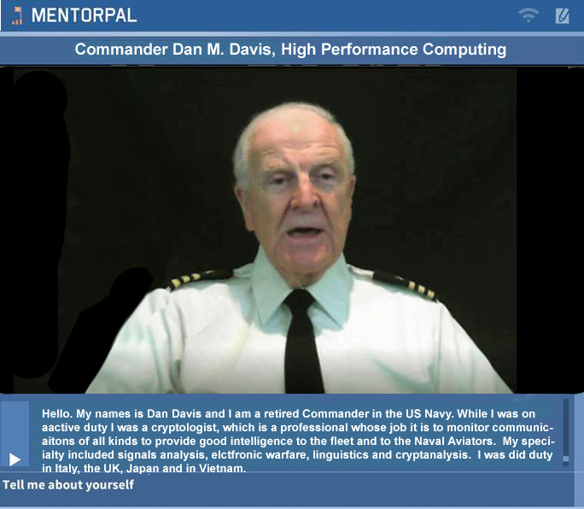
The Solution: MentorPAL
Virtual mentors for high school age students, scaled
An interactive virtual agent that allows students to ask their own questions
Tablet based chat system
Mentors handpicked for their diverse set of experiences and mentoring ability
Responses must be rapid, germane and engaging to retain student interest

Slide 4
Question Generation
Hand generation of germane question list (5-1.5K)
Appropriate personnel are recruited to respond
~20 hours of taping is required for basic questions
Responses are then machine transcribed, hand edited and carefully analyzed for utility and appropriateness
Many of these steps require machine evaluation and analysis using language data bases
Size, speed, and access are all important parameters

Slide 5
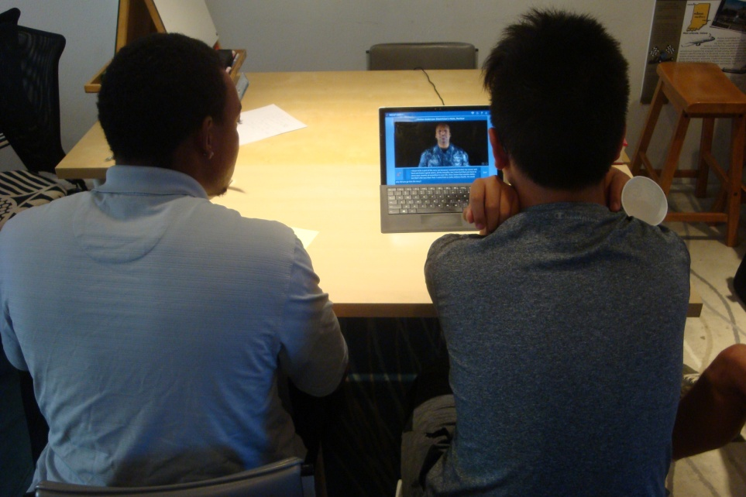
Evaluating Progress
Program is then tested on students
Subjects are monitored to assess “issues”
Issues of concern:
  Responsiveness of mentor
  Conversational quality
  Student engagement
  New questions
Students have trouble formulating good questions
Major issue still is speed of data retrieval & responses

Slide 6
Data Flow Through System
Students enter question or picks from list
Keyboard or voice recognition input
Input sent to ICT’s NPC Editor and classifier
Question is analyzed for critical central points
Word corpus is engaged to parse out meaning
Response program compares input to answers
MentorPal data is activated to cue up video clip
All steps have to be accomplished in < 500 msec

Slide 7
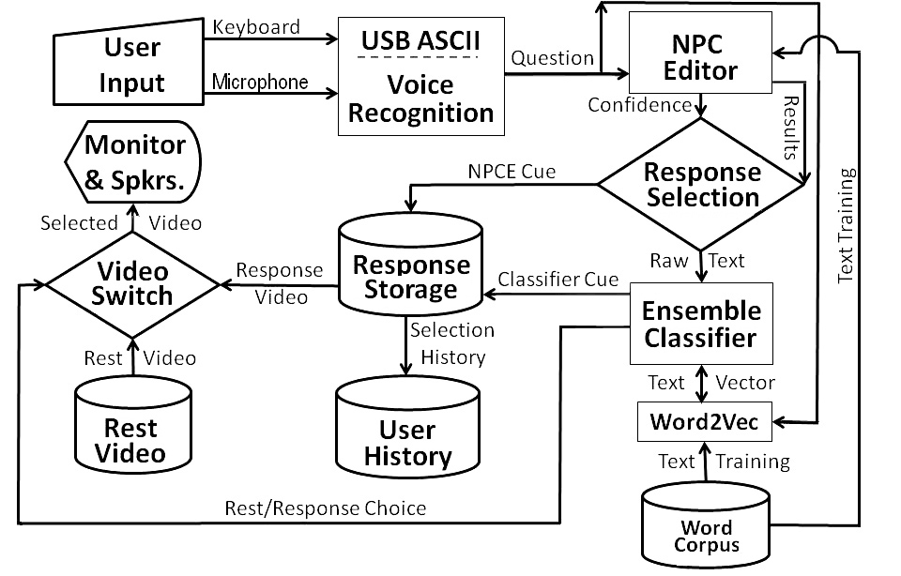
Notional Flow Chart

Slide 8
Word Corpus
Word2Vec: 3M words out of Google 100B word data
Vector data size: 3.6 GB
Paging became a disruptive factor in MentorPal
Loading data required 5 minutes on boot up
Time delays impacted student engagement
Need for an optimized system for reduced data size and response times
Address both time and size constraints

Slide 9
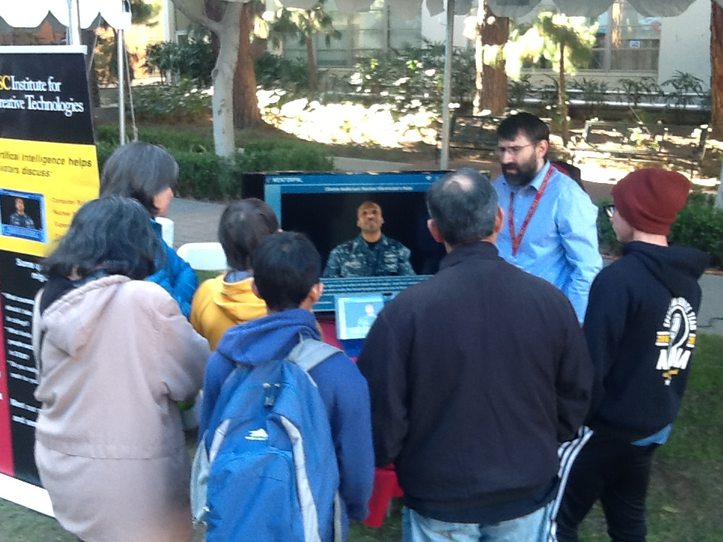
Demonstration

Slide 10
Limitations and Challenges
Basic limitation categories
  Size (especially critical for small devices)
  Time (input, access, and retrieval)
Limitations are synergistic, impacting each other
Further constrained by physical size and cost issues
Classifications systems used in MentorPal
  combined logistic regression
  long short-term memory
  skip gram
  Word2Vec

Slide 11
Major Thesis
Personnel costs and other communication frictions make computer-generated conversations attractive
These capabilities depend on Artificial Intelligence (AI) and Natural Language Processing (NLP)
Efficiently creating, storing and using this data is critical
Exacerbating the issue is the trend to smaller devices
Minimizing data merits research and optimization
Improvement in this area would be a valuable contributor to this and other technologies

Slide 12
Approaches
Previous work on this topic
  Dimensionally based
  Parameter based
  Resolution based
Analyzed trade-offs & avoided redundant information
Linear transformation: map vectors to fewer features
Pruning: eliminating less important features; better
Bit truncation: reducing descriptions till degradation
Results: bit truncation was best method, but methods are suboptimal for domain specific filtering

Slide 13
New Approach
Goal: minimum memory with minimum performance impact
Two schemes for reduction:
  Word frequency
  Domain relevance
Discard infrequently used words
  Word frequency measured using Zipf’s law
Relevance – compare language model with corpus
  Cosign similarity measures angle between vectors

Slide 14
Results from Minifying Effort
Measured by leave-one-out paraphrase test (382 total)
  May be an unreliable metric for effectiveness
Comprehensive model generation takes exponential time
  Future opportunity for research
Sample models generated show promise
Future training is anticipated to generate better response rates without impacting data sizes

Slide 15
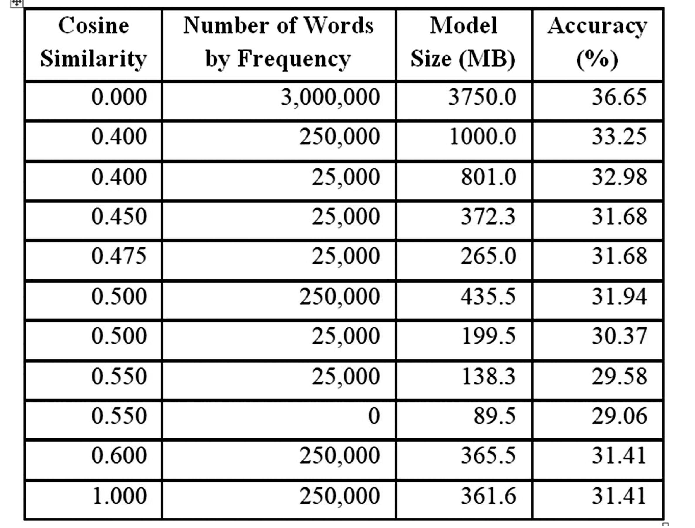
Performance by Cosign Similarity and Frequency Reduction

Slide 16
Analysis
0.45 to 0.475 reduction results in a model size reduction from 372.3 MB and 265 MB respectively
Smallest model generated, retained words: threshold was a cosine similarity >0.55
Yielded a 89.5 MB model and ~7 percent decrease in perfect matching accuracy
Need more research in varying models
Hampered by training time for each new model
Minification will eventually reach a point in which accuracy drops exponentially

Slide 17
Further Impacts
Should directly impact success of MentorPal
Extensible to other uses of virtual conversationalist
Kubrick and Clarke had fully conversational computers projected for “2001’s” HAL and “Star Trek’s” Computer!; students want similar interfaces
Small domain chatbots are common and useful
ICT projects have found uses from Holocaust survivor archiving to PTSD treatment therapies
All will need minified data sets

Slide 18
Future Research
Assessing utility of FaceBook’s FastText
  Trains is seconds, rather than in days
  FastText uses approaches similar to the ones above
Multi-lingual databases are looming and problematic
  A bi-lingual MentorPal will surely be critical
  Commercial firms working this issue
Applying this approach to other programs which are plagued by size and time constrains may bear fruit
New field for domain focused application optimization

Slide 19
Conclusions
Virtual conversations are burgeoning and vital
Minification of databases are necessary for success
Minification has been shown to be possible
Degradation has been tolerable or trivial
Large data sizes are disruptive and cause paging
Needs will only increase and demands for smaller device sizes will only become more urgent
This work should be extensible to other areas

Slide 20
Acknowledgements & Caveats
Much of the work described above was conducted in response to a Office of Naval Research contract named MentorPal: Growing STEM Pipelines with Personalized Dialogs with Virtual STEM Professionals, N00014-16-R-FO03, as well as NPCEditor and PAL3, under Army contract W911NF-14-D-0005. The opinions expressed herein are the authors’ own and do not necessarily reflect those of the Department of the Navy, the Department of the Army or the U.S. Government.

