Slide 1
Advanced Technologies to Enhance Education to Optimize Information Flow Utilization
2018F-SIW-0036
Mark C. Davis, PhD, Computer Engineer
Retired: US Navy, IBM, and Lenovo

Slide 2
Basic Thesis of Paper
The shortcomings in the comprehension of massive data flows and the development of computer-enabled methods of addressing those shortcomings are critical topics. Experience with new capabilities to amass, manage and deliver virtually limitless information has shown that one of the major barriers to optimal use by the users. There is an inability to assess, comprehend, and filter the overwhelming data.
A major component of the data transfer issue is the existence of a sort of friction that degrades the best comprehension of the data. The current environment has suggested some supportable contentions: information friction has been ameliorated by technology, despite some restrictions imposed by organizational leadership.

Slide 3
eLearning is a Critical DoD Asset
DoD personnel need to be adequately educated
Training is only one of the pillars of performance
Education in the DoD is disrupted by:
  Ops Schedules
  Geographical dispersion of personnel
Operations tempos continue to rise
Simulation offers an economical way to counter this
All of this requires more and more information

Slide 4
Changing Times
Information on paper being supplanted
Problems:
  Too much information
  Glut keeps down optimal use of data
  The has been an inclination to use like printed material
  Putatively, there is more capability than that
The web is full of sites just using text or video
These are successful, but could be enhanced.
Students “learn” (memorize) but are not educated

Slide 5

Teaching does not guarantee learning
“I haven’t needed to know why it is colder in the winter” says this Harvard Graduate

Slide 6
Information: Flows and Frictions
Information has history of being constrained
Sometimes malevolently restricted by organization
Sometimes constricted by technology
  Stagecoach delivering letters across America
  High cost of long-distance phone calls until the 90’s
Even when not constrained, there are problems
Security of data is critical, but it is not always secure
Unfiltered data is often overwhelming

Slide 7
Approaches to Counter Friction
High Performance Computing
Better filtering of data using Artificial Intelligence
Better training for originators and for recipients
More critical thinking training.
Constructivist education to better convey MEANINGFUL data to students
Carefully designed intercontinental systems to ensure the data arrives in timely function

Slide 8
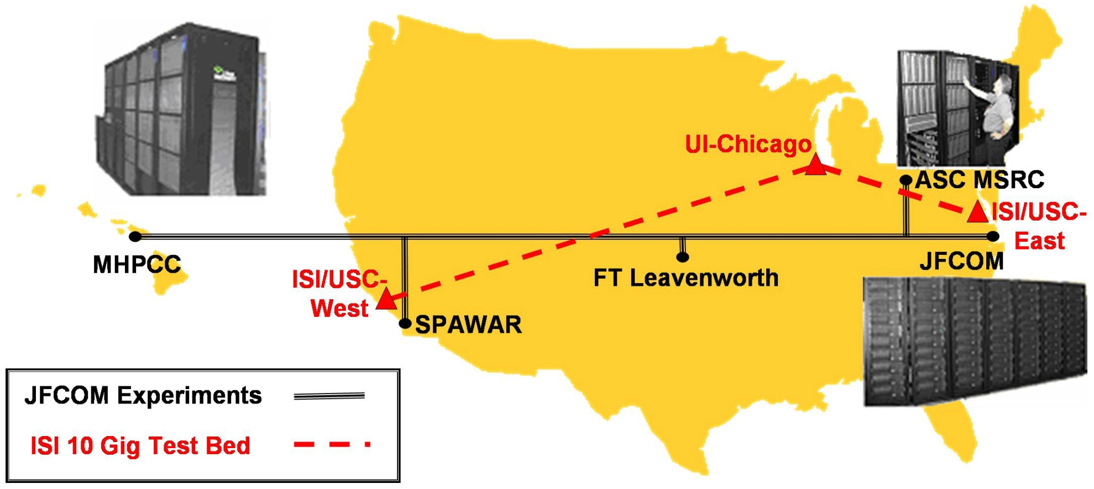
USC Transcontinental Test Bed

Slide 9
Constructivist Method
Constructivism is useful tool in education
Accepted pedagogical foundation
Particularly suited to individual study
Tolerates interruption
Implementations can be transmitted to any computer for remote learning
This method has been shown to be more effective
Can enhance Critical Thinking by its very nature

Slide 10
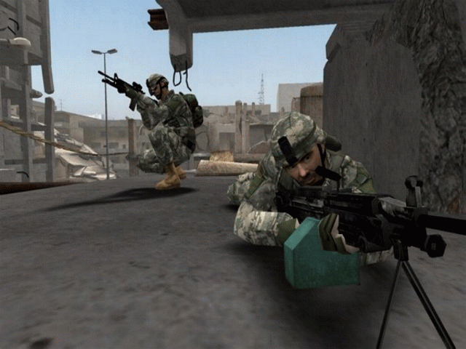
America’s Army Example

Slide 11
America’s Army Enhances Education
The traditional way of teach Infantry doctrine is via classroom instruction and field practice
Constrained by costs, time, training areas, …
In an Alexander Flemming moment, a program designed to recruit soldiers was found useful
Instructors noted those playing the computer game were doing better during exercises
Not just rote memory then practice
Engaging realistic repeated simulated participation
Undergirded with constructivist pedagogy

Slide 12
Conclusion
Information Flow Friction is major hurdle
A/I approaches like Deep Learning may help
Need better filtering and user control
Technology can only solve part of the problem
Users are another barrier
Critical Thinking is “Critical”
Not taught even in some of the best schools in US
Can improve Critical Thinking with two approaches:
  Rule-based rubrics on analysis
  Thoughtful Socratic or Constructivist pedagogies

