Slide 1
New Technologies to Enhance
Computer Generated Interactive Virtual Humans
2017-SIW-0017
Jeremy J. Liu, University of Southern California, USA

Slide 2
Basic Thesis of Paper
The use of Virtual Humans is increasingly important to the defense of this nation. The human qualities of these entities continues to grow, but there are still many grand challenges facing this community. Fortunately, new advances in technology are emerging that may help meet the remaining grand challenges. This paper examines the use of Virtual Humans, identifies many of the Grand Challenges, and identifies a few of the more promising approaches to implementing the new capabilities in the quest of more effective training, analysis and evaluation. The authors then consider the various impacts of these issues.

Slide 3
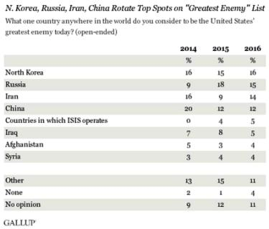
The US is Under Attack
The US faces a growing number of threats
Defense budgets continue to be curtailed
Operations tempos continue to rise
Simulation offers an economical way to counter this
Gallup Poll results for US Enemies

Slide 4
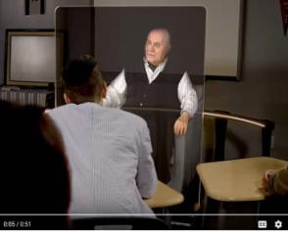
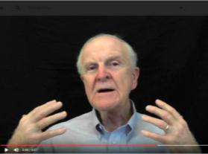
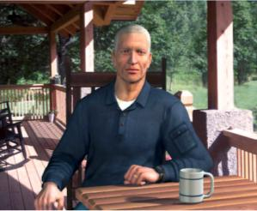
The Uses of VH’s are Varied
An critical part of the simulation tool kit is humans
Virtual humans are used in many ways
At ICT they are used to
  Capture memories of holocaust survivors
  Advise young STEM students
  Counsel PTSD patients

Slide 5
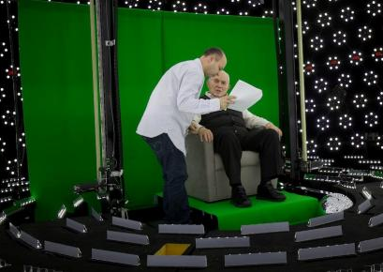
VH’s Take lots of Compute Power
Virtual Humans consume lots of compute cycles
  Voice recognition requires support
  Visualization is compute intensive
  Natural Language Processing must be fast and correct
  Lighting subjects for holographic displays is complex

Slide 6
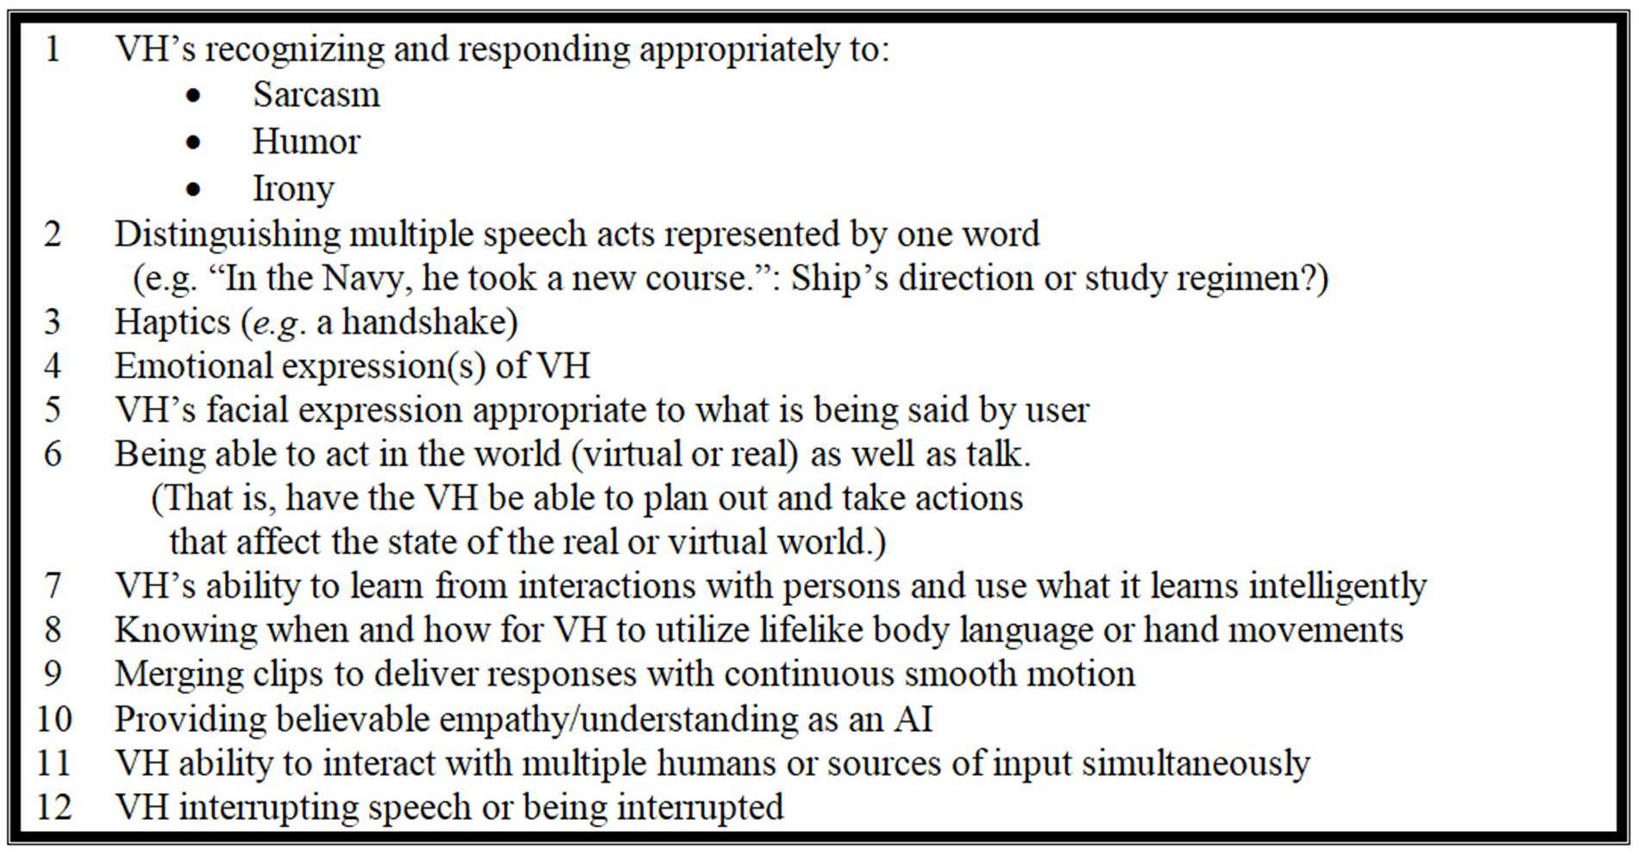
Grand Challenges of VH’s

Slide 7
Quantum Computer
Richard Feynman of Caltech proposed in the 1980’s the power of a “Quantum Computer”
Instead of a binary value of one or zero, it uses “qubit” with a quantum range of values.
General purpose quantum computing is still the stuff of speculation and vociferous argument.
D-Wave has delivered a quantum annealer to USC
Another is Google’s, in the San Francisco Area
They operate at a chilly 0.0015K (15 milikelvins)

Slide 8
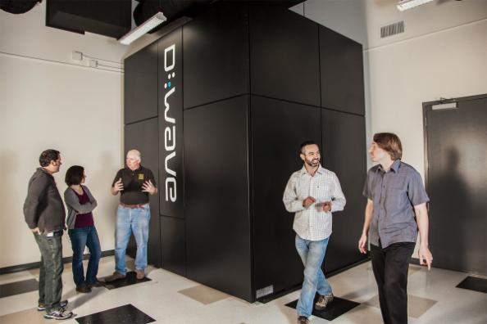
USC’s D-Wave

Slide 9
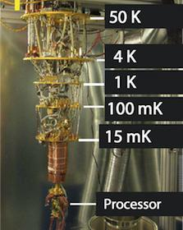
Using Quantum Computers
A quantum computer should demonstrate incredible computational power
It can be in multiple states at once, a condition called “superposition.” It can act on all its possible states simultaneously.
It can evaluate a series of optima beyond the power of the largest digital computer.

Slide 10
Slide based on “Double List”
Virtual Humans need more sophisticate analytic techniques
Much of what is needed depends on analysis of Big Data
Big Data may be large amounts of text or imagery
Analyzing this is not trivial
Neural Net learning may fall short
Deep learning promises to help overcome this obstacle
Instead of applying the weights and selections of simple neural nets, deep learning filters using a series of steps called hidden layers
This process is a technique that may also be amenable to implementation via a quantum computer

Slide 11
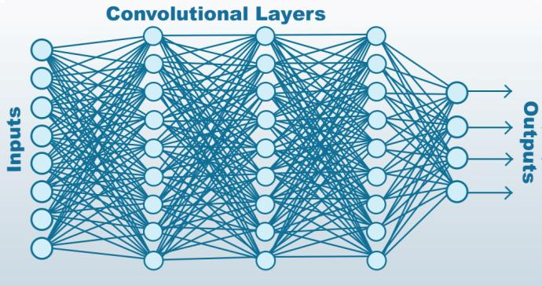
Deep Learning Layer diagram

Slide 12
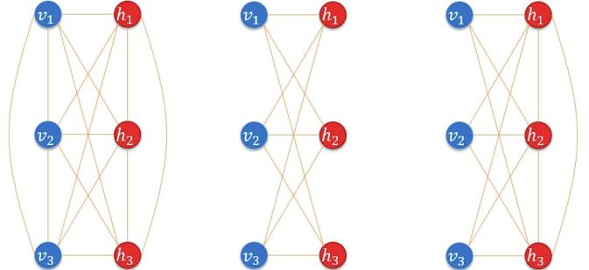
Boltzmann Machine Diagram

