Slide 1


Enhancements for Homeschooling & ADL:
Virtual Humans, Technologies & Insights
Mark C. Davis, PhD
CTO, Wood Duck Research, Inc.
Co-authors: Nancy L.H. Young & CDR Dan M. Davis

Slide 2
Introduction
Home schooling has similarities to DoD ADL education
Common challenges include
  Irregular schedule
  Restricted instruction staff
  Unpredictable teachable moments
Comparisons identify areas for improvement
Alternate teaching methods have promise
Some technologies can enhance both domains
ADL – Advance Distributed Learning

Slide 3
Reasons To Home School
Motivation | Percentage
A concern about the school environment | 91%
A desire to provide moral instruction | 77%
A dissatisfaction with academic instruction at other schools | 74%
A desire to provide religious instruction | 64%
Provide a nontraditional approach to education | 44%
Other reasons | 37%
Child has special needs | 16%
Child has a physical or mental health problem | 15%

Slide 4

Home Schooling and
DoD OJT Training Parallels
Characteristics | DoD ADL | Home School | Public School
Ability to respond to “teachable moment”
Self-pacing capability
Tailor instruction to individual student
Easy access to video instruction to augment learning
Inviolate group schedule requiring hard stop to learning
Periodic admin, safety and logistics interruptions
DoD – Department of Defense
OJT – On the Job Training

Slide 5
Opportunities for Enhancement
Characteristics | DoD ADL | Home School | Public School
Teacher is an expert in the field: languages, equipment
Teacher is the expert in the field: witness to history, inventor |  |  | 1
Advantages of Social Interaction: competition, collaboration | * | *
Facilities: gym, track, complicated simulators |  | +
 | Notes
1 | Scales poorly
* | Significant social interaction available outside of education setting
+ | Organizations to support home school are common

Slide 6
Alternate Teaching Methods
Lecture based
  Tried and true
  Lowest instructor training cost
Constructivism – problem solving based
  Very effective
  Requires high motivation and high training and preparation
Socratic method
  Highly dependent on instructor skill

Slide 7
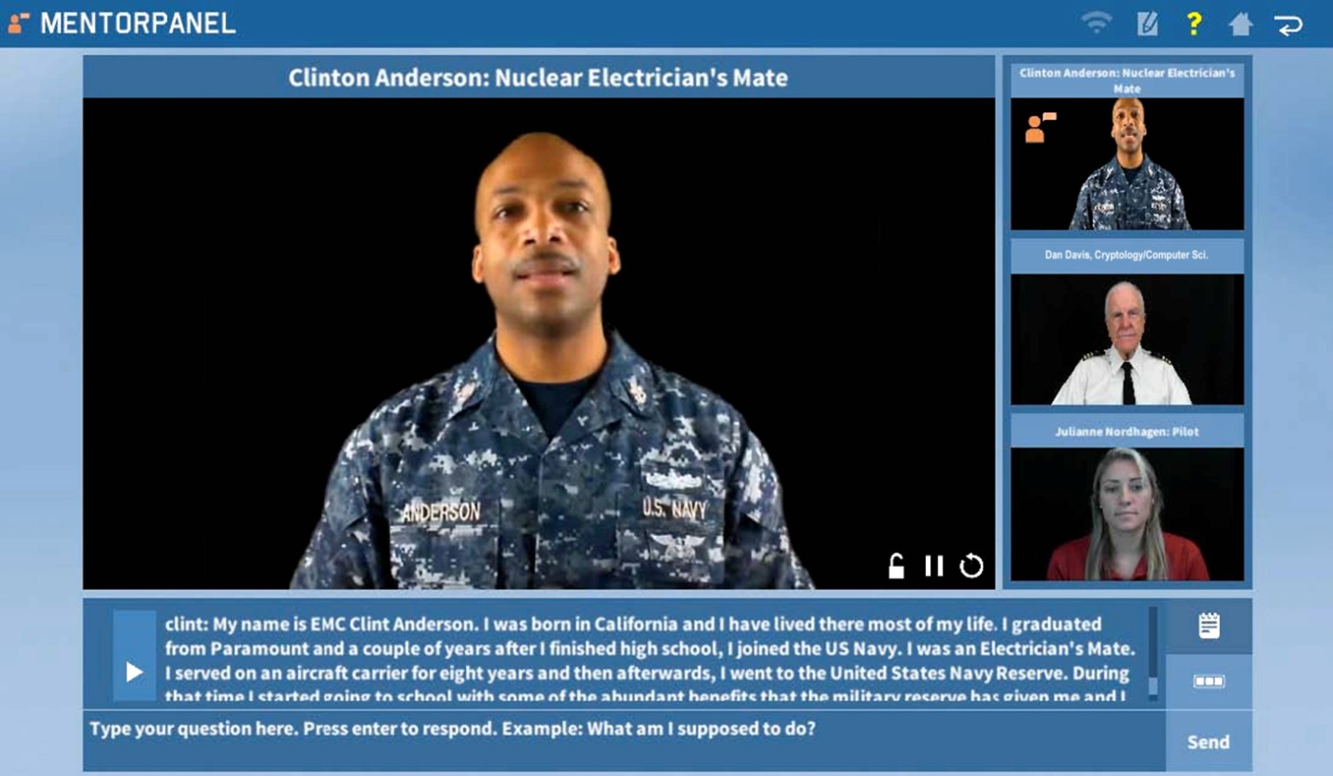
Virtual Humans

Slide 8
Roles of Virtual Humans
Teacher
  The real expert
Expert for question and answer sessions
  Engaging experience focusing on students concerns
  Opportunity for mentoring
Partner for practice
  From language drills to troubleshooting exercises
Team members for simulations
  Augmented reality or virtual reality games

Slide 9
Conclusions
Homeschool and ADL have similar needs
Alternative teaching techniques are challenging
Emerging technologies (Virtual Humans) can help
Joint approaches have high potential

Slide 10
Questions?

