Slide 1


Pedagogical Tools to Enhance Analytic Skills:
Interactive Virtual Tutorial Environments
Dan M. Davis
Consultant, Uinv. of Southern Caliornia
Co-Authors: Christi Phelps & Dr. Frederica Stassi

Slide 2
Major Theses
Critical thinking is a vital skill that is often held to be missing in this nation’s students. The authors hold that teaching critical thinking in the science and mathematics classes is hampered by the necessity of learning the basic tools of these disciplines. One of the authors has found the use of analytic processes in the study of literature is putatively effective in teaching critical thinking, as the students come prepared to read and write English and therefore can focus on analysis. New Artificial Intelligence (AI) and Natural Language Processing (NLP) technological advances make the implementation of these approaches extensible in many academic environments.

Slide 3
Critical Thinking (CT) Vital
Academics complain students not capable of CT
Not universal, even at the PhD level
Industry echoes that complaint
DoD recognizes the need for CT in all ranks
Military Historians report needs and past successes
Secondary School teachers fault school systems

Slide 4
Attempts to Improve
Some have tried to correct methods
John Taylor Gatto reports hiding his methods
Jaime Escalante was great, but not extensible
Need to impart basic methodological skills
This focus detracts from CT proficiency
Writing Across the Curriculum issues

Slide 5
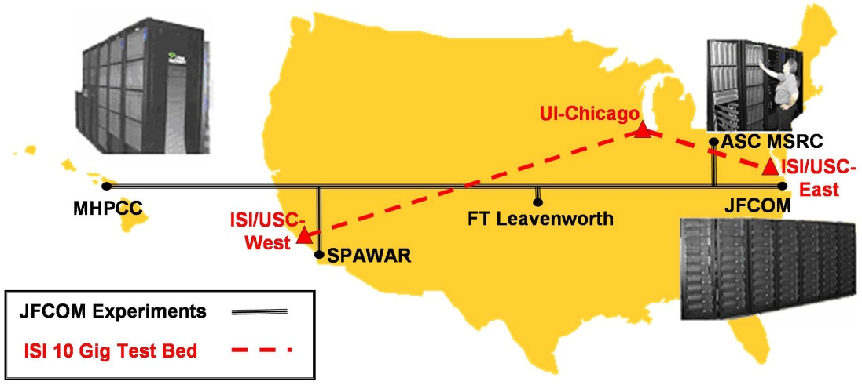
Trans-Continental Capabilities

Slide 6
Range of Effective Approaches
Several recognized approaches
Can teach simple rubrics for CT analyses
Can inculcate via instructional approaches
  Socratic
  Educational Sloyd
  Constructivist

Slide 7
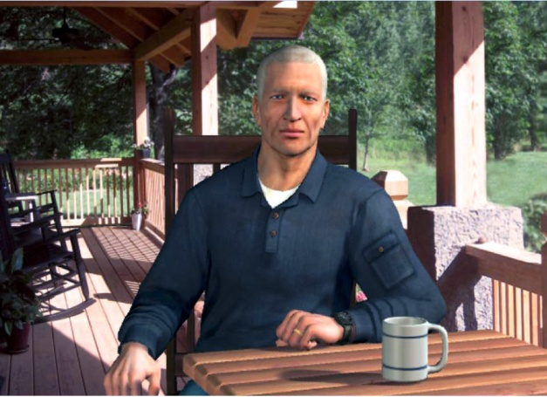
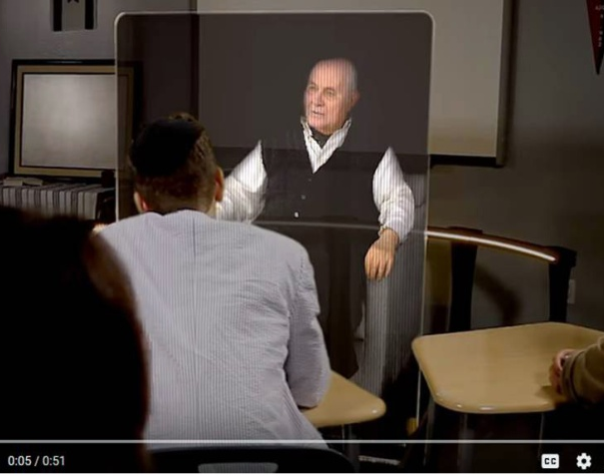
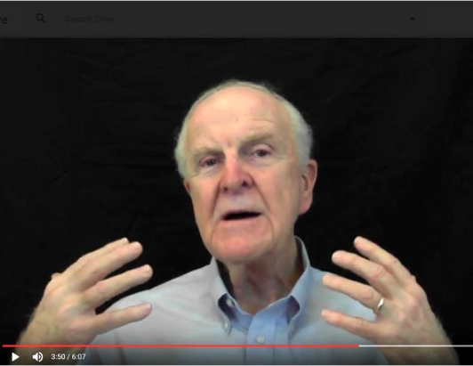
Presentations of On-Line Tutors

Slide 8
Constraints on Teachers
Student numbers in classroom
Personal strengths and professional skills
Range of student personalities and intellect
Issues of standard pedagogical methods
Ethnic and ESL issues

Slide 9
Advances in Virtual Humans
Computer advances in AI and NLP
Various formats and interfaces available
  Animated avatars
  Video clips of instructors and interactive tutors
  Holographic 3D displays
  Voice recognition and conversational agents

Slide 10
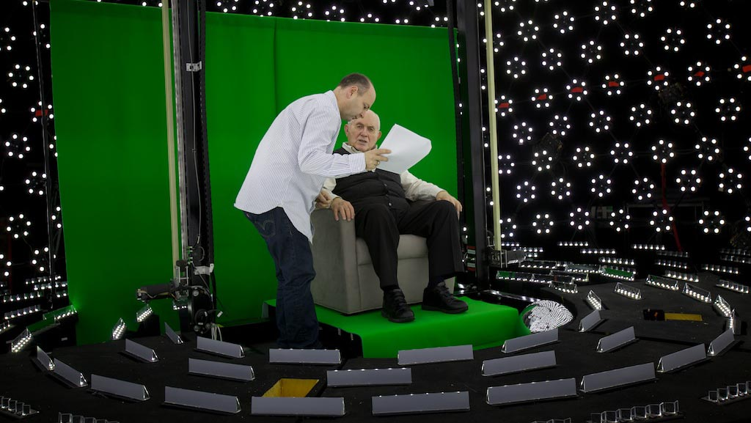
Creating a Tutor via Holographic Imagery

Slide 11
Instantiations and On-going Research
SimCoach to counsel VA patients
New Dimension in Testimony to archive “survivors”
MentorPal to advise High School STEM students
Scalability, training, consistency, and compliance
Entertainment industry arts and skills used

Slide 12
Deep Learning and AI
Can produce self-learning
Requires human monitoring
Careful establishment of figures of merit
Deep Learning should produce more realism
Challenge: develop questioning AI agents

Slide 13
Quantum Computing
Quantum Computers now on line
In early stages of Clayton Christensen’s development
Will be disruptive technology (maybe)
Limited applications, but should be good for AI
Process “Big Data” and provide stochastic analyses
Orders of magnitude faster

Slide 14
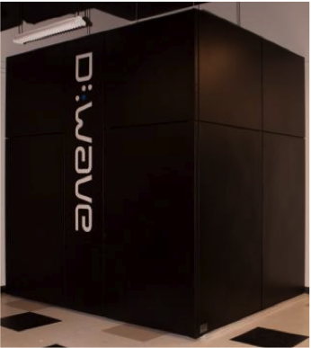
Quantum Computing to Advance AI

Slide 15
D-Wave Quantum Annealer
Example of already fielded quantum computing
Canadian firm; quantum processing confirmed
~ 2K Qubits, six-way connectivity => 16-way soon
Runs at 15 milliKelvin (colder than outer space)
One at USC, one in Bay Area (Google), DoD has ordered one

Slide 16
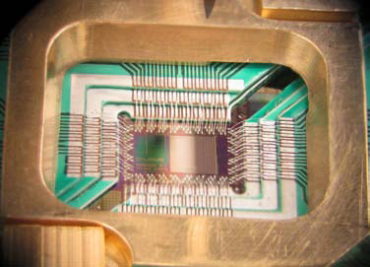
Image of an Early Quantum Processor

Slide 17
Use of Quantum Annealer
Two major uses have been confirmed
  Optimizations
  Complex pattern recognition
In AI context, potential in analyzing CT training:
  Deep Learning of huge data bases of test results
  Create human-like analyses of on-going conversations
  Recognize CT and creativity

Slide 18
CT Training Vision
Can emulate successful English Lit CT training
Using current teachers could provide library of clips
Deep Learning and Quantum-enabled AI could enhance
Computer agents could:
  Monitor
  Advise
  Question
― Direct
― Record
― Assess

Slide 19
Conclusions
Widespread interest but little to celebrate
Well-considered ideas and ideals (NGSS and Common Core),
Consumers continue to complain of poorly prepared students
Alternatives are well known and much espoused
Effective implementation is still lacking for many programs
Modern M & S technology can effectively augment instructors
Further pedagogic, algorithmic and hardware advances will help

Slide 20
Acknowledgements
This paper would not have been possible save for the experience, counsel, time and effort of Judith Jacobus, Erik Elstad, Laurel Davis and Johna Walsh, all experienced teachers who work in the Los Angeles Basin in Southern California. Also the support and encouragement from Professor William McComas engendered the sustaining interest in these topics. Naturally, while their input was heeded, any mistakes in analysis or conclusions are the authors’ own.

