Slide 1


Quantum Computing: Evaluating Potential Quantification of Psychological Projective Test Scoring
Dan M. Davis
Consultant, Uinv. of Southern California
Co-Authors: Kenneth Shaw, Sanad Z.Rizvi, & Dr. Mark Davis

Slide 2
Three Theses
Projective tests are valuable assets to understanding behavior and assessing psychopathologies, e.g. PTSD
Manual implementation of these tests present significant issues of evaluator bias, repeatability, and validity
Emerging capabilities in modeling and simulation can both deliver ameliorative solutions for current obstacles and provide future benefits and efficacies

Slide 3
The Projective Tests
Use of ambiguous stimuli (usually images)
Elicits hidden emotions
Most famous: Rorschach “ink blot” test
Hard to score and results are inconsistent
They are valuable and widely used

Slide 4
The Rorschach Test
Created by a Jungian Psychiatrist in 1920’s
Administrator sits with subject, presents ink blots
First presented a group, then individually
Administrator asks questions, e.g. “What do you see?”.
Scoring system parameters: color, form, texture, location, originality, ideation, etc.
Several scoring systems exist

Slide 5
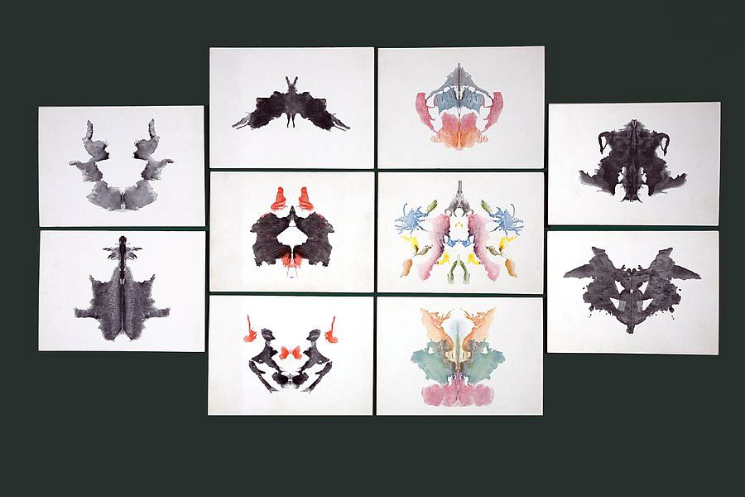
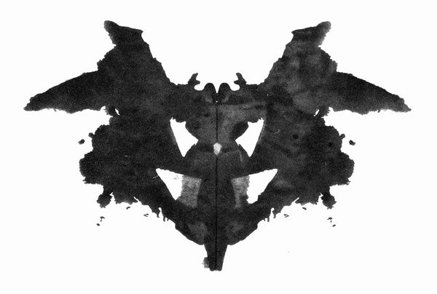
Rorschach Test Ink Blots

Slide 6
Thematic Apperception Test
Developed by Henry Murray in the 1930’s
Set (8-20) of evocative photos/paintings are shown
Administrator asks subject:
What led up to this?
What’s happening now?
Scoring is subjective; validity is suspect
Useful in identifying issues
― What are the people feeling?
― What is the outcome of the event?

Slide 7
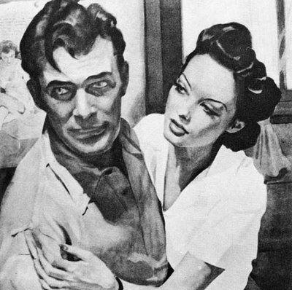
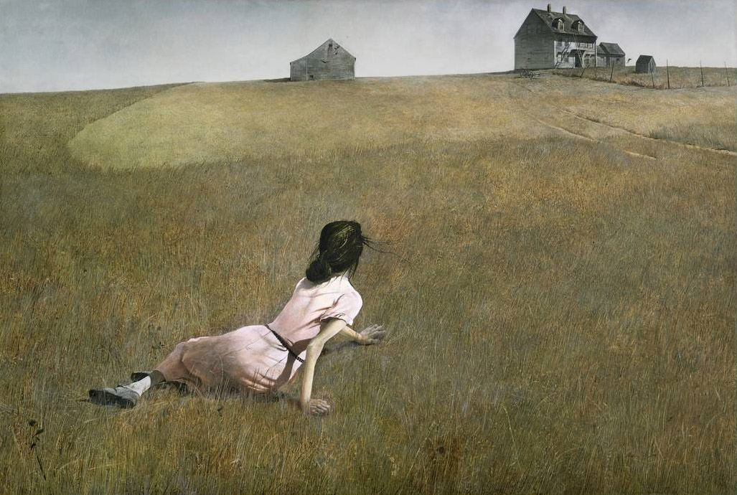
TAT Evocative Images

Slide 8
Draw a Person (DAP) Test
Developed by Florence Goodenough in mid 1920’s
Used mainly to evaluate children
May be diagnostic for psycho-pathologies; poor for IQ
Child asked to draw a man, a woman, and themselves
Numerical scoring based on features, organization, body parts, etc.
Adult use has been discussed

Slide 9
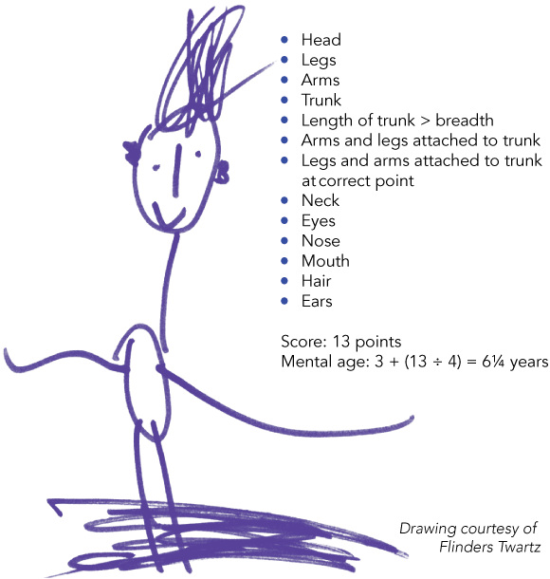
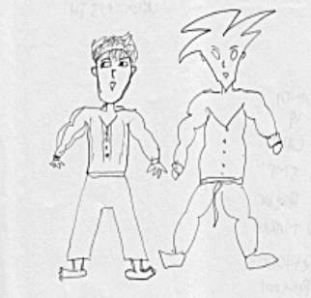
Draw a Person Examples

Slide 10
Artificial Intelligence (AI)
Common thread for these tests: very subjective
AI might identify correlations otherwise not seen
Responses and DAP images could be collected
Machine logging and image analysis performed
Associated test and subject histories considered
Correlations sought & validated
Diagnostic analysis program

Slide 11
Limits to Current Computing
Digital computing is nearing limits (Moore’s Law)
Data collected would need to be huge
Ethnic and social differences would be significant
Image recognition and analysis now beyond the pale
Detection of nebulous terms poor: creative, sensitive
Deep Learning needs power

Slide 12
Deep Learning
Called “Neural Nets on steroids”
More layers & interconnectivity, less manual input
Especially good for image analysis, e.g. X-rays
Depends on & can manage large labeled data sets
Projective tests have amassed huge data sets
Data form them is VERY heterogeneous/chaotic
Digital computing limited

Slide 13
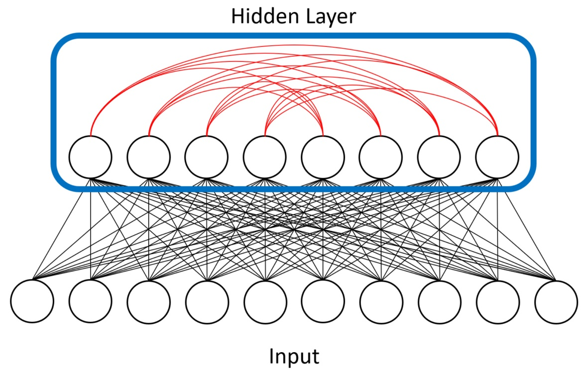
Deep Learning Diagram
Liu, J., et al. (2018). Adiabatic Quantum Computation Applied to Deep Learning Networks. Entropy, 20(5), 380.

Slide 14
Boltzmann Machines
Boltzmann Machines are a form of neural nets
Restricted Boltzmann Machines (RBMs) are related
These analyses require significant compute power
GPGPU’s a great boon to enabling RBM computations
Results are not deterministic, but good at ID’ing trends
Very good at feature learning and classification
Way forward for projective tests

Slide 15
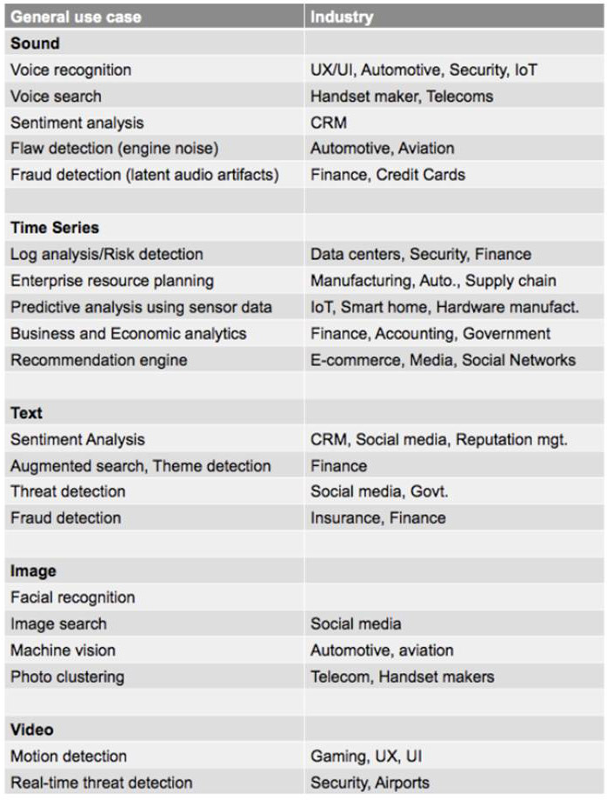
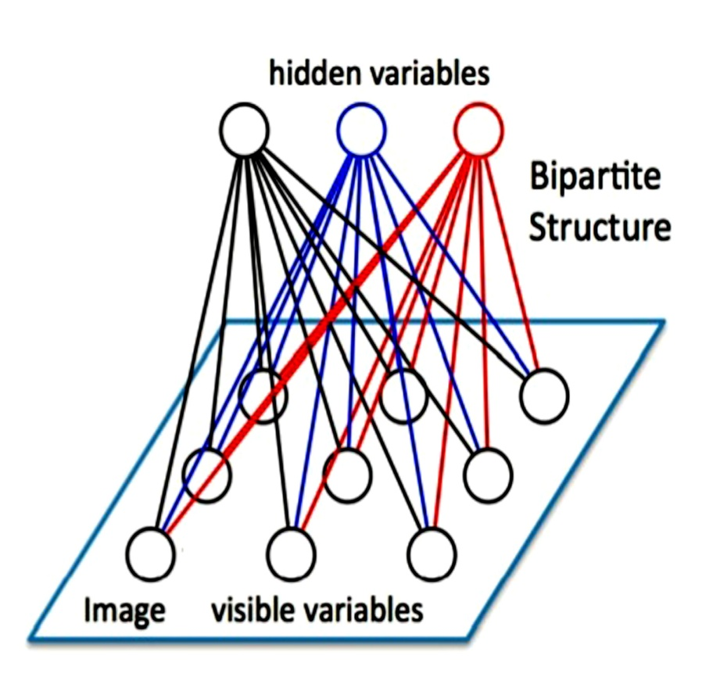
Boltzmann Uses and Diagram
AI Wiki: https://skymind.ai/wiki/use-cases

Slide 16
Quantum Computing
Richard Feynman suggested in 1985 article
Topic of great interest since then; dreams of power
Instead of binary datum, quantum values are shadowy
Can represent range of values simultaneously
Evaluates vast data possibilities simultaneously
Tailor made for projective test analyses
Recent advances significant

Slide 17
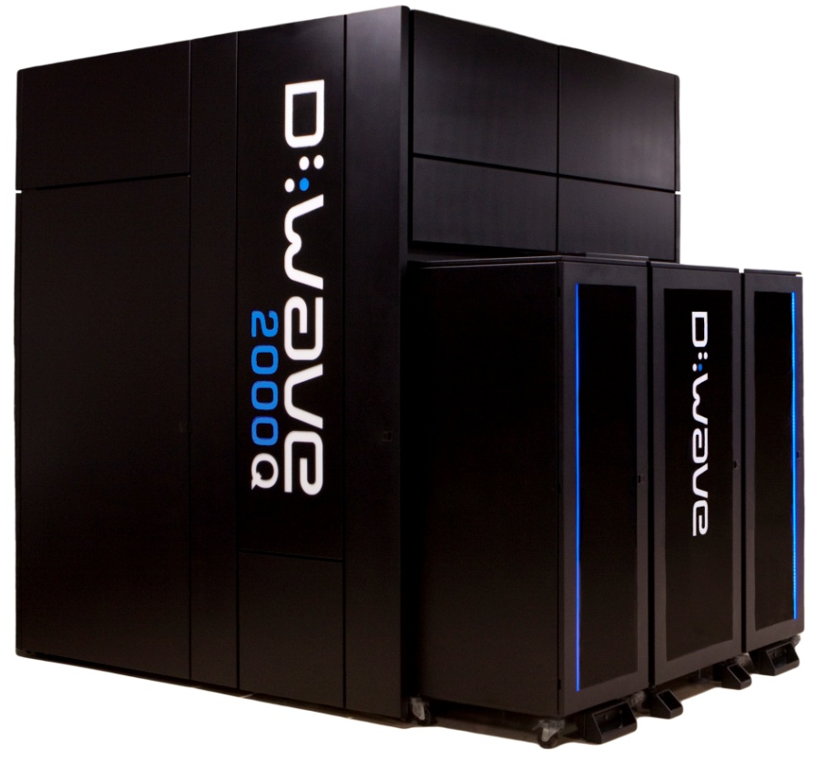
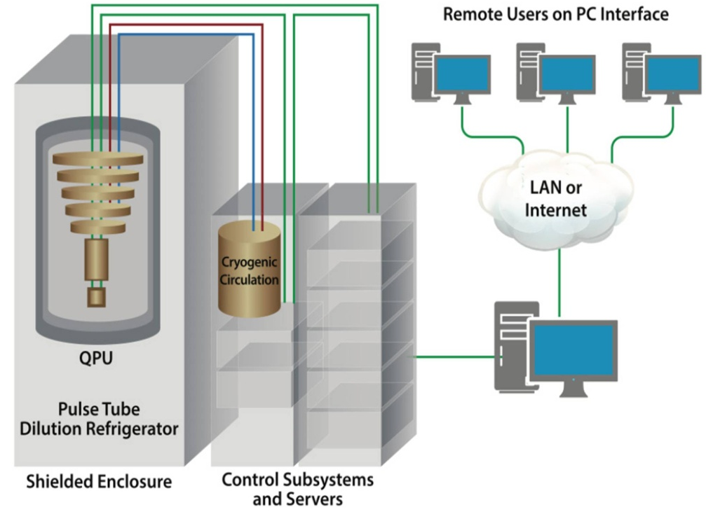
D-Wave Machine
© D-Wave images

Slide 18
Quantum Computers Today
Several firms have quantum computers of various configurations
Experimental version in most cases (IBM’s machine 5 and 16 qubits)
Canadian firm D-Wave has had operational annealer for several years
A Quantum Annealer is very useful for Projective Test analysis
D-Wave architecture is built on Boltzmann Machine model
Current model D-Wave has 2000 cubits (@ 15 milliKelvin, brr!)
USC model has been stable and useful for research
Current 6-way connectivity growing to 16-way in next generation
Other D-Waves at Google & Los Alamos

Slide 19

Potential of Virtual Humans (VHs)
One putatively effective method of reducing subjectivity: use VHs
Presenting test administrators via computer agent interfaces possible
Repeatability issues and administrator bias amelioration to be expected
Sensors could record multi-parameter data from subjects; speech, body language, tone
Testing in other venues shows good user acceptance, e.g. MentorPal
Smart Phone Version of USC’s MentorPal

Slide 20
Conclusions
The M&S community needs:
increasing sophistication
better identification of behaviors
new ways to handle vast amounts of data
ability to learn, analyze, and report projective tests
capacity for more human-like virtual conversational abilities
There are emerging technologies that hold promise
The most speculative of these is Quantum computing,
Existing hardware and expanding software should help

Slide 21
Acknowledgements
The authors would like to acknowledge that assistance and advice of Jeremy Liu, Ke-Thia Yao and Robert Lucas of USC in helping analyze the progress of quantum computing in the US and Benjamin Nye and William Swartout for their leadership as Principal Investigators of MentorPal. Nevertheless, the authors alone are responsible for the content of this paper and any mistakes therein are their own.

