Slide 1

Inculcating Metacognition and Critical Thinking:
Standards for Implementing Virtual Humans
2021-SIW-Presentation-006
Dan M. Davis, JD, ICT – University of Southern California, USA
With Frederica J. Stassi, EdD, Mark C. Davis, PhD
and Karen J. Ristuccia, DMin.

Slide 2
Major Theses
The major thesis of this paper is that technologies are emerging that will enable expansion of critical thinking and metacognition skills so that innate intellectual capabilities can better be made manifest.
This approach is vital to the optimal pursuit of defense organizational goals.
There are constraints that hinder inculcating such skills in DoD personnel and these constraints are not easily ameliorated.

Slide 3
Background
  Populations: have been at war for all of written history.
Combat: an unforgiving environment for the irrational
US has paid in blood: more accurate Civil War rifles
These lessons were not learned: this led to WW I losses.
Torpedo Eight at Midway battle: all were shot down
A fifth of names on Vietnam wall: did not die in combat
Virtual reality and virtual humans are emerging
They can be used to improve selection and training

Slide 4
Critical Thinking
Warfighters’ needs: logical capabilities and analytical reasoning
Good g-factor tests can measure intellectual capabilities
These tests have been extant for millennia
Courage can be tested to some degree
Testing “critical thinking” not so easy: need an independent study
Characterize the concept and Quantify the ability and potential.
Intellectual capabilities are susceptible to stress and fatigue

Slide 5
Metacognition
Definition: Thinking about thinking
First advanced by John Flavell late in the 20th Century
Disciplined process of analyzing one’s logical approaches
Warfighters may wonder what applicability it has for them
Quare: when might metacognition not be not productive
OR, defense experience & scholarly study support utility
It is a vital skill for the warfighter
Can metacognition and critical thinking be developed, implemented and sustained?

Slide 6
Natural Language Processing
Computers can be used to understand and manipulate Natural Language (either in text or in speech)
Natural Language Processing (NLP) is effective
It is a series of computational methods
Analyzes and manipulates natural speech in “real time”
One or more strata of linguistic techniques are used
Human-like language processing is useful for a range of tasks
Creation of engaging conversational exchanges are possible
Observations support that these often create realism and evoke emotional connection
Notes:
Tell story of PhD giving out K&R at IBM and the story of Probst’s giving out Strunk and White at EA

Slide 7
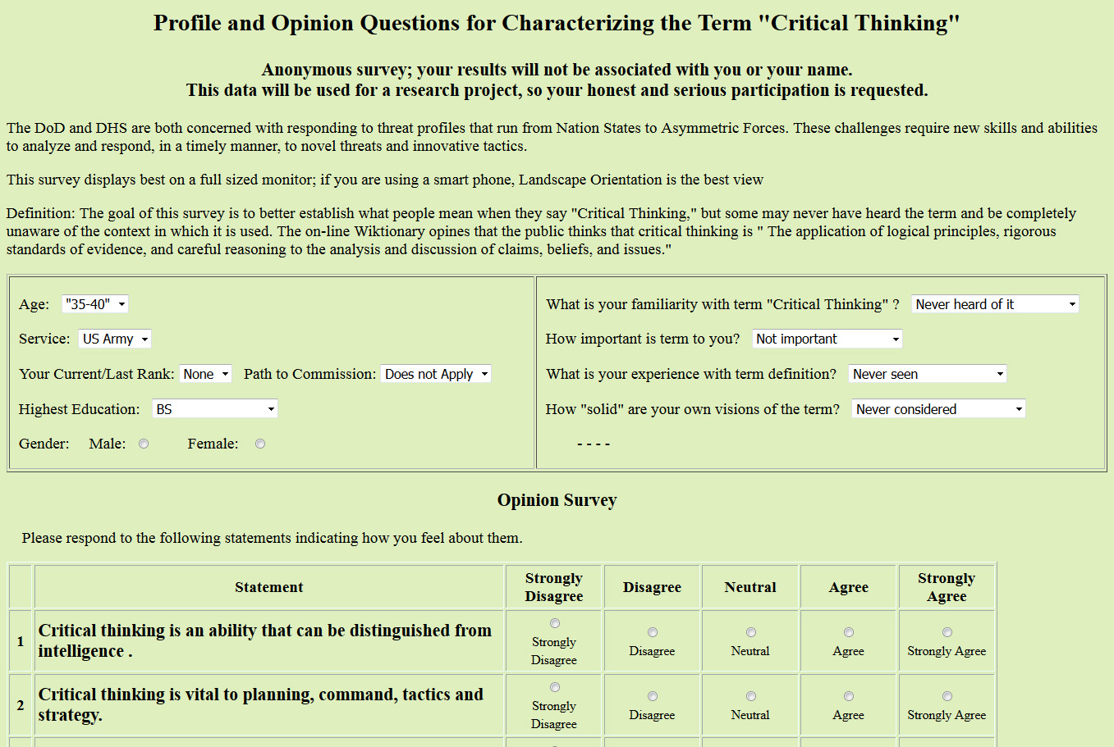
Definition of Critical Thinking
Establishing what the DoD Personnel may think Critical Thinking means
An informal survey to help baseline further study
Written in PHP and HTML – Likert Scale

Slide 8
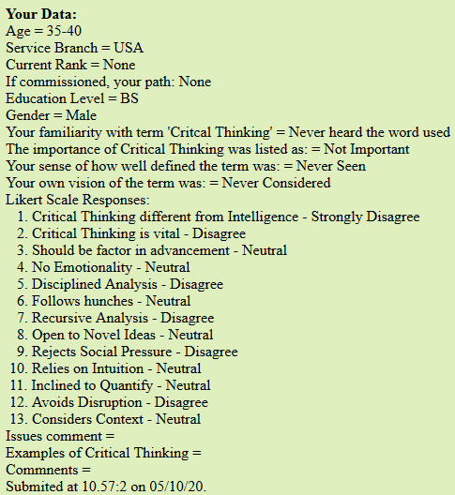
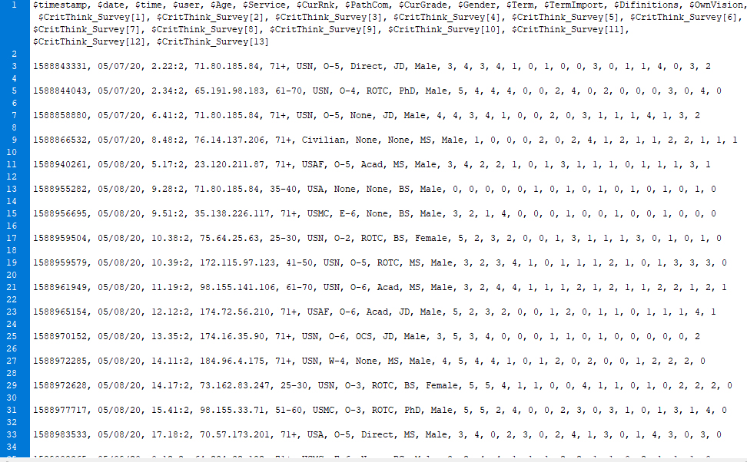
Polling the DoD
Important goal in research was to follow the leads of and to respond to the needs expressed by, the warfighters
Standards should reflect their needs
Left: feedback response to the poll participants
Below: the data format for the flat file used

Slide 9
Early Preliminary Results (N=60)
Familiar with term: | Term Importance: | Definition experience: | Own vision of term:
4 Never heard the term used 4 Have heard others use it 16 Have used it a little 20 Used it and am inter-ested in concept 6 Deeply Involved 10 Participated in Discus-sion | 11 Not Important 0 Interesting 24 Useful Concept 0 Important to 15 Important to me 10 Vital to all | 10 Never Seen defined 4 No Consensus 19 Aware of competing Definitions 27 Mine Evolving 0 I recognize a well defined consensus 0 Universal Term | 4 Never Considered 2 Nebulous 23 Open to new ideas 11 Will Adopt Others 20 Comfortable with my own 0 Committed to mine
Please feel free to participate in the study:
http://www.hpc-educ.org/Danz/CrtThnkSurvRedirect.html

Slide 10
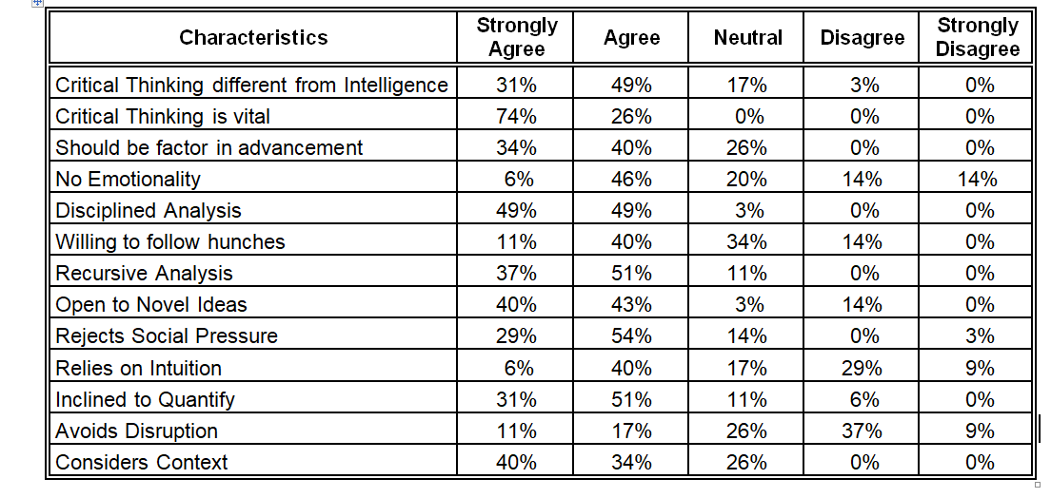
Preliminary Results

Slide 11
Current Pedagogies
Three principle way to improve analytic skills
Equally effective in both critical thinking and meta-cognition
Didactic – train use of rubrics
Socratic – drive critical thought by challenging
Constructivist – establish stimulating environment
Need very adaptable and committed teachers
Constrained by classroom disorder

Slide 12

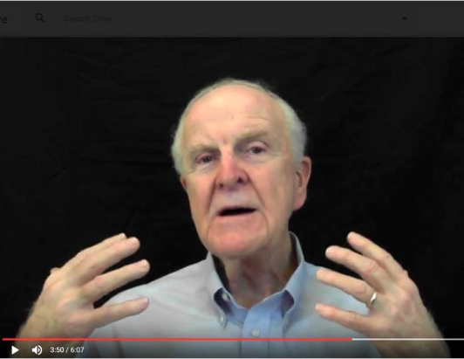
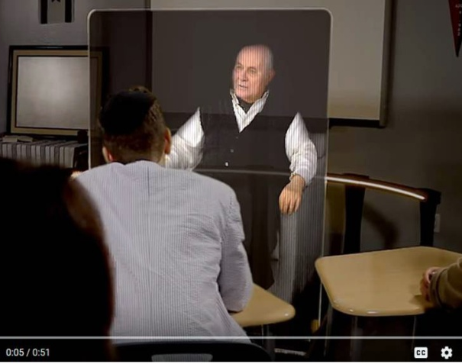
State of the Art: Virtual Conversational Agents

Slide 13
Emerging Technologies
Computer advances in AI and NLP
Various formats and interfaces available
  Animated avatars
  Video clips of instructors and interactive tutors
  Holographic 3D displays
  Voice recognition and conversational agents
AI, Deep Learning and Data Lakes
Can produce self-learning agents
Requires human monitoring
Careful establishment of figures of merit
Deep Learning should produce more realism
Challenge: develop questioning AI agents

Slide 14
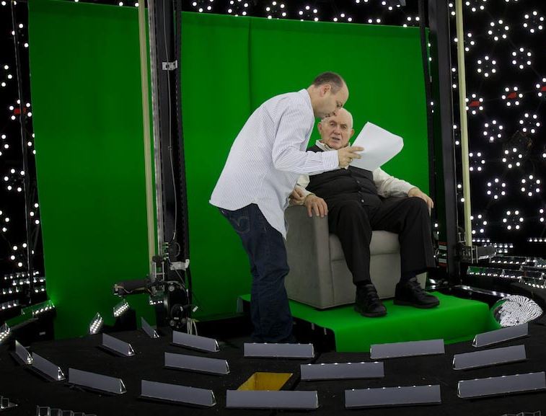
Ongoing Research
2D-SimCoach for VA patients
3D-New Dimensions in Testimony archives “survivors”
MentorPal to advise High School STEM students
Benefits: Scalability, training, consistency, and compliance
Entertainment industry arts and skills valuable experience

Slide 15
Metrics
Major issue in this area is the lack of metrics
Without metrics, it is difficult to recognize the impact.
Lack of consensus on what critical thinking means hinders this
SISO specializes in creating standards and psychometrics
Concerted effort is required
Some of the emerging technologies discussed may enable analyses that will facilitate this metric creation and validation
SISO has a role in pursuing this

Slide 16
Implementing a Practicable Methodology
 | Individualization | 24 X 7 Access | Teacher Charisma
Didactic | Classroom Size of 1; self paced | Open class scheduling | 1 hero teacher, but scalable to all
Socratic | Focus questions on 1; others not idled | Mentor available globally | Private forum for challenge
Constructivist | Different environment for each student | Pause button on situation | Different levels of coach’s support

Slide 17
Benefits of Approach
Emerging capabilities are enablers of powerful set of A/I programs to deliver mentors, tutors and instructors 24 by 7, … millenia
Anywhere there is network connectivity.
This capability has the real potential to improve battlefield success
Technical feasibility of these programs has been shown
NLP interfaces, and high production-value videotaping can deliver
Effective assessment and training of Critical Thinking and Meta-cognition are within the reach of the DoD and the Nation

Slide 18
Acknowledgements
Much of this work mentioned in the presentation was supported by grants from the Office of Naval Research's STEM Program (ONR N00014-16-1-2820) and by assisted by students supported by the National Science Foundation Research Experience for Undergraduates program (NSF 1560426). Nevertheless, the positions taken in the paper are the authors’ own and do not represent in any way the views of the Department of Defense or the US Government.

Slide 19
Questions

