Slide 1

Communications Management Plan for Technical and Terminology Standards
2021-SIW-Presentation-015
Dan M. Davis, ICT – University of Southern California, USA
Co-Authors: Milton Rosenberg and CAPT Daniel P. Burns, USN (Ret.)

Slide 2
Major Theses
The development of a communications management plan is necessary for effectively reaching the community to produce the impact that standard’s professionals seek. Further, it is asserted that the study and analysis required to formulate and implement such a plan will not only result in improved recognition and use of the standards, but the process itself will generate otherwise overlooked insights into the needs for, uses of and modifications in those standards.

Slide 3
Background Experiences
Early work at University of Colorado (1970’s)
Jet Propulsion Laboratory (JPL) in ’80’s
Imposed Standard: ADA
Caltech research at CACR in Parallel Computing
Standards: DIS as well as HLA and RTI
Large Scale computing and the use of GPGPU’s
Standard: CUDA language for GPU non-graphic use
Communications hurdles for technical personnel
Time spent communicating

Slide 4
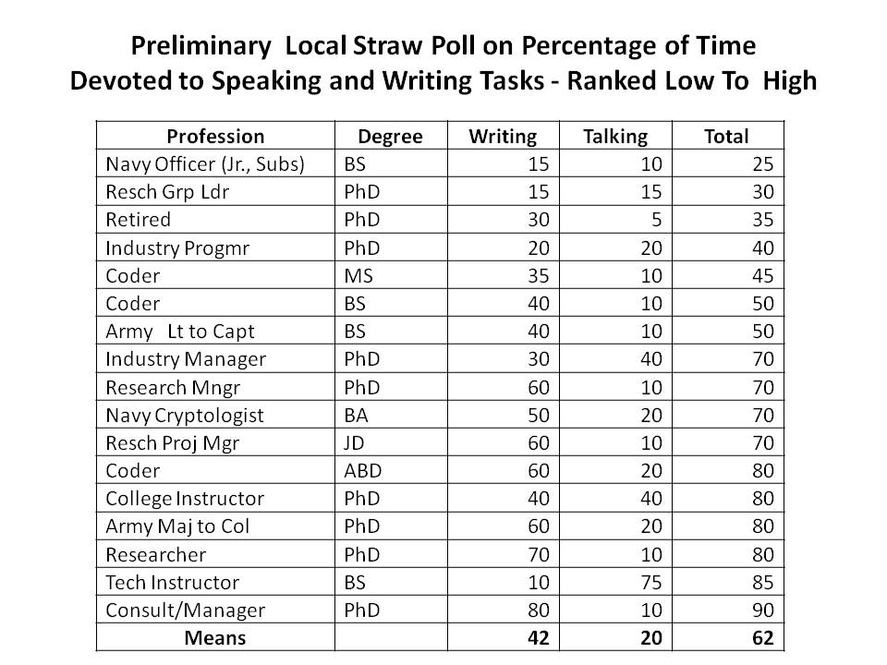
Time Spent Communicating
Preliminary local Straw Poll:
Self-Reported Percentage of Time Spent on Speaking and Writing Tasks
Ranked Low to High
Mean = 62%

Slide 5
Does the Research Community Communicate Well
Writing across the Curriculum
  Goals – better writing
  Metrics – money spent, campus acceptance, students trained
  Self-evaluation – spent money, induced lip service, got students
Personal experience at several schools
Visit from a CEO who was PO’ed about poor STEM comms
Capabilities: Natural Gifts or Training Products?
Is there a role for SISO?

Slide 6
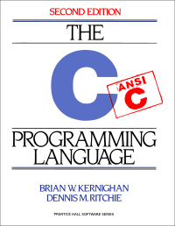
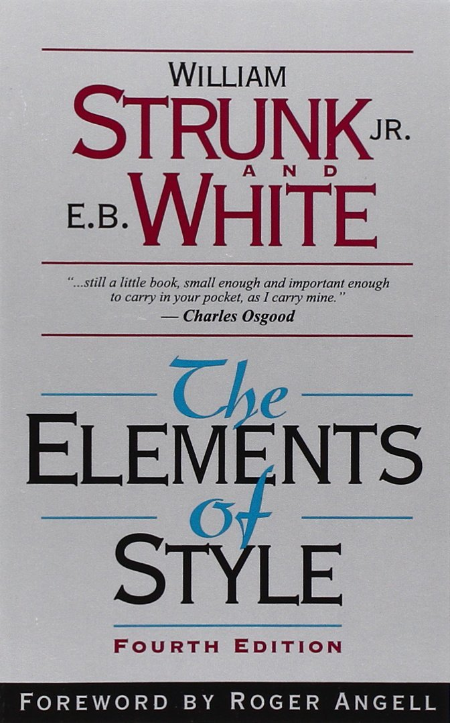
K & R vs. Strunk & White
IBM used to give out free copies of K&R, but a major game company now has to give out Strunk & White because their programmers can’t write well
Notes:
Tell story of PhD giving out K&R at IBM and the story of Probst’s giving out Strunk and White at EA

Slide 7
What SISO Functions Require Support
Communication of Findings
Garnering of Recognition
Solicitation of SISO Funding
  Government Grants
  Membership fees
  Foundations
Research/Standards Synergy
Instruction of STEM Students
Early recognition of needs
Promulgation of Standards
Monitoring of Use(s) in Field
Proposing New Standards
Modification of Old Standards
Nurturing Professional Status
Recognizing Achievements
Encouraging Scholarship

Slide 8
To Whom Might SISO Communicate
The Standards Communities
The End Users of the R & D
The Research Community
  Government Labs
  Academia
  Industry
The Funding Communities
The Professorial Communities
Legislative Champions
The Public
The War Fighters
  Procurement
  Logistics
  Training
Students
“Players to be named later”

Slide 9
What Might a Communications Plan Diagram Look Like
It might be illuminating to look at an example
This one is take from a project at USC
The Navy was funding USC to improve STEM interest
The project was managed through the NRL
Our manager was a PhD civilian
We had little contact with Naval personnel
DDavis was the only veteran on the USC team

Slide 10
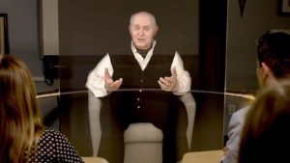
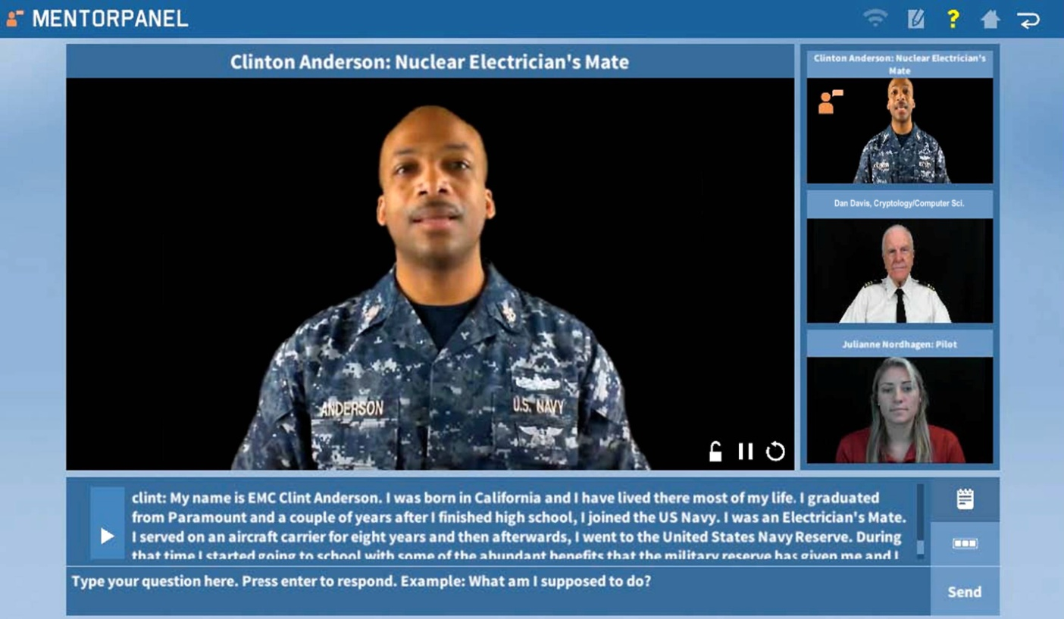
Standards Issues
Current ICT work: Holocaust Survivors
Creating engaging virtual conversations
The New Dimensions in Testimony Project via NLP and 3D Hologram
Need for mentors in careers
Mentor Pal via NLP and Video Clips
What is it/she/he: Real, Virtual, ???
Why does it matter
Can these issues be addressed

Slide 11
Communications Flow Chart
Communications Flow Chart for Mentor PAL (Personal Assistant for Learning)
Legal
Provost
Direction
Campus CO
Campus HR
Funds
Pers Needs
New Hires
IP Office
Issues
Counsel
Ex Dir, ICT
Contracts
HR Mgr
Status
Proposals
New Ideas
New Interest
Co-PI’s Mentor PAL Proj.
Findings
New Ideas
New Work
PM
Consultant
Programmers
Subjects
Student RA’s
Summer Interns
Academic
Navy
Community
Progress Evaluation
Evaluations
SME Input
New Ideas
New Interest
NRL Program Manager
New Work
End User
Researchers
Contract Office
Active duty Pers
Contacts
Other offices
SME’s and Reviewers
Requirements
Other
Warfighter
New Concepts

Slide 12
Communications Management
Perform a situation analysis.
Define Organization’s goals and objectives.
Define the key input communities and cognizant audiences.
Identify information flow channels.
Establish a schedule, with recursive revision milestones
Identify a person responsible for each
Evaluate the results and instantiate enhancements

Slide 13
Impacts Anticipated
Improved analysis of standards creation, adoption and revision
Better recognition of standards, both definitional and physical
Increased visibility of and respect for standards processes
Enhanced viability of standards institutions, e.g. SISO
More productive research and technology development
Improved defense capabilities and reduced personnel losses

Slide 14
Conclusions
Current communications may (MAY) be open to improvement
Without optimal communications, optimal efficacy cannot be achieved
A communication management plan is a recognized way to both assess and improve that function in all phases of standards life cycles
The cost of the implementation of such a plan would
easily be justified by its anticipated benefits

Slide 15
Acknowledgements
Virtually all of the work involving Virtual Humans reported here came from a series of research projects of which the Principal Investigator was Dr. Benjamin D. Nye, Director of Learning Sciences at ICT. Without his technical vision and unflagging support, none of this would have taken place. The various projects mentioned were supported by a range of DoD organizations and, while this paper reports insights gained during that work, that was not the focus of the research. Much of this work was supported by grants from the Office of Naval Research's STEM Program (ONR N00014-16-1-2820) and by students supported by the National Science Foundation Research Experience for Undergraduates program (NSF 1560426). Nevertheless, the positions taken in the paper are the authors’ own and do not represent in any way the views of the Department of Defense or the US Government.

