Slide 1


Instantiating “Humanity” into Virtual Humans: Boundless Opportunities; Daunting Obstacles
SISO XR Study Group
Dan M. Davis
for the Institute of Creative Technologies
University of Southern California, USA

Slide 2
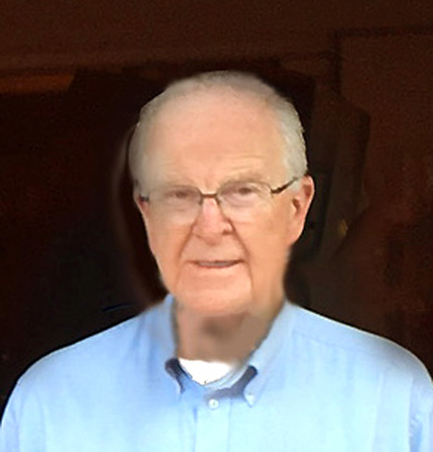
Greetings from Dan Davis

Slide 3
Major and Minor Theses
Major Thesis: XR is a vital approach to insuring that we put more human-like behaviors in simulations intended for training, education and motivation, as well as for the more analytic functions of analysis and evaluation
Minor Theses:
Increasing sophistication in the users demands enhanced simulated human behaviors
Disciplinary “silos” and technical focus on programming skills can inhibit progress in realism
XR will accelerate the multi-disciplinary approach necessary for resolution of problems facing developers

Slide 4
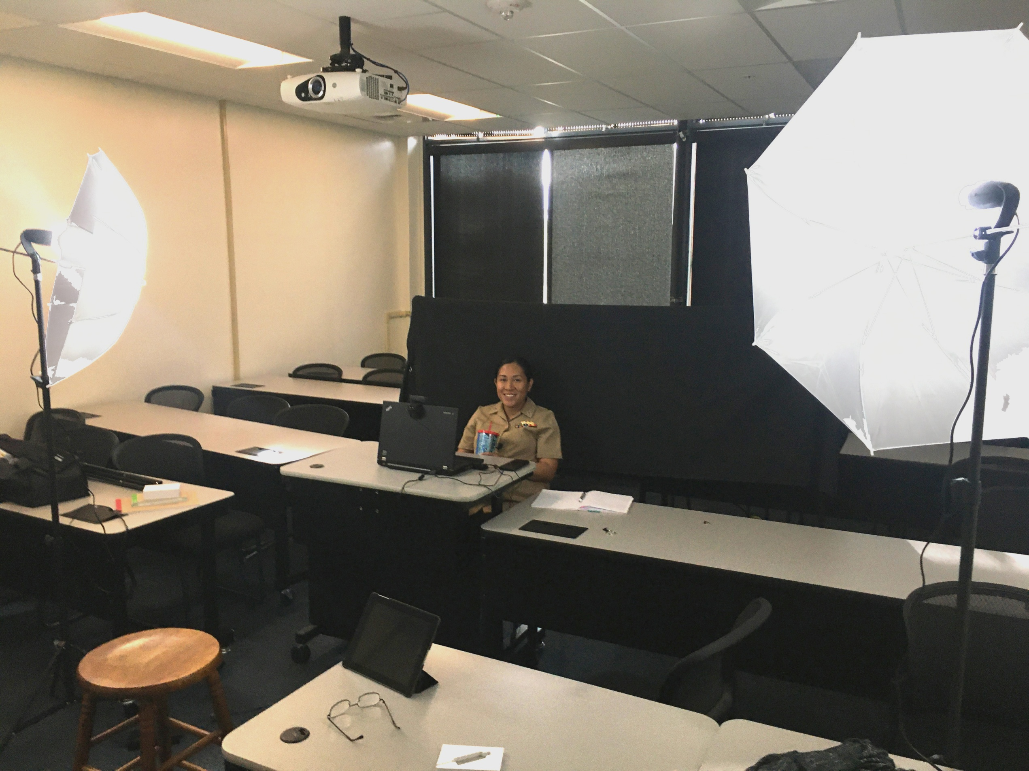
Studio for a Live Officer Mentor to be “Virtualized”
The “library” of advice from virtual mentors begins with asking a live officer questions about Navy careers, usually about 600 to 1,500 questions. These are then edited into short, 2 minute answers and the text is transcribed and vectorized for retrieval by the Natural Language Processing (NLP) program, to match the student’s question in <500 miliseconds.

Slide 5
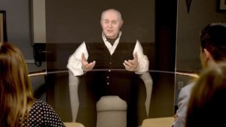
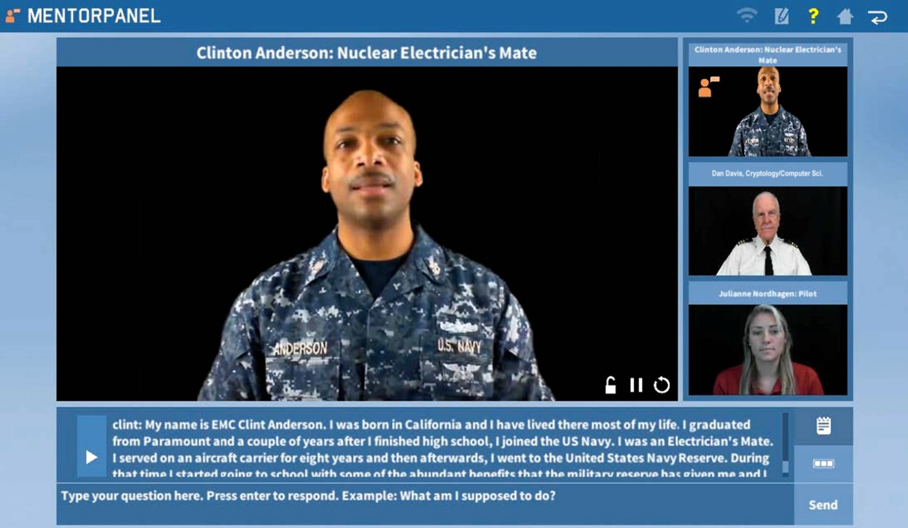
Who Needs XR Capabilities NOW?!?!?
Current ICT work: Holocaust Survivors
Creating engaging virtual conversations
The New Dimensions in Testimony (NDT) Project via NLP and 3D Hologram
How does Günter respond to apology?
Need for mentors in careers
Mentor Pal via NLP and Video Clips
Students didn’t know what to ask
Live person could sense hesitancy
Can these issues be addressed

Slide 6
A Few Things that are On the Table
Questions arise about which technologies are now emerging
There are a wide range of needed capabilities:
3-D visualization of data and environmental context
Immersive experiences in dynamic surroundings
Appropriately paced reactions to behaviors
Subjective visual clues to support simulated emotions
Presentation of and reaction to unexpected events
Ability to initiate relevant conversation

Slide 7
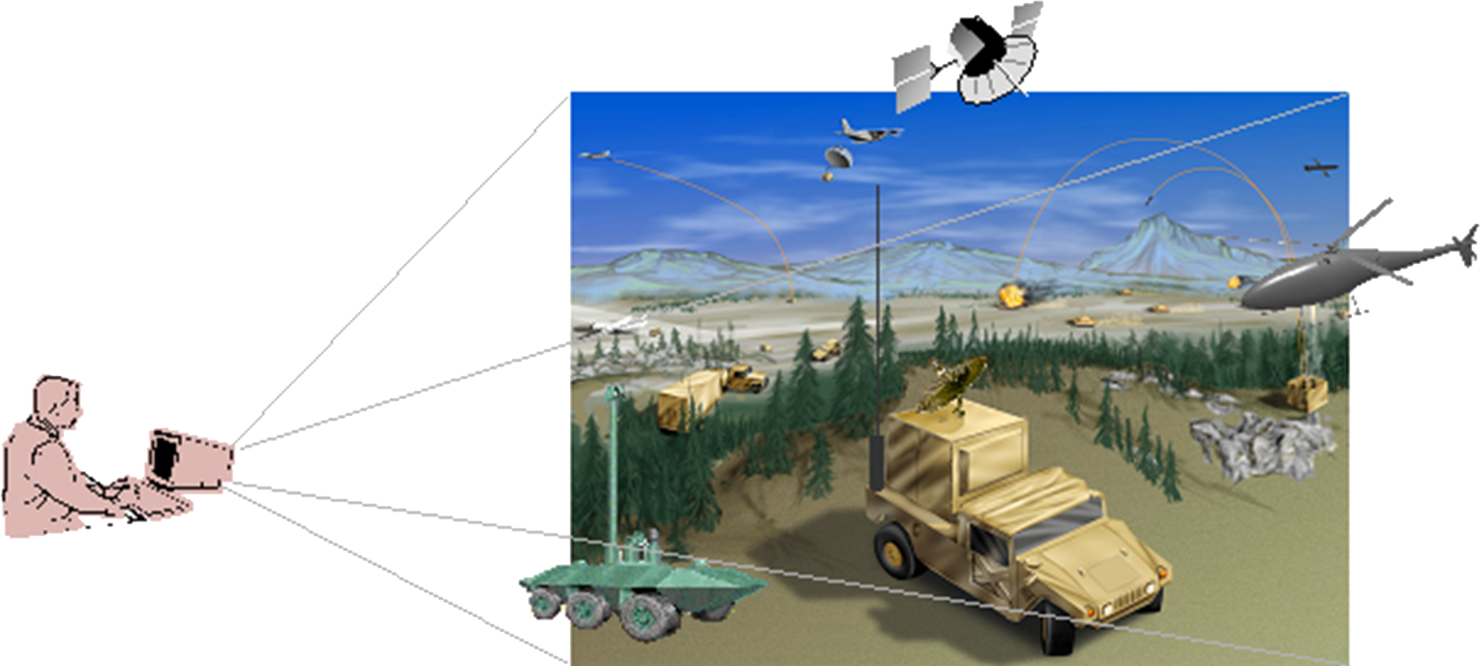
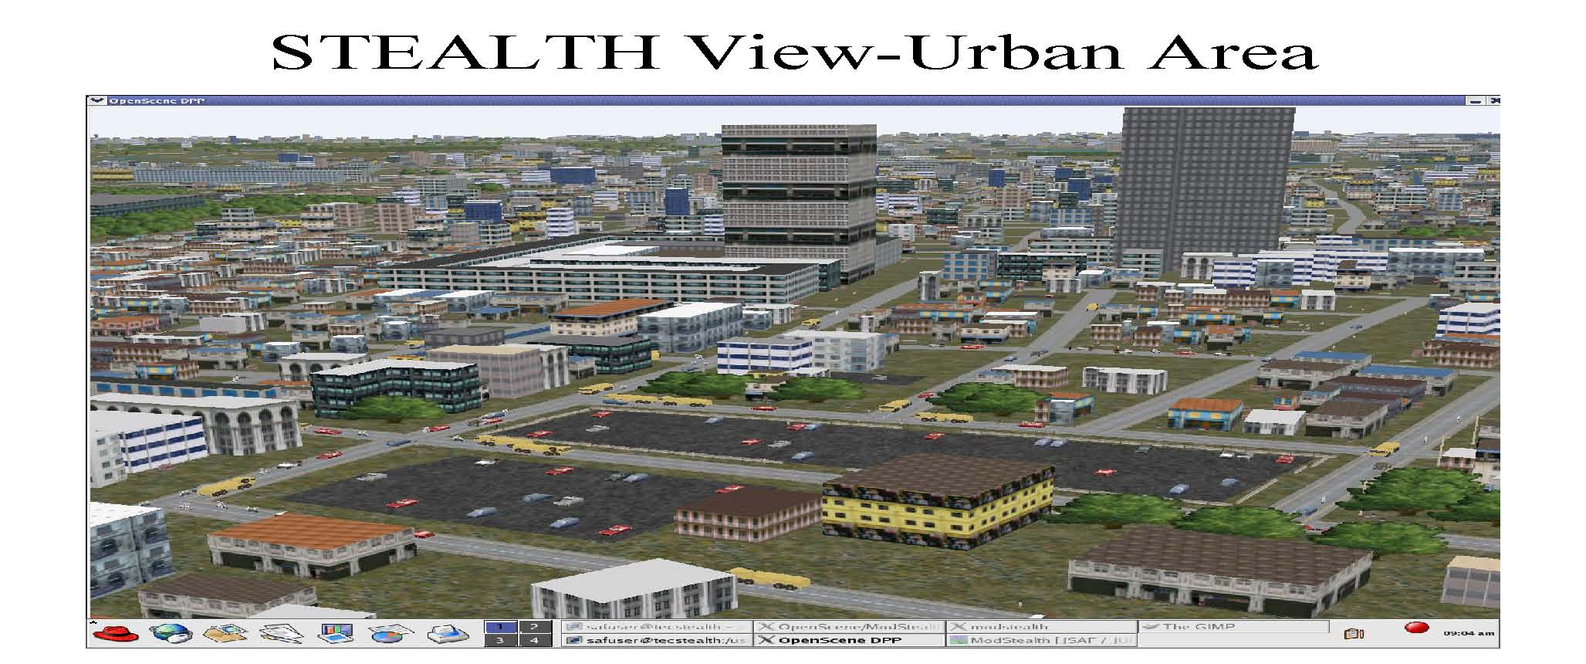
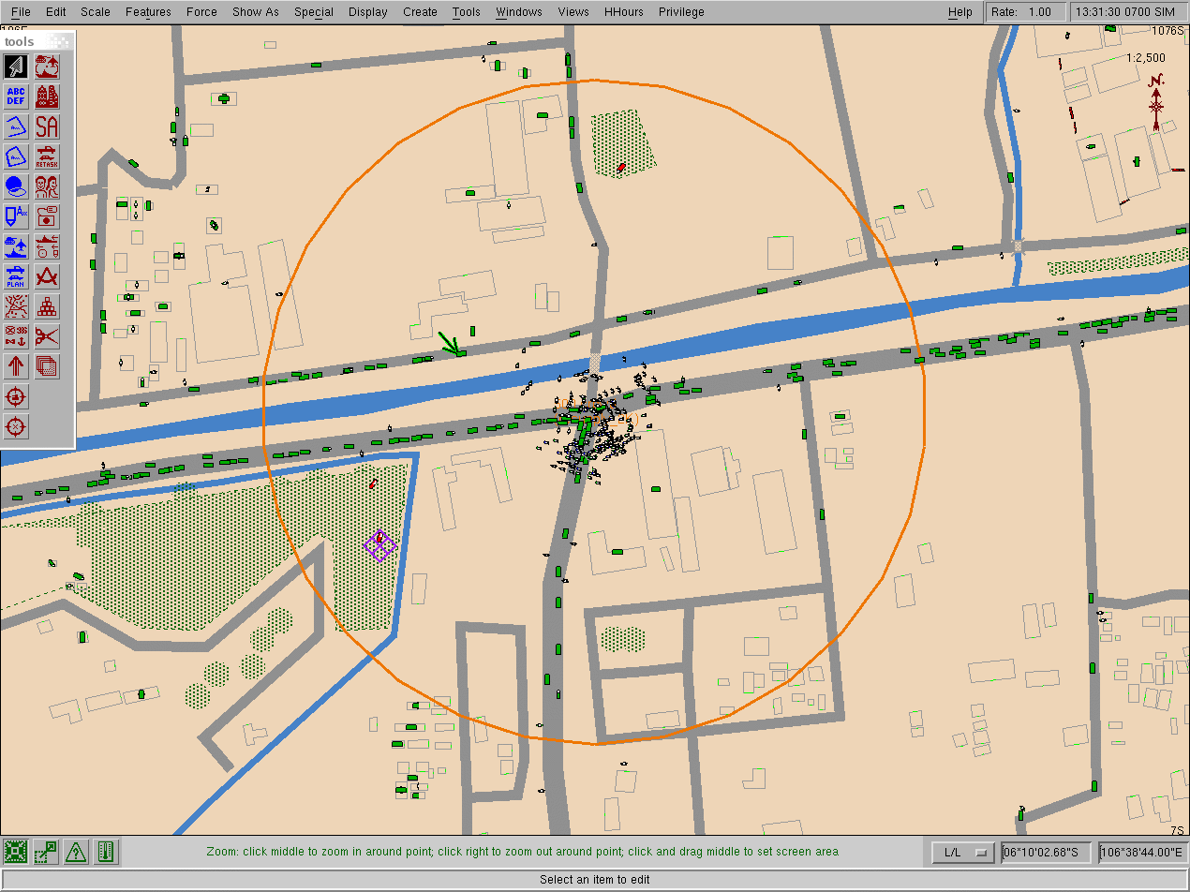
Need for Behavioral Science
Simulations are seductive in suggesting uniform behavior
JSAF effort in the 90’s was good example of this phenomenon
Easy for programmer to order compliance by the troops
Harder for human commanders to insure the same
Work of Kahn at Princeton and Ariely at Duke show this

Slide 8
Issues to Address in USC’s NDT Work
At ICT we need to enhance the NDT program to respond better to user emotions
If the person is in tears, the subject (Günter) would respond to their
This requires a multi-disciplinary use of several technologies. Issues:
sensor evaluation of the user
body language of the subject
subject’s facial expression
A live person would see this and respond accordingly or inappropriately
This requires additional emerging technologies from the XR palette:
artificial intelligence
computer learning
deep learning
These are not fantasies, but technologies that need XR to enable their use
oral response of the subject
fast re-evaluation of subject’s reaction
awareness and consideration of others there

Slide 9
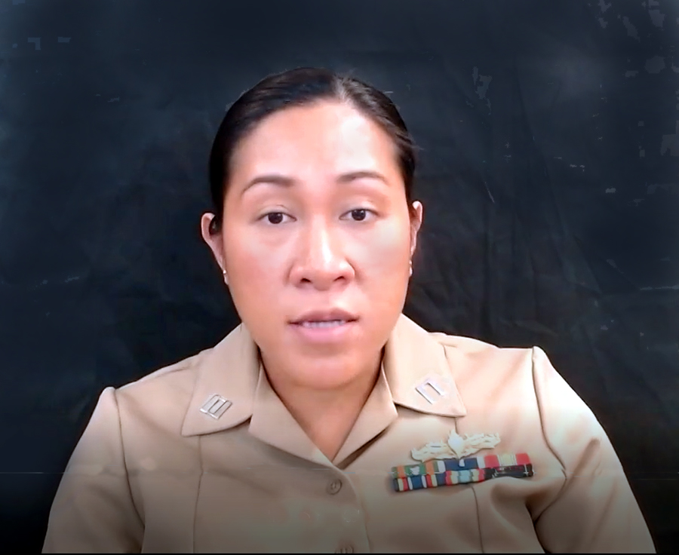
Issues to Address in USC’s MentorPAL₃ Work
The Mentor PAL₃ Project needs for XR to enable humanness:
Real time assessments of primary user
Real time assessments of all who are part of the “audience”
Organizing information for the user based on layers of insight:
  User current openness to new data
  User’s ability to process information presented
  User’s changing attentiveness
Stimulating and motivating pursuit of issues
Assess efficacy for user and in general for other users
Sense when the dialogue mode should be replaced by other media
Manifesting appropriate mood and communicated emotion to subject mentor
…
Such a range of issues cannot be addressed by a single creation of reality.

Slide 10
Challenges for the SISO Community
Coordinating the manifold and disparate realities will neither be trivial nor painless
Identifying and separating them will require rigor, critical thinking and cross-disciplinary collegiality
Among other issues are the wide-spread acceptance and adoption of various institutional and technical standards
Metrics
Terminology
Interface specifications

Slide 11
Conclusions
Many types of reality and combinations of them are now extant
This has created a new universe of opportunity for training, analysis, evaluation, therapy and mentoring not otherwise available
Be it Cross Reality or Experiential Reality, XR can be the correct instrument to bridge the gaps and provide the way forward
SISO has an obligation to be the driving force for that effort.

Slide 12
Acknowledgements
Virtually all of the work involving Virtual Humans reported here came from a series of research projects of which the Principal Investigator was Dr. Benjamin D. Nye, Director of Learning Sciences at ICT. Without his technical vision and unflagging support, none of this would have taken place. The various projects mentioned were supported by a range of DoD organizations and, while this paper reports insights gained during that work, that was not the focus of the research. Much of this work was supported by grants from the Office of Naval Research's STEM Program (ONR N00014-16-1-2820) and by students supported by the National Science Foundation Research Experience for Undergraduates program (NSF 1560426). Nevertheless, the positions taken in the paper are the authors’ own and do not represent in any way the views of the Department of Defense or the US Government.

