Slide 1


Stemming Migrations from Engineering to Liberal Arts:
Enhanced Computer-Generated Mentor Standards
2022-SIW-Presentation-003
Dan M. Davis, Catholic Polytechnic University
and University of Southern California, United States
Co-Authors: CAPT Daniel P. Burns, Dr. Jennifer H. Nolan & Dr. Mark C. Davis

Slide 2
Major Theses
One major thesis of this paper is that Computer Generated Realities provide promise in addressing a major impediment to graduation of Engineers. Another is that these personnel are needed to sustain the technical ascendancy of the United States and its allies. On of the impediment is the flow of Engineering students over to Arts and Sciences before the students' second years at the university. More than half of incoming engineering students abandon technical training. Also reflect a misconceived image of the engineers, exacerbated by media portrayals and the dearth of skilled mentors. The ability of Computer-Generated Mentors (CGM's) to compensate for many of these short-comings is advanced, outlined and justified.

Slide 3
The Target for this Concept
This effort is intended to address engineering graduation rate shortfalls
It will suggest the creation of on-line mentors for students
Issues of importance include
  Terminology
  Data management standards
  Interface definitions
  Metrics
There are many issues of concern to the standards community
The role of communication is critical

Slide 4
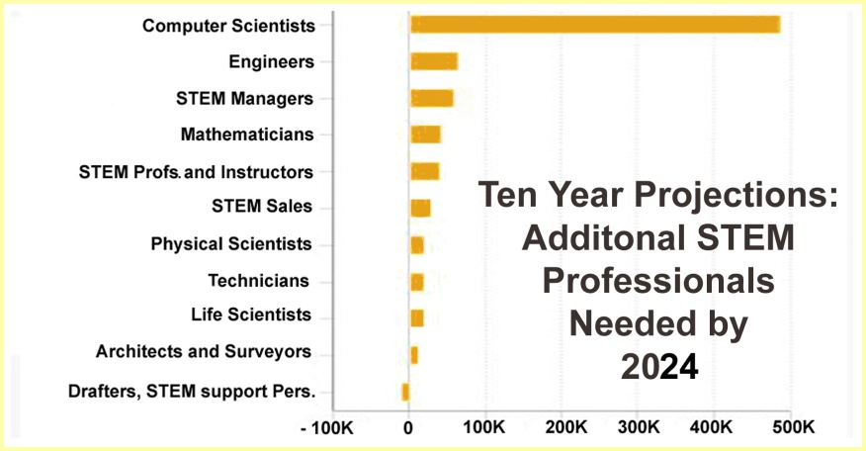
Is there a “Shortfall”
These professionals are:
  Our people
  Users of our contributions
  Needed for our nation’s defense
  Vital to our society’s progress and life
The numbers are for additional people, over the replacement rate
Be aware that there is an attrition rate that may be larger than the retirement age rate
Many professionals find other careers or become functionally obsolescent

Slide 5
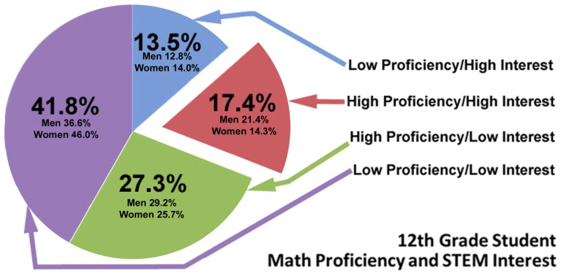
Status of Student Situation
One of the issues is who is out there in the population:
  Who is capable
  Who is interested
  Who is open to being convinced
  Who is better advised to seek other careers (13.5% in the graph)
  Who might be capable and ready for a new career
Need to live in reality
Note that graph to right shows 70% low proficiency in math
These numbers impact both STEM in general and standards directly
This community requires a unique blend of skills

Slide 6
What has been causing the migrations
Not a new phenomena
DoD can force the issue in the service academies and ROTC programs
What are some reasons for migrating:
  Incapable of doing the level of math
  Poor preparation in our K-12 system
  Capable but not “willing”
  Negative image of the profession
All exacerbated by lack of engaging and accessible mentors

Slide 7
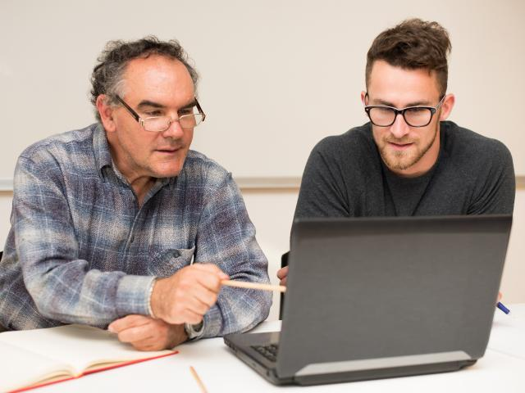
Characteristics of a good STEM Mentor
Mentorship is essential in (STEM)
is a set of skills to be learned
  Communications
  Collaboration
  Engagement
  Empathy
  Technical fluency
  Loyalty
Accessibility is often a challenge
Geographical and temporal hurdles

Slide 8
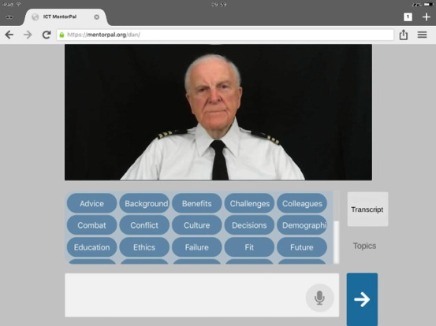
A Computer Generated Mentor?
There are several Computer-aided mentors in development
Using emerging capabilities from the M&S Community
One example (of many) is the finished MentorPal project at USC
Advised High School Students about STEM careers in the Navy
Effectively showed students were engaged by the on-line computer agents from library of video clips

Slide 9
Capabilities grew out of M & S
Creating simulated experiences has been a function of military training for centuries, if not millennia
From abstractions as sterile as the chess board to as physical as the Olympic Games, goal was to engage the users to alter them
Alteration sought in this case is not combat readiness, but increased commitment to career in STEM
The issue that might be raised is whether M & S can effectively engage the emotions of the user
Early attempts e.g. chess &the Olympics may have been too remote
Later efforts proved much more arousing of human reactions

Slide 10
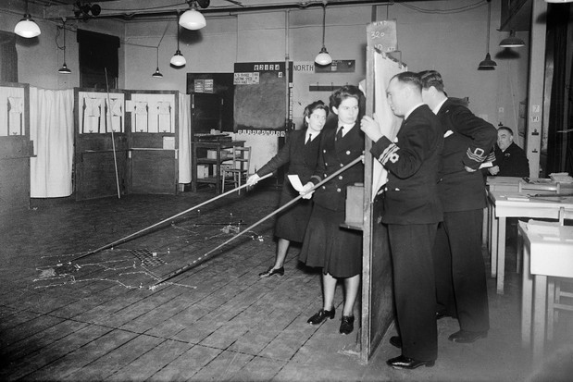
Emotionally Engaging Simulations
Pre-digital games were played out in physical simulations
Picture to right is a WW II Royal Navy anti-submarine exercise
As crude as it may seems, the participants found it very absorbing
Officers stand behind screen as the WREN’s manipulate ship tokens
Digital simulations even more emotionally arresting.

Slide 11
From Training to Education to Mentoring
Prof. Clayton Christensen reported how companies get focused on how they can do what they do better and miss other opportunities
Is there a duty to use the capabilities at hand to address the future provision of adequate STEM workers
The battlespace simulations have morphed into a conversational mentor to foster Navy STEM careers
Can that be used as a model for making inroads on the STEM professional drought that is predicted?
What might the impact be?
What might the risks be?

Slide 12
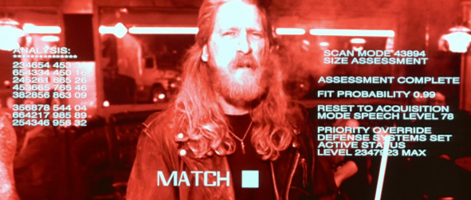
Augmented Reality with Virtual Mentors
Accessibility is one of the primary goals of Virtual Mentors.
That need is usually seen a function of geographic or socio-economic distance between mentor and mentee
Now real-time assistance from Augmented Reality (AR) is possible
The Terminator got AR
assistance when needed
Envision, if you will, having
a Virtual Mentor with you
at all times and everywhere
Ethical risks are daunting

Slide 13
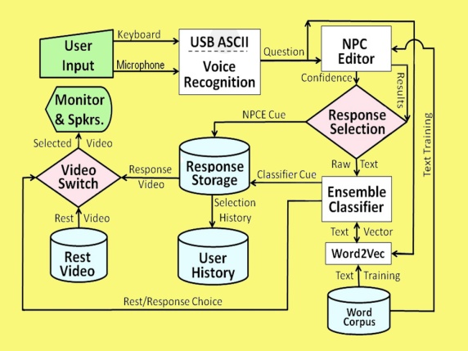
Overview of Virtual Mentor Data Flows
This is a basic simple diagram of a robust and effective virtual mentor
This mentor is reactive only, but work is underway in several centers to make the mentor more capable
This flow chart has produced a viable and effective mentor
Adding features to make the mentor more able to initiate conversations is possible

Slide 14
Conclusions
There is a putative shortage of STEM Personnel in the future
The population that could fill this need is small indeed (~ 45%)
Of that populations segment, more than half are uninterested
There are about 14% who are interested, but may not be capable
Several of the issues that keep the capable for finishing may be amenable to Mentoring support to overcome societal negatives
Mentors are hard to find, evaluate and engage
Virtual mentors can be tailored and implemented
They are accessible, regardless of geographic, socio-economic and temporal constraints.

Slide 15
Acknowledgements
The authors wish to thank all of their live mentors; without them we could not have contributed as well as we did. We should also note that much of the work cited was supported by grants from the Office of Naval Research's STEM Program (ONR N00014-16-1-2820) and by research assistants supported by the National Science Foundation Research Experience for Undergraduates program (NSF 1560426). Nevertheless, the positions taken in the paper are the authors’ own and do not represent in any way the views of the Department of Defense or the US Government.

