Slide 1


Resurrecting a 55-Year-Old Program:
Standards for Emerging Proactive Interaction
2022-SIW-Presentation-005
Dan M. Davis, Catholic Polytechnic University
and University of Southern California, United States

Slide 2
An Old Concept Made Real and XR
There is an emerging technology: "XR". Virtual Reality(VR) and Augmented Reality(AR) have begun to overlap, leading to Extended Reality or XR. The emergence of this concept has spawned many approaches to plethora of issues. Mental health and speech therapeutics might benefit from this new capability. In 1971, the ELIZA program was conceived at the Massachusetts Institute of Technology (MIT). It was an attempt at Natural Language Processing (NLP) and virtual conversations. It fell short of the mark due to technical limitations. There was subsequent progress with NLP. The constricting limitations of the Eliza instantiations may have been dramatic, but the ability of XR techniques to address them is remarkable. This had led to a viable Virtual Therapist. This opens up a serious discussion as to interface standards and metrics, but especially safety standards. Some of these will entail both computer code functions to identify dangerous situations and effective live-human oversight.

Slide 3
Time, Progress and Standards
The passage of time seems to bring out images of recycling issue
Progress inevitably seems to make the improbable realizable
The question may be: How does the Standards Community:
  Recognize the issues in a timely way
  Facilitate the achievement of the goals
  Hinder progress
Following along the trail of a multi-decade quest may illuminate this
Back in 1971 there was a project attempting a mental health agent
The University of Colorado (CU) was furthering the work at MIT: ELIZA
The machine: CDC 6500; the Code: Fortan IV and SNOBOL 4.

Slide 4
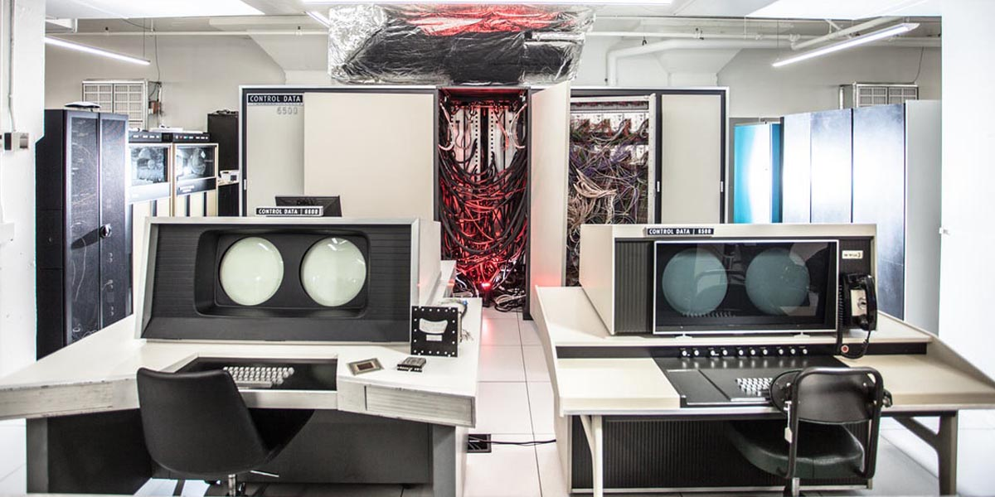
When a Mainframe Computer was Mainframe
CDC 6500 at Purdue, similar
to the one at Colorado Univ.
CPU, RAM and interfaces in
cabinets behind the two
work-stations
Two high-speed reel-to-reel
shorter tape decks on left wall
behind CPU
Input – IBM punch cards
Output – very noisy line-printer or very slow Modem and IBM 2741 Selectric Typewriter (Selectric with electronic interface RS-232-C)

Slide 5
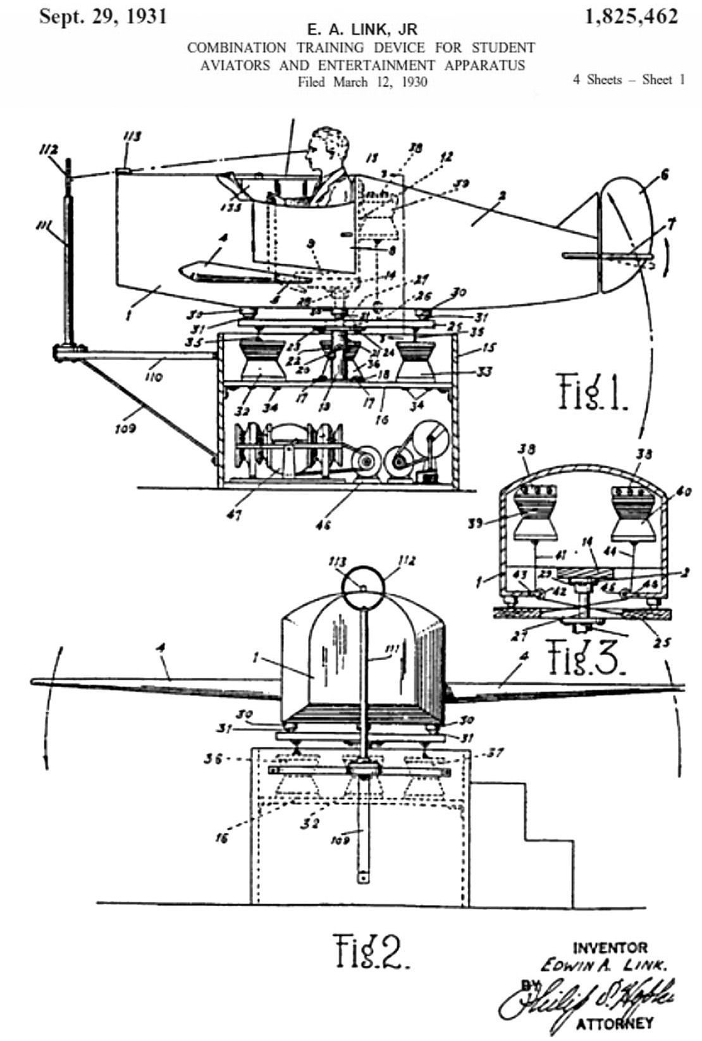
Simulators before the Digital Age
Still in use in 1970’s, these Link Flight Trainer simulators were electro-mechanical
They did not require any advanced input like the CDC 6500 or IBM 360/370.
Therefore, they did not require any interface standards or compatible terms
Memories of that time seem to indicate standards were more the forte of mechanical engineers
Even the imaginative MIT ELIZA team seem to have no great vision of a therapist

Slide 6
Progress, Technologies and Standards
The early work at MIT was not very encouraging and progress, while steady, always seemed to leave the impression: maybe next year.
Nevertheless, progress was spurred on by three drivers
  The explosion of computing and then the internet in ’80’s and /90’s
  The advent of the computer gaming societal segment
  The drive of the military to provide more effective simulations
All of those brought the early 21st Century and another life for computer-generated agents that were effectively conversational
Advances in NLP allowed very rapid selection of appropriate responses, that then were delivered by a range of different ways.

Slide 7
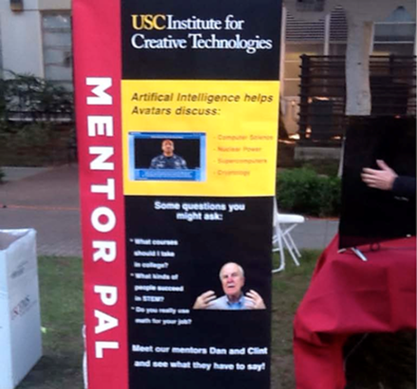
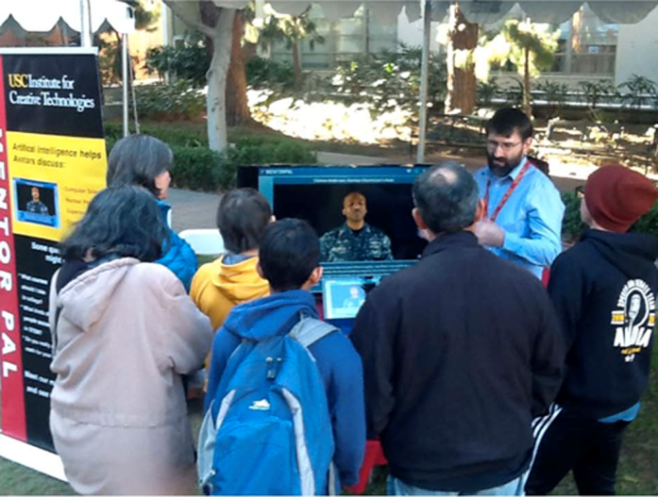
Creating “Conversationality”
Three technologies have enabled a sort of conversation: Voice Recognition, NLP, and Learning Analytics
Using easily acquired equipment a series of video clips were created making up a library of several hundred
These clips were answers by an engaging mentor
The questions were generated by a team at USC
It included young Cadets from USMA and staff
When users pose questions, the program selects
the most appropriate answer in <500 msec.
A field trial was held at a USC career day event
on campus that was well attended.

Slide 8
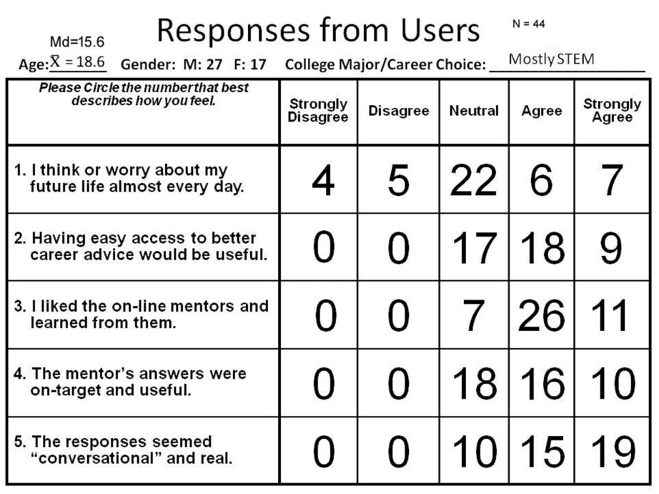
Are Computer Agents “Conversational”
The question was: “Were the students able to converse.”
This was assessed in two ways
  The users were observed
  The users took a short straw poll
Both modes seemed to support the “conversationality” of the program
When orally debriefed, the users complained more about the GUI
Some were very excited about the experience; adult users even more so.

Slide 9
Formal Standards
As the decades have passed, increasing complexity and dispersion of hardware and personnel have led to the need for formal standards
The most preeminent of these have been the interface standards to ensure disparate functions of large-scale simulations can operate
Now, with human factors and the behavioral sciences involved, the need for human-oriented standards may come into play
Especially with the possibility of doing irreparable psychic harm or inducing suicidal thoughts, an new set of standards may be needed
Testing and approving a device to reduce suicidal tendencies may be more difficult than the format for position and orientation data

Slide 10
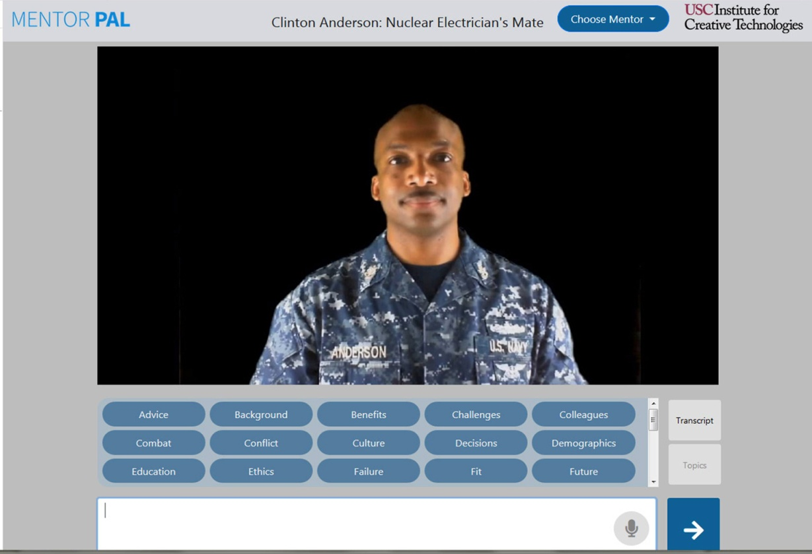
Complexities of Helping the Therapist Out
Putting together a therapist may be
within the grasp of current technology,
but standards may be difficult
The technology exists today to present
a responsive computer agent like this
one
In order to make it able to initiate and
change conversations is within reach,
but it will involve some development
Learning Analytics may help understand the role of the individual and this may lead to a better approach to a genuinely “caring” therapist

Slide 11
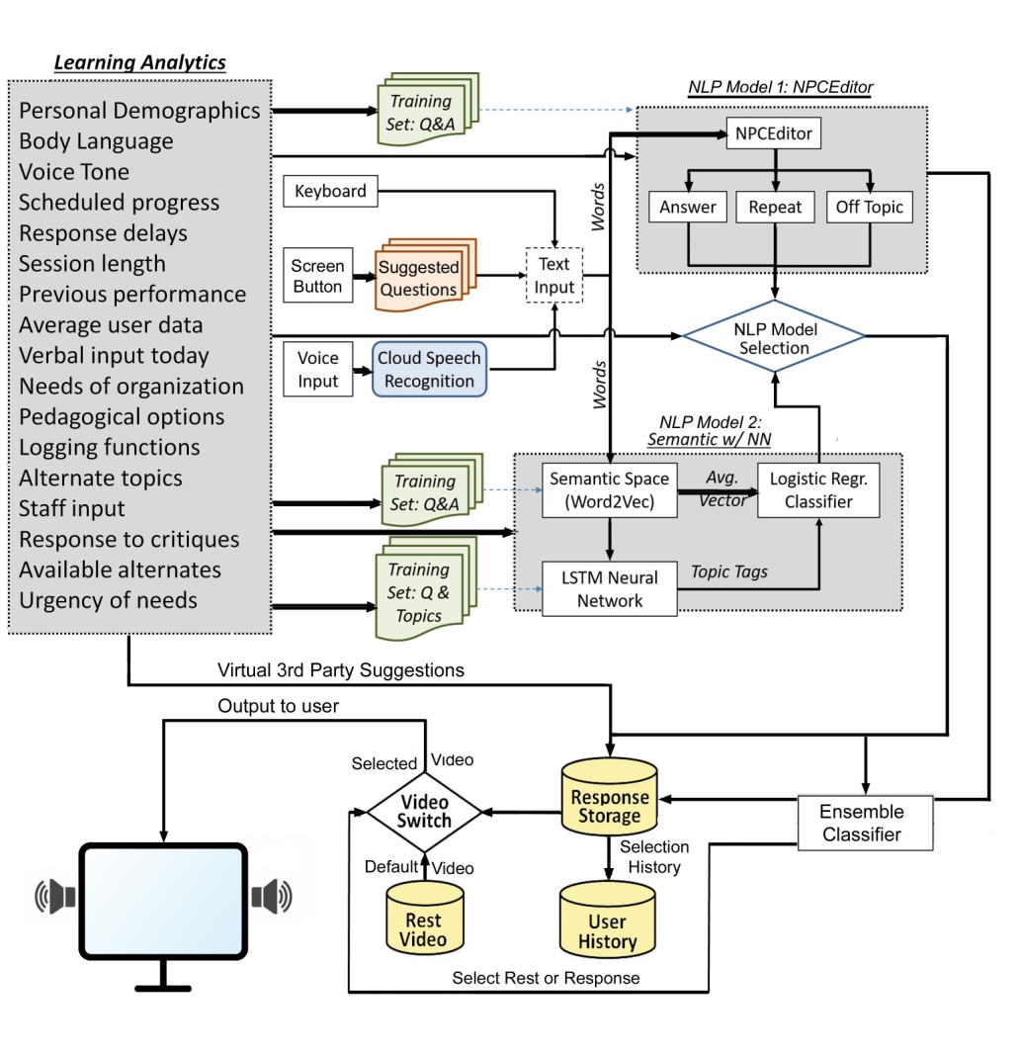
Conversation Initiation Enters the Flow
To add the initiation of conversation and topic changes will require a number of other inputs
The ones envisioned for Learning Analytics should be of invaluable assistance in the implementation phase
The left-most gray box in the flow chart shows some candidate parameters

Slide 12
Conclusions
An early goal of high performance computing was a virtual therapist
If fell short of the mark and lay dormant to some degree for decades
It now is demonstrably possible to have a nearly life-like conversation
Standards have come and gone for interfaces, metrics and terminology
There are still some un-met goals; conversation initiation is one
Interactivity could improve with more sensors, e.g. body language analysis
That complexity in hardware, algorithms and coding will require standards
The need is there; the technologies are emerging; the standards will be needed for such a sensitive set of circumstances and such valuable assets

Slide 13
Acknowledgements
The authors wish to thank all of their live mentors; without them we could not have contributed as well as we did. We should also note that much of the work cited was supported by grants from the Office of Naval Research's STEM Program (ONR N00014-16-1-2820) and by research assistants supported by the National Science Foundation Research Experience for Undergraduates program (NSF 1560426). Nevertheless, the positions taken in the paper are the authors’ own and do not represent in any way the views of the Department of Defense or the US Government.

