Slide 1


XR Standards - Conversationally Adept Virtual Humans:
Autonomous Combat Team Members’ “Incarnation
2022-SIW-Presentation-014
Dan M. Davis, Catholic Polytechnic University
and University of Southern California, United States

Slide 2
Issues Confronting the Community
There are needs for standards in the Modeling and Simulation (M&S) community to facilitate the extension of XR. There is also a the rapid and accelerating progress in virtual human behavior. The future of such technology trends is extrapolated. Technology now provides various non-human operational entities that be infused with doctrinal guidance and controlled locally by a human. The man/machine interfaces are critical and demand analysis. The benefits of using non-humans for dangerous tasks must considered. The introduction of human control via augmented reality and its impact on human controllers would be major issue. There is a need to discuss the avenues of research in Artificial Intelligence to avoid violations of standards or US humanitarian mandates. These issues are considered in a way that should be extensible into other areas with similar issues.

Slide 3
The Tradition of Treating Tools as Humans
The world is changing at an ever-increasing rate
This is adding to the stress on everyone
Among the most highly stressed have always been men in combat
There are many ways to relieve that stress, some of which are pernicious and insidious
One of the more benign has been to anthropomorphize objects
Machines are given names, weapons become friends, airplanes are decorated with and addressed by images and names of loved ones
Something seems to drive people to humanize inanimate objects

Slide 4
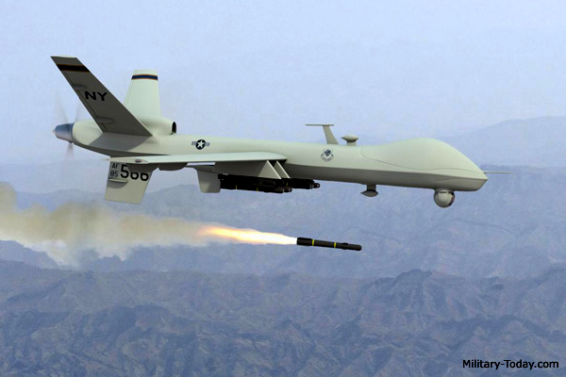
Distancing as a Psychic Defense
People are inclined to treat others poorly if they can “de-humanize” them
This can often lead to ethical and moral abuses to which civilize people object
This distance is becoming even more severe as the separation increases, both geographically and operationally
Note the drone in the picture
It may be half a world away and there may be half a dozen intervening systems between it and the operator meting out death with its missile
Augmented Reality may be able ameliorate both of these problems

Slide 5
Augmented Reality and More
Augmented Reality has given new promise to assisting humans
By various methods it can facilitate and influence
It may also unintentionally cause a human to react in undesirable ways
If all of life gets reduced to digits, even the living may seem of less consequence
The evolving field of Extended Reality (XR) literally brings a new dimension to this situation
By synergizing VR and AR, it is now technically feasible to present a simulated, VR, reality in a way that will augment and clarify situations

Slide 6
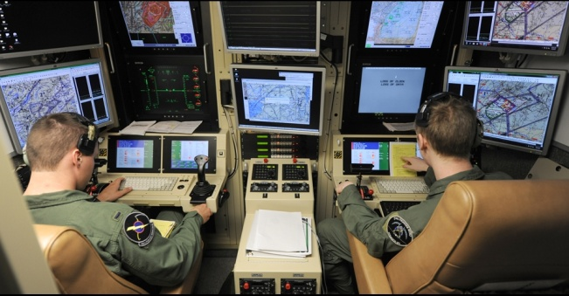
Humanizing the Inhuman
The drone pilots below are the ones half a world away
One wonders, have they given their drone a name
If they did, does that give them a connection they want or need
If this turns out to be an action of worth, should it be fostered
Further humanizing the device by “manning” it with a avatar might heighten the effect
Making a small robotic vehicle look like a soldier may have the same effect on the infantry

Slide 7
An AR Humanized Inanimate Object
Such digital anthropomorphization is within the current capabilities
Fully functioning animated or video taped people can be computer generated to the satisfaction of the users
Using digital technology, such computer agents could easily be superimposed on inanimate objects
The effects of such a system are unknown and the authors take no position on the results, but suggest the interest in its impact
The more immediate questions are
Can it be done?
What standards are likely to be in play?

Slide 8
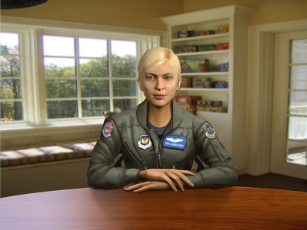
Nearing Photorealist Animation
Assuming the technology to superimpose an
animated character over an inanimate one,
what would be the image in the user’s eye?
There is evidence that slightly photorealistic
images do have a significant effect on users
One piece of data was that a program called
SimCoach was develop for the VA using several
animated counselors, one of whom is shown in the picture above
These gave advice to PTSD sufferers and the data showed the patients spent more time on the phone and delved into deeper emotional topics than the other patients did with a live counselor on a Skype call

Slide 9
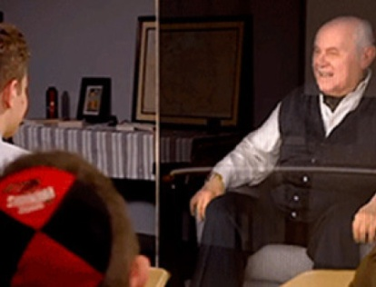
3-D Holographic Video Clip Displays
Another project was built around the holocaust survivors
These hologram videos were shown in classrooms
They were so moving, many people wept openly
More movingly, one college student went so far as to apologize to “Gunter” (shown here), all the while knowing it was a computer generated conversation

Slide 10
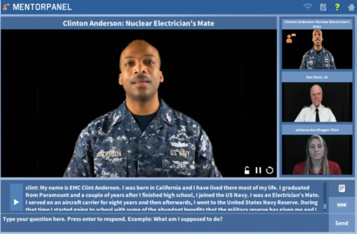
Standard 2-D Displays
Naturally, widely available 2-D electronic displays also very effective
Shown here is Chief Anderson in a MentorPanel display
This kind of image could easily be superimposed in a Video Headset or on a control monitor, but would have more constraints as to motion and orientation than an animation

Slide 11
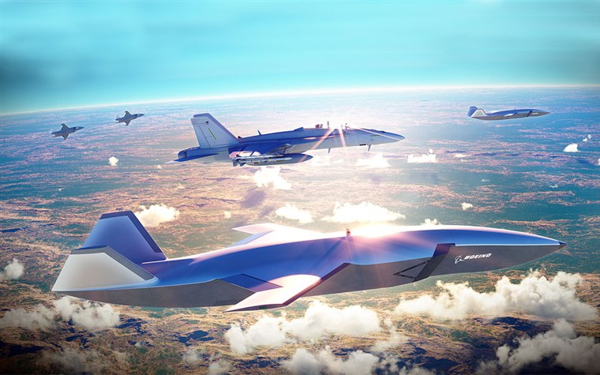
Establishing the Impact
Here is a manned plane with several drone “wingmen”
The question is, would he act differently if there was a cockpit with a “pilot” on each plane? Would it be better?
The standard’s community should be a participant in developing the needed interoperability and metric standards for such an effort.

Slide 12
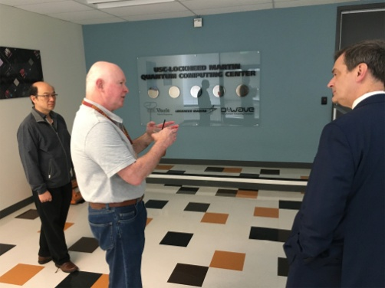
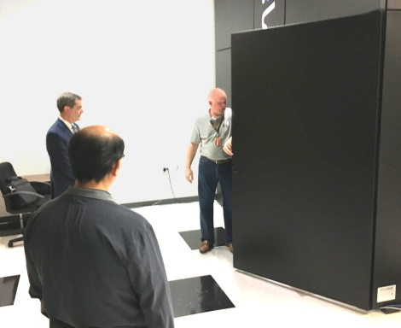
Creating Reasonable Actions
The vast range of potential actions and resultant movement, orientations and state changes boggles the mind
Some of these could be produced locally, but some would require high-speed, broad bandwidth communications to larger servers.
Some may even require the non-deterministic analyses promised by the quantum computers
Here, the scale of one, is shown during a briefing to a director from DHS

Slide 13
Observations and Conclusions
Combat personnel have anthropomorphized weapons and vehicles since time immemorial; some say it relieved some of their stress
The advent of simulation, VR, AR and XR have done much to make these simulations increasingly real
The impact of that may be positive or in may insulate a person from their humanity to a dangerous degree
Further anthropomorphizing objects and now well within the realm of possible efforts to give a life-like image to the objects
Such an effort would be well served by the standard’s community’s deep involvement from the very beginning

Slide 14
Acknowledgements
The authors wish to thank all of their live mentors; without them we could not have contributed as well as we did. We should also note that much of the work cited was supported by grants from the Office of Naval Research's STEM Program (ONR N00014-16-1-2820) and by research assistants supported by the National Science Foundation Research Experience for Undergraduates program (NSF 1560426). Nevertheless, the positions taken in the paper are the authors’ own and do not represent in any way the views of the Department of Defense or the US Government. No animals were harmed in the making of these slides.

