Slide 1


Military Writing in Simulations and Operations:
Establishing Metrics and Standards
Dan M. Davis,
Catholic Polytechnic University and University of Southern California, USA
Co-Authors: Jennifer H. Nolan, Jerome C. Placido, John J. Tran, and Judith L. Jacobus

Slide 2
Theses of Paper

Slide 3
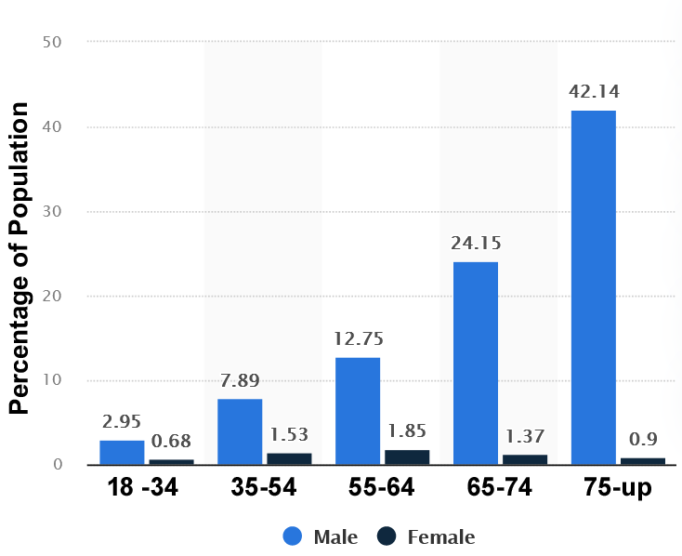
Percentage of US Veterans by Age and Gender

Slide 4
Slide based on “Title only”

Slide 5
Slide based on “Title only”

Slide 6
Slide based on “Title only”

Slide 7
Slide based on “Simple List”
Item level 1
  Item level 2
    Item level3

Slide 8
Slide based on “Double List”
Item level 1-1
  Item level 1-2
    Item level 1-3
Item level 2-1
  Item level 2-2
    Item level 2-3

Slide 9
Title of the presentation
Title of the section

Slide 10
(Slide based on “Blank”)

