Slide 1
Real-time Self-driving Car Experience: M&S and Self-driving Standards Synergy
2023-SIW-Presentation-014
Mark C. Davis, PhD
Wood Duck Research, LCDR USN-Ret, Mooresville North Carolina, USA
Co-Authors: Daniel P. Burns, Jennifer H. Nolan, Dan M. Davis and Judith L. Jacobus

Slide 2
Theses
While it is uncertain if Advanced Driving Assistance Systems(ADAS’s) will have the impact anticipated, it does seem that they are highly likely to be a significant part of civil life in the Western World and across the rest of the globe. This usage will impact large segments of society, so will have, accordingly, impacts on military operations. In a parallel environment, the military is becoming more and more invested in autonomous combat vehicles.
One thesis of this paper is that the on-going developments in civil and defense communities may hold useful insights for both.
Another is that the M&S community and the Standards professionals in it, may find a useful series of developments in ADAS communities from which M&S would profit, should they keep channels of information open between the two.
The final thesis is that the ADAS community is already amassing data on human/computer interfaces and other impacts of the user of ADAS’s and which may already be of interest to both simulating civil populations and combat within them.

Slide 3
Basic Disclaimers
Terminology
  In the underlying paper, we used the common term Self-Driving Automobiles or SDA’s, as this is one of the more popular terms for them
  Another, perhaps more descriptive and professional term is Advanced Driver-Assistance System or ADAS, which will be used in this presentation (a new standard?).
  Only time will tell which term will be part of the vernacular, but the choice here was more for brevity than professional precision; the terms are used interchangeably
R&D Participation or Financial Interest
  None of the authors is actively engaged in any formal study or research effort in this matter, but all have backgrounds in computer simulation or education
  None of the authors has any direct financial interest in the matters being discussed, save for being a citizen

Slide 4

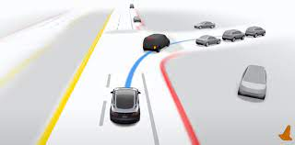
When will we get self-driving?
Self-Driving IS HERE already!
State or art: lane-minding, speed control and following distance
Total autonomy testing in restricted areas
More complete solutions in beta tests
  The system used by our co-author would turn over to human control if it sensed lack of attention (sensed by wheel pressure and direction of gaze)

Slide 5
ADAS Basic Functions and Goals
Basic requirements of an ADAS:
  Route identification, optimization and modification
  Speed control and power consumption monitoring
  Collision avoidance and safety enhancement
  Lane selection and turn execution
Additionally, the above requirements must be executed with an appropriate balance of at least these criteria:
  Safety
  Optimal time to arrival
  Comfort vis-à-vis maneuver actions

Slide 6
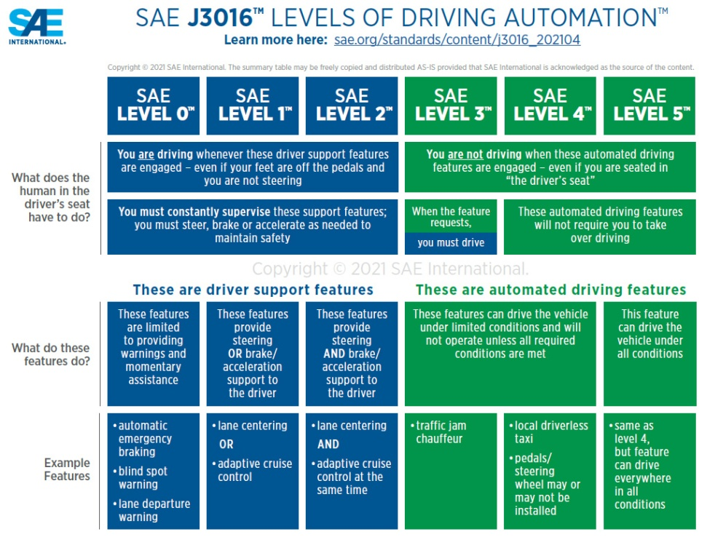
Advance Driver-Assist Systems Technology
In Automobiles, the Society of Automotive Engineers (SAE) reins
SAE has defined levels of ADAS control
These are expanded in SAE J3016:
  Level 0: No Driving Automation
  Level 1: Driver Assistance
  Level 2: Partial Driving Automation
  Level 3: Conditional Driving Automation
  Level 4: High Driving Automation
  Level 5: Full Driving Automation
Image to right shows some analyses

Slide 7
Lessons Learned from ADAS Beta Testing
Current technology is like teaching a teenager to drive
Human tendency is that you know you can do it better
  Watching another entity operate includes reaction time lag
  Everyone has a different strategy
Gaining trust takes time
  Operator must understand ADAS methodology (algorithm/policy)
  Experience and exercise improves trust
Takeaways:
  User interface must enhance trust (Why did it do that?)
  Training will be at least as important as with traditional technologies

Slide 8
Automated Combat Vehicles (ACV’s)
ACV’s show a much wider range in types, environs and uses
As well as surface, nations now have sub-surface vessels and aircraft
All three environments have vehicles with varying levels of control
They face many of the issues of civil ADAS, but have some more:
  Weapon control
  Resistance to take-over by foes
  Need to maintain technical ascendancy
One of original raisons d'être for M&S was the ability to simulate:
  Drones,
  Autonomous Ground Vehicles
  Robotic Naval Vessels

Slide 9
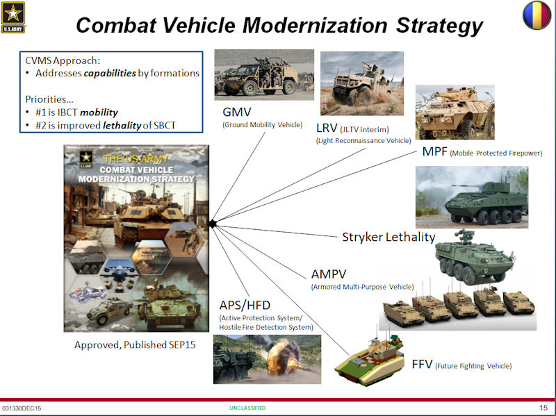
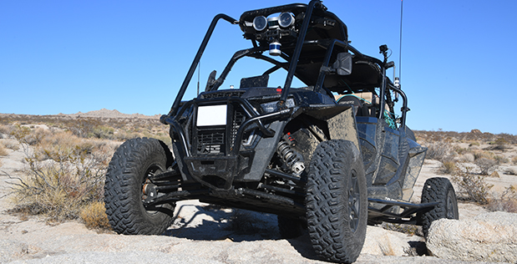
Lots of Strategies Attempting to Guide Progress
Battlespace will be “full” of autonomous vehicles
Dynamically developing strategy in various levels of DoD
M&S Community could be useful in factoring in changes
More than just combat vehicles
Positing the advent of autonomous supply and logistics

Slide 10
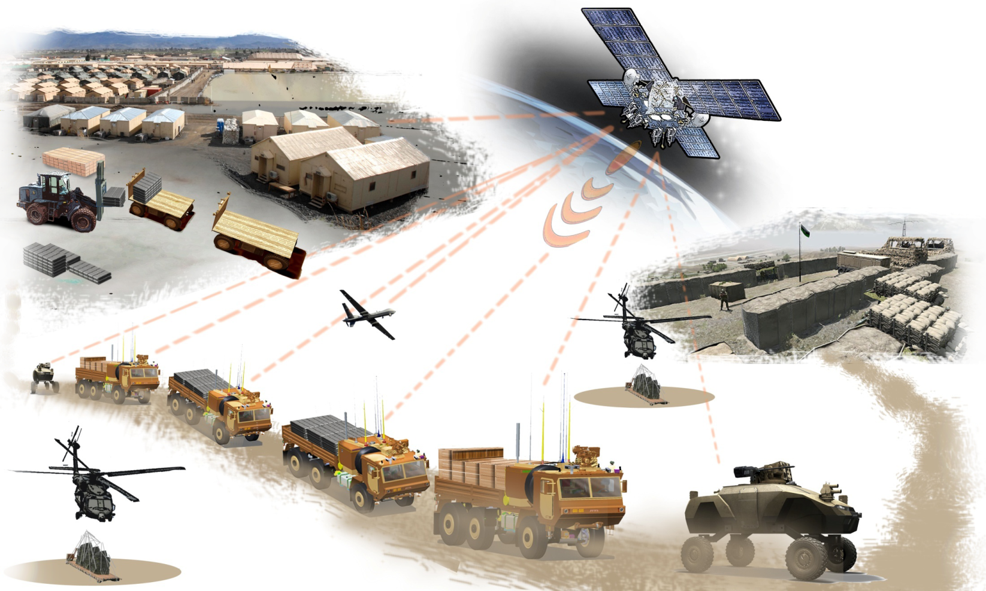
Autonomous Logistics

Slide 11
What Might the DoD Contribute to Civilian ADAS’s
As the DoD rushes ahead to prevent losing the technology advantage, the civilian effort is funding more vehicles in actual conditions
The design of ADAS’s was directed to the use in which they are now increasingly operational
This use has brought to the fore the major emotional and sensitivity issues that can “make or break” new technologies
There are examples of poor technical decisions have been made by the public because of emotional reactions to factual issues
The standards community may want to consider if they have a professional obligation to encourage more logos and less pathos

Slide 12
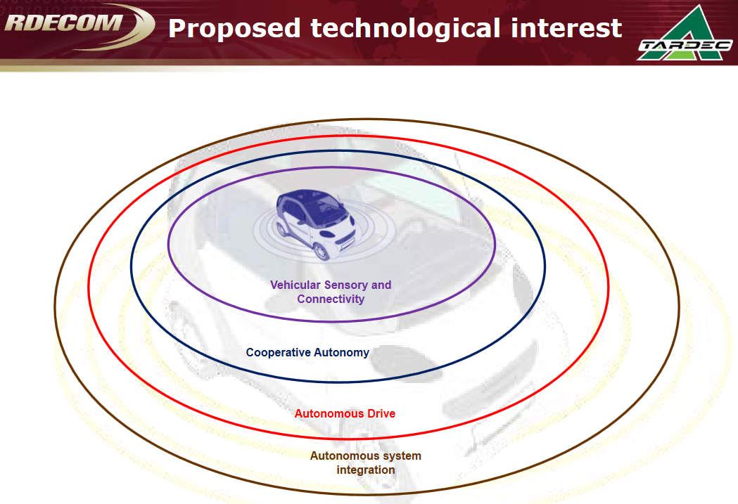
Will the Future Need Standards?
The DoD strategy for technology adoption:
Create an expanding list of priorities of what needs to be considered first and best.
The DoD hierarchy:
  Safety
  Mutual interaction
  Full autonomy
  Integration of critical systems

Slide 13
The Human Reaction
The public may be more sensitive and adverse to products designed with little attention to impacts on the users than service personnel
Already there are reports about the impact of autonomous driving upon the stress level of the users
As with any emerging technology, there may be some major disruptions in the way people lead their lives
People note that the desire to rely on ADAS’s is, to some degree, countered with the increased stress from lack of control
Humans see this even without a machine intrusion; the person in the driver’s seat is often more at peace than the rider in the right seat

Slide 14
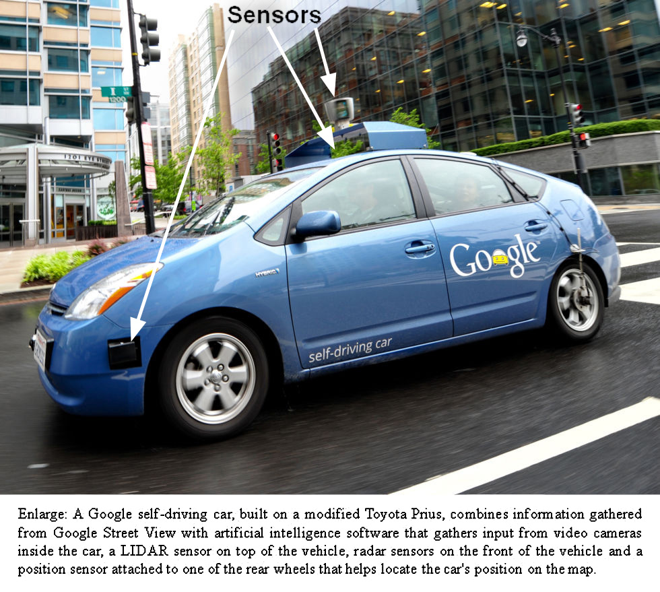
External Sensors Have Many Negatives
Sensors can be burdensome
  Appended
  Wind noise
  Aerodynamics costs
Tesla going a different way
They are following a more austere suite, mainly cameras
Future will decide
Standards would facilitate a more valid discussion

Slide 15
Autonomy Considerations
To meet some of these challenges, new technologies may make the ADAS technologies more comfortable and acceptable
Having a Virtual Conversational “coach” to work with the user or seek user input may reduce the fretting caused by fresh ideas
In order to establish realistic and valuable parameters for change/improvement, Neural Net Training would be useful
Going outside the ADAS and user, Deep Learning could probe emotions
Emotional state of riders could be monitored by better sensors to recognize stress and anxiety, then adjust the ADAS’s driving style
Using data from above, then correlated with vast stores of other data, Natural Language Processing might help to parse out connections

Slide 16
Technology and Issues
Problem | Potential counters
Trauma and stress reduction | Virtual conversational counseling
Establishing parameter criteria | Neural Net Training
Better understanding of emotional issues | Deep Learning
Monitoring personnel emotional states | Emerging sensor capabilities
Identifying emotional correlations | Natural Language Processing

Slide 17
Conclusions
Self-Driving Automobiles are here already
Much data is being amassed on impact on humans
Autonomous Combat Vehicles are a similarly burgeoning phenomenon
With around a million ADAS’s on the road, a lot of data is being created
Both in simulations and operations, all the communities have things to offer the other, so as to preclude having to learn painful lessons twice
The standards community has both significant skills in, and value to be gained by, being part of this evolution
At the very least, they need to be aware of capabilities, trends, and controversies to support better defense simulations in urban areas

