Slide 1


Military Writing in Simulations and Operations:
Establishing Metrics and Standards
Dan M. Davis,
Catholic Polytechnic University and University of Southern California, USA
Co-Authors: Jennifer H. Nolan, Jerome C. Placido, John J. Tran, & Judith L. Jacobus

Slide 2
Theses of Paper
A major thesis of this paper is that, given that communication skills are a primary requisite for military success, scant attention is paid to both training and evaluation of that skill.
Another is that the Modeling and Simulation community may not have sufficiently focused on this vital ability.
A third derivative thesis is that much of this hesitancy can be ascribed to the lack of identification, qualification, quantification and instantiation of both figures of merit and levels of mastery.

Slide 3
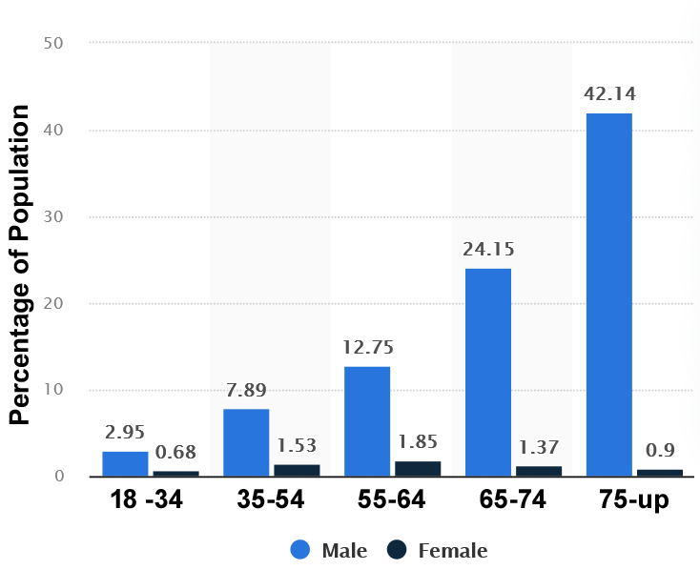
Why communicate
Coordination of groups require an effective mode for passing information up and down
Failures to do so can result in catastrophic losses
Poor writing skills will injure career progression
A general lack of communication to the public will result in failure of support therefrom

Slide 4
What happens when “comms” fail?
Public unaware of what it means to serve in the military
Only the very junior ranks (E-1 to E3?) are spared the need to write much
Much depends on how well information is communicated
  Mission success
  Combat losses
  Operational effectiveness
  Career progression
Many simulations do not include, let alone evaluate communications from live participants

Slide 5
Don’t new personnel know how to write and speak?
The perception in the military, higher education and industry is that new accessions were already taught to write and speak with
  Conciseness
  Cogency
  Compelling force
All of the communities mentioned have found that this is not true
Anecdotally, it seems all have fallen prey to that vision from the Wizard of Oz that a piece of paper makes the Scarecrow intelligent
  FitRep input inept
  CalState Officer issues
  CEO of computer company

Slide 6
How much Writing Time do Professionals Spend
As much as the public overestimates the losses in combat, they underestimate the time spent writing. This informal survey of a variety of fields found that professionals spent about 63% of their time writing or preparing to speak.
Profession | Degree | Writing | Speaking | Total |  | Profession | Degree | Writing | Speaking | Total
Navy LTJG Sub Surface | BS | 15% | 10% | 25% |  | Research Manager | PhD | 60% | 10% | 70%
Research Group Leader | PhD | 15% | 15% | 30% |  | CDR Navy Cryptologist | BA | 50% | 20% | 70%
Retired | PhD | 30% | 5% | 35% |  | Research Project Mgr | JD | 60% | 10% | 70%
Industry Programmer | PhD | 20% | 20% | 40% |  | CPO Navy Instructor | BA | 20% | 50% | 70%
Coder | MS | 35% | 10% | 45% |  | Coder | AA | 60% | 20% | 80%
Captain Coast Guard | DDS | 25% | 20% | 45% |  | College Instructor | PhD | 40% | 40% | 80%
Coder | BS | 40% | 10% | 50% |  | Army Major - Colonel | PhD | 60% | 20% | 80%
Army Lt - Captain (Infantry) | BS | 40% | 10% | 50% |  | Researcher | PhD | 70% | 10% | 80%
Recovery Room RN | BSN | 35% | 25% | 60% |  | Air Force Colonel Missiles | JD | 60% | 20% | 80%
Navy Electrician CPO | BA | 40% | 20% | 60% |  | CPO Navy Linguist | BA | 65% | 15% | 80%
Capt Marine Artillery | MA | 35% | 25% | 60% |  | Tech Instructor | BS | 10% | 75% | 85%
Industry Manager | PhD | 30% | 40% | 70% |  | Consultant/Manager | PhD | 80% | 10% | 90%
 |  |  |  |  |  | Means |  | 42% | 21% | 63%

Slide 7
Training time for communications
The issue is establishing the best way to find out if communications work
There seem to be very few ways of getting good data (lack of standards?)
When considering these issues, easy to feel it is all just too subjective
Nevertheless, it seems to be misperceived at every level that previous training has provided the person with the correct foundation
University of Chicago writing expert says they ALL fail
Training time does not adequately match the importance of tasks
High School (English largely literature) College (one course) Military (little)
Then the question arises: “Well, what do senior NCO’s & officer write?”

Slide 8
What do Military Personnel Write About?
Sorted alphabetically
After Action Reviews | Five paragraph orders | Officer Performance Reports
Award citations | Formal proclamations | Operations manuals
Battle orders | Equipment maintenance reports | Procurement orders
Classroom lectures | Intelligence Reports | Staff advisory reports
Correspondence | Letters to unit KIA's families | Standing orders
Ceremonial plans | Lesson plans/lectures | Technical manual revisions
Enlisted Evaluations | Movement orders | Training Plans
Fitness Reports | Officer Evaluation Reports | … ???

Slide 9
What Can Technology Do?
Major obstacle: no way to meaningfully assess communication skills
  Too varied!
  No consensus on figure of merit!
  Too many different contexts to assess an over-all skills!
Hard to promise a “new way”, but there are some glimmers of hope
Can now evaluate innumerable criteria extracted from massive data
  Isolate correlations between style and success
  Quantify number of features presented by individual
  Evaluate impact of improvement mechanism and deploy automatically
New hardware to more effectively implement data analyses

Slide 10
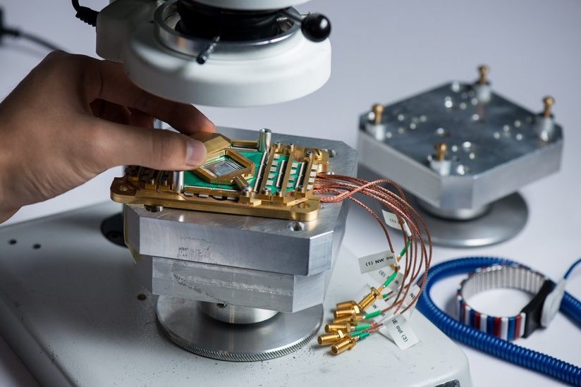


Emerging Technologies e.g. Quantum Computing
Several major new approaches
  Neural Net Training
  Big Data Analyses
  Deep Learning Insights
Can deliver what humans can’t
Quantum computing is stochastic
Free from human frailties
Automatically probe progress
  Photo Credits
    D-Wave
    IBM
    Honeywell

Slide 11
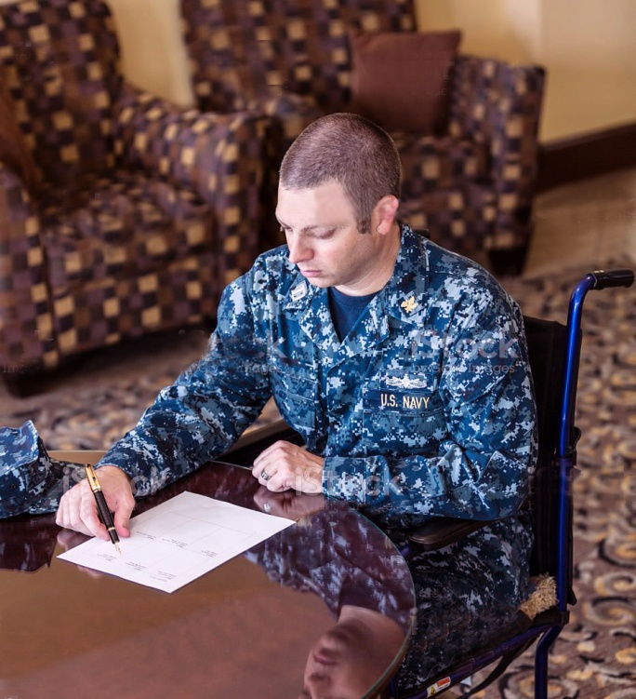
What could the future offer?
Writing is not a trivial task
Training may not have prepared individual
Collating existing written and spoken passages now can be executed, monitored and graded
Progress then compared to FitRep/OER rating
Remedial refreshers recommended
One could choose to make results part of the official record or to keep confidential
Coaching from virtual conversational mentor
Young Navy Civil Engineer: Drafting a document

Slide 12
Conclusions
Writing and presenting are two of the most critical skills for military personnel
Current procedures are constrained by a lack of standards, elevated ops schedules and dwindling staffs
Current training does not provide sufficient assistance
Techniques are available that might enable significant progress using emerging technical capabilities
The M&S Standards community has a position to champion this issue

Slide 13
(Slide based on “Blank”)

