Slide 1
Real-time Self-driving Car Experience: M&S and Self-driving Standards Synergy
2023-SIW-Presentation-014
Dan M. Davis
Catholic Polytechnic University &University of Southern California, USA
Co-Authors: Mark C. Davis, Daniel P. Burns, Jennifer H. Nolan and Judith L. Jacobus

Slide 2
Theses
While it is uncertain if Self-Driving Automobiles (SDA’s) will have the impact anticipated, it does seem that they are highly likely to be a significant part of civil life in the Western World and across the rest of the globe. This usage will impact large segments of society, so will have, accordingly, impacts on military operations. In a parallel environment, the military is becoming more and more invested in autonomous combat vehicles.
One thesis of this paper is that the on-going developments in civil and defense communities may hold useful insights for both.
Another is that the M&S community and the Standards professionals in it, may find a useful series of developments in SDA communities from which M&S would profit, should they keep channels of information open between the two.
The final thesis is that the SDA community is already amassing data on human/computer interfaces and other impacts of the user of SDA’s and which may already be of interest to both simulating civil populations and combat within them.

Slide 3
Basic Disclaimers
Terminology
  In this paper, we use the common term Self-Driving Automobiles or SDA’s, as this is on of the more popular terms for them
  Another, perhaps more descriptive and professional term is Advanced Diver-Assistance System or ADAS.
  Only time will tell which term will be part of the vernacular, but the choice here was more for brevity than professional precision; the terms are used interchangeably
R&D Participation or Financial Interest
  None of the authors are actively engaged in any formal study or research effort in this matter, but all have backgrounds in computer simulation or education
  None of the authors has any direct financial interest in the matters being discussed, save for being a citizen

Slide 4
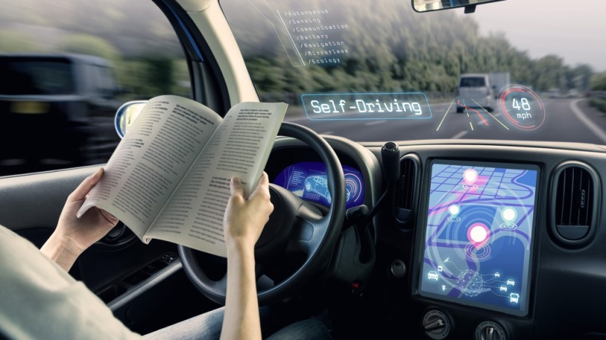
When will we get self-driving?
Self-Driving IS HERE already!
Most all of us have driven cars that
have lane-minding, speed control and
vehicle separation preservation
One of the authors has started a car,
gave it the address and took no
interventions, arriving safely, as was directed by him
That is not quite yet the level depicted in the image which is shown above in a way which does clearly show a very casual driver and inattention
The system used by our co-author would turn over to human control if it sensed lack of attention (sensed by wheel pressure and direction of gaze)

Slide 5
SDA Basic Functions and Goals
Basic requirements of an SDA:
  Route identification, optimization and modification
  Speed control and power consumption monitoring
  Collision avoidance and safety enhancement
  Lane selection and turn execution
Additionally, the above requirements must be executed with an appropriate balance of at least these criteria:
  Safety
  Optimal time to arrival
  Comfort vis-à-vis maneuver actions

Slide 6
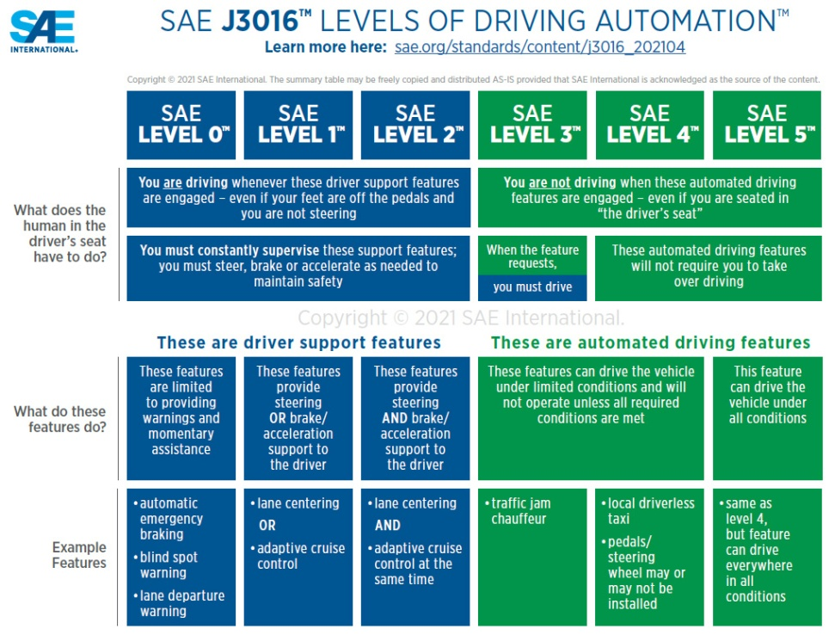
In Automobiles, the Society of Automotive Engineers (SAE) reins
SAE has defined levels of SDA control
These are expanded in SAE J3016:
  Level 0: No Driving Automation
  Level 1: Driver Assistance
  Level 2: Partial Driving Automation
  Level 3: Conditional Driving Automation
  Level 4: High Driving Automation
  Level 5: Full Driving Automation
Image to right shows some analyses
-
-
-
-

Slide 7
Automated Combat Vehicles (ACV’s)
ACV’s show a much wider range in types, environs and uses
As well as surface, nations now have sub-surface vessels and aircraft
All three environments have vehicles with varying levels of control
They face many of the issues of civil SDA, but have some more:
  Weapon control
  Resistance to take-over by foes
  Need to maintain technical ascendancy
One of original raisons d'être for M&S was the ability to simulate:
Drones

Slide 8
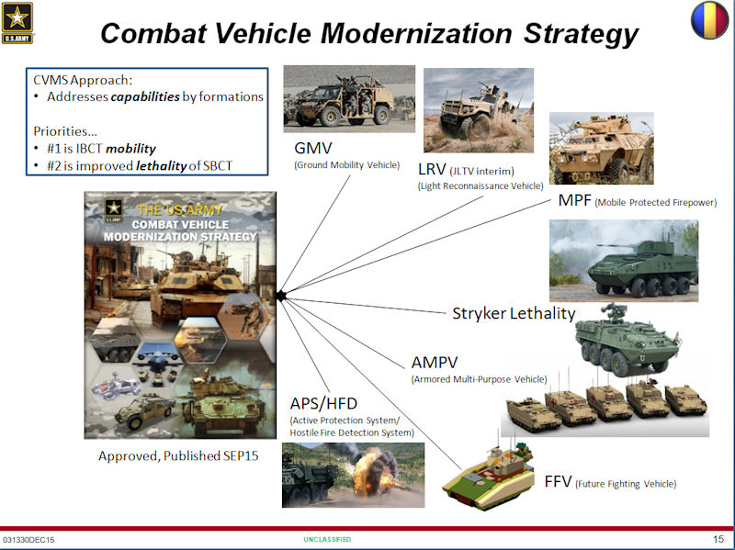
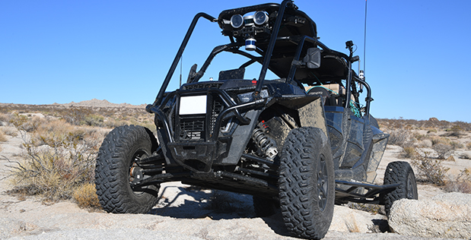
Battlespace will be “full” of autonomous vehicles

Slide 9
Slide based on “Title only”

Slide 10
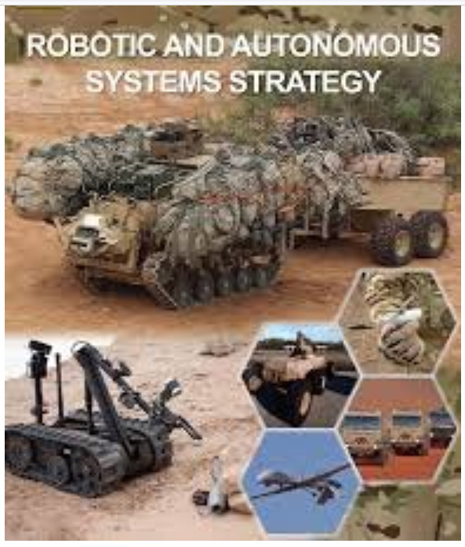

Slide 11
Slide based on “Title only”

Slide 12
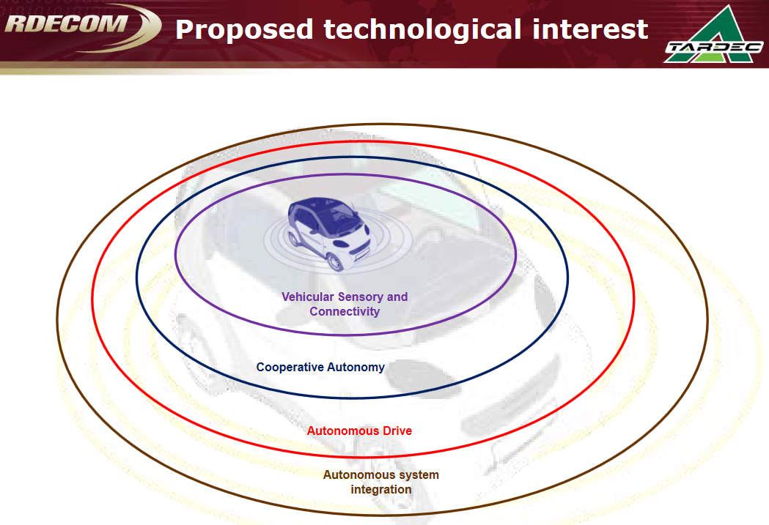
Will the Future Need Standards?

Slide 13
Slide based on “Title only”

Slide 14
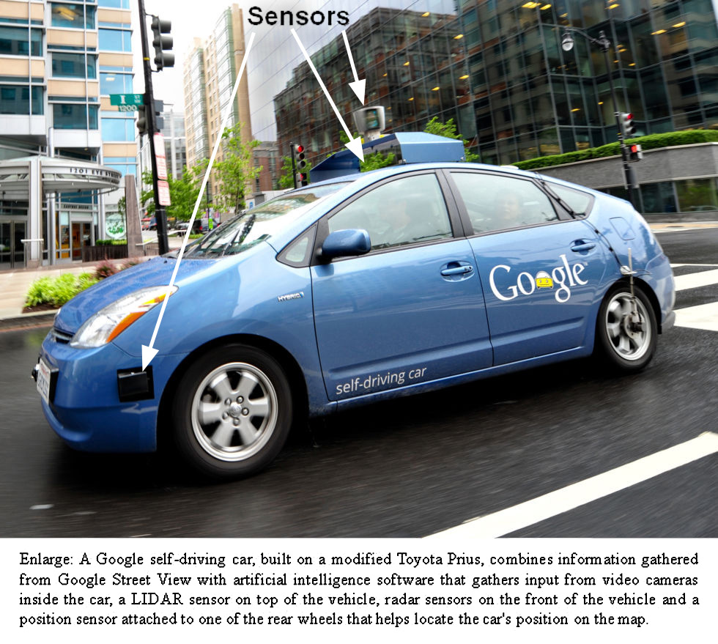
Sensors can be burdensom
  Appended
  Wind noise
  Aerodynamics costs
Tesla going a different way
Future will decide
Standards would facilitate a more valid discussion

Slide 15
Technology and Issues
Problem | Potential counters
Trauma and stress reduction | Virtual conversational counseling
Establishing parameter criteria | Neural Net Training
Better understanding of emotional issues | Deep Learning
Monitoring personnel emotional states | Emerging sensor capabilities
Identifying emotional correlations | Natural Language Processing

Slide 16
Slide based on “Title only”

