Slide 1


Learning Analytics and Deep Learning:
Emerging Standards for Instructional Metrics
Dan M. Davis,
Catholic Polytechnic University and University of Southern California, USA
Co-Authors: Jennifer H. Nolan, Jerome C. Placido, John J. Tran & Judith L. Jacobus

Slide 2
Theme
Students, university administrators, parents, colleagues and society all need an effective way to evaluate professors (and educators in general). Currently this is very hard to identify and quantify. Emerging technologies may hold promise for finally being able to establish correlations between teaching qualities and goals achievement. That brings to the fore: What qualities? Which goals? When achieved? In each of these cases, the M&S Standards community may have skills to offer. That community has long been a bridge between the behaviorists and the software coders and the hardware engineers. The vast majority of the stakeholders in the opening sentence are often not as proficient in the needed disciplines.

Slide 3
Education has a Long History
Education has been around a long time
Accepting some kind of apprentice tradition, it may have existed since the inception of human speech some 200,000 years ago
About the time of the advent of writing (five thousand years ago), some forms of education were extant, but probably not very formal
By the period of the classical Greeks, a more formal approach and tutor tradition came into being
The University system appeared about the time of Norman Conquest
Democracies in the latter part of the 18th century required literacy
The industrial age induced an emphasis on discipline and science

Slide 4
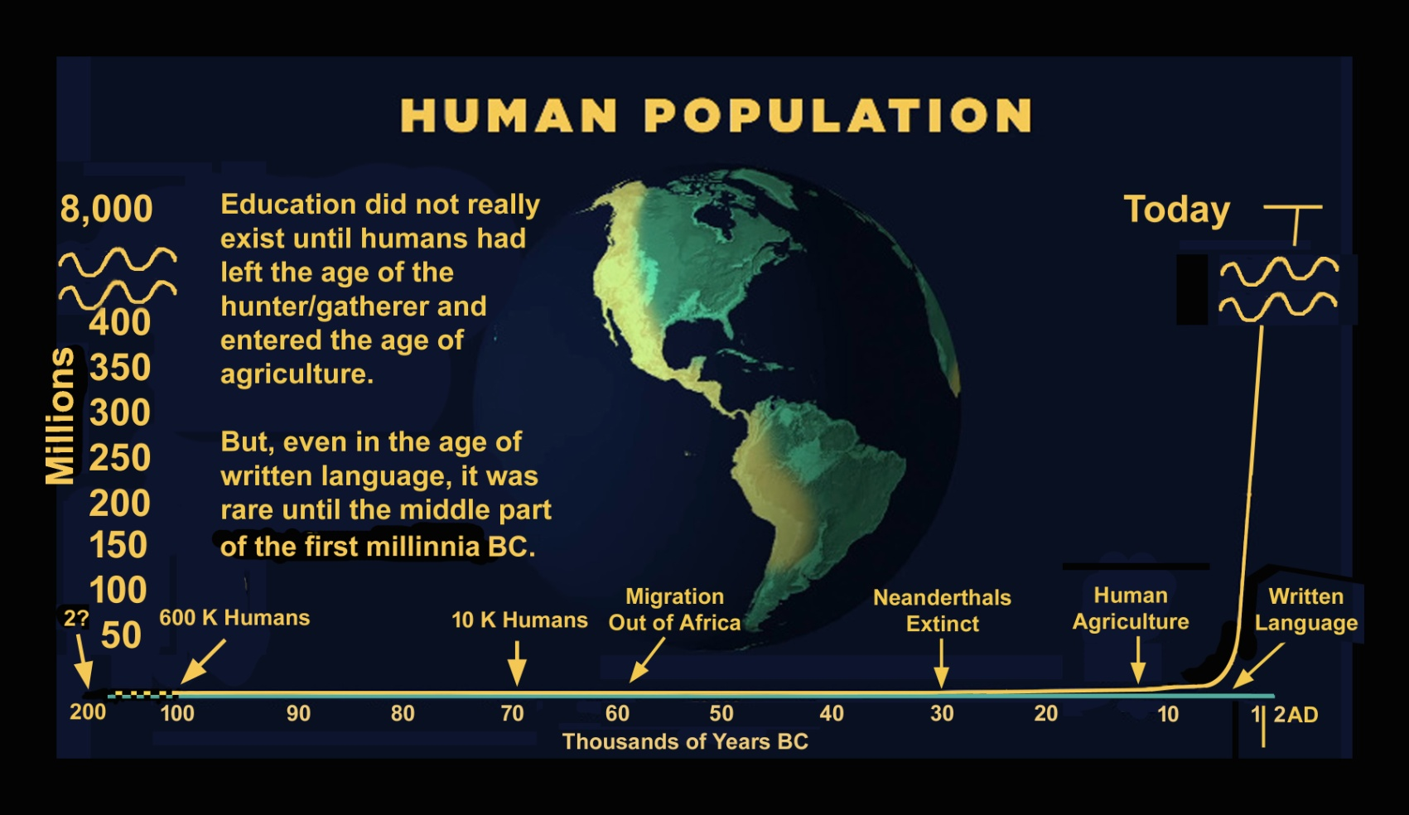
Human Population and Education

Slide 5
Teacher Evaluations Over the Centuries
Over the millennia, teachers have held a special position in society
But standards were often more ethical the rational (Socrates, Scopes)
In Europe, the Church carried the torch of education post Roman era
Tutoring was a major model in both Europe and Asia
In the early democracies, literacy was so low any literate person could be considered a good teacher, c.f. Samuel Clemmons
The industrial revolution brought more demand for universal educational achievement
One scholar is reported to have advised a Harvard-bound student: “Select the professor, not the subject.”

Slide 6
Evaluation Methods
There are a number of evaluation methods extant
  Teachers themselves
  Senior teachers
  Students
  Research records
All have their weaknesses
The intended recipients/beneficiaries of the graduates say otherwise
  Students find they did not master skills needed for life
  Grad School Profs say students are under-prepared
  Employers complain students are not ready

Slide 7
Student Evaluations
Elementary School students rate by attractiveness
High school students focus on wrong goals and often disregard and denigrate their teachers
College students are asked to do rankings
  Formal response by university
  Input to student rating web sites
Criteria listed are useful, but students admit they were swayed by:
  Entertainment quality of professor
  Ease of workload
  Generosity of grades given
Again, the Wizard of Oz Syndrome: “I am here to get a piece of paper”

Slide 8
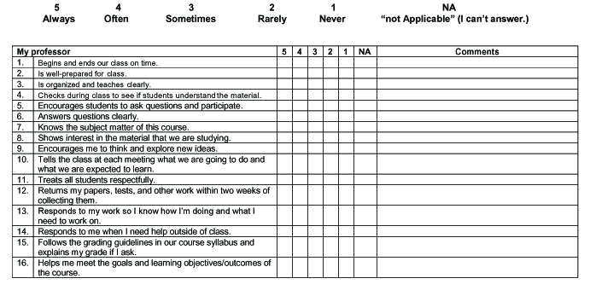
Current Professor Evaluation by Students

Slide 9
Goals
Goals have changed over the decades
Some were misplaced
Some are still very much in question
Major (MAJOR) dichotomy between “users”
  Students
  Parents
  Faculty
  Employers
Goals should be a rational, desirable and quantifiable
Platitudes and politics can be destructive

Slide 10
Capabilities that the Classical Greeks Lacked
Neural Nets
Big Data
Sensors to measure attention
NLP to make sense out of written (or spoken) words
Linear programming to integrate multiple inputs
Deep Learning
Learning Analytics
Standards’ Community expertise in all these areas

Slide 11
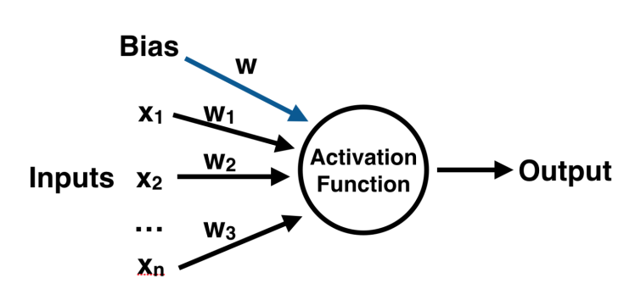
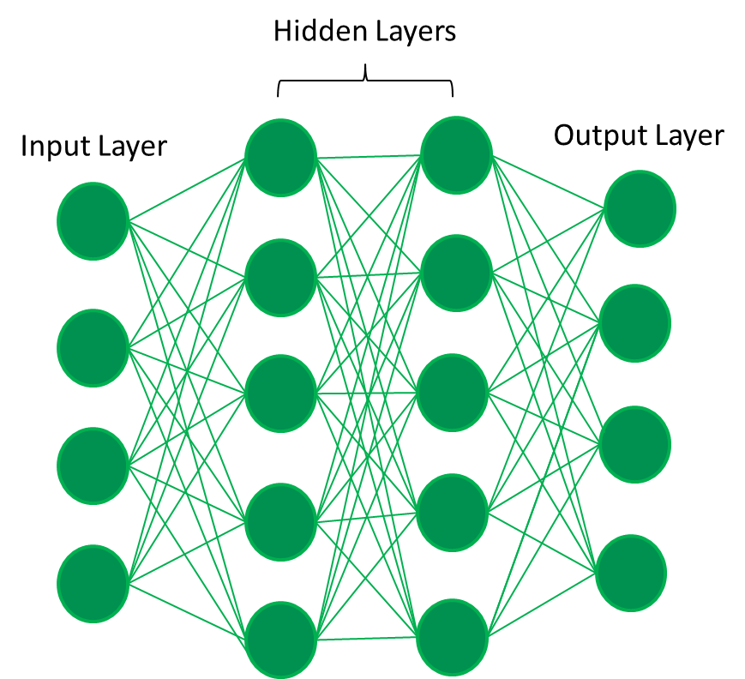
How do Some of These Work
Neural Nets
Big Data
Deep Learning
Learning Analytics

Slide 12
Privacy and Ethics Issues
New sensitized demand of protection for users and accountability for program personnel
Embarrassing or even harmful use could be made of data
Differing parties have differing goals, so many may not want to share either their positions on matters or data that may impact them
Integrity and diversity issues are especially likely to evoke strong reactions
Any machine driven analytic device, especially those with not human intervention, may generate result offensive to some

Slide 13
Can Changes be Made
Output of insights may be hard to implement using old methods
Differing goals of various individuals in one class may make one unified type of delivery less attractive to some at the same time it is optimal for others
Machine generated teaching might be able to avoid this issue or, at least, ameliorate the discordance
In addition to the rating and coaching for the individual teacher/professor, it could provide a special path of unique needs
Several computer-agent technologies would be applicable

Slide 14
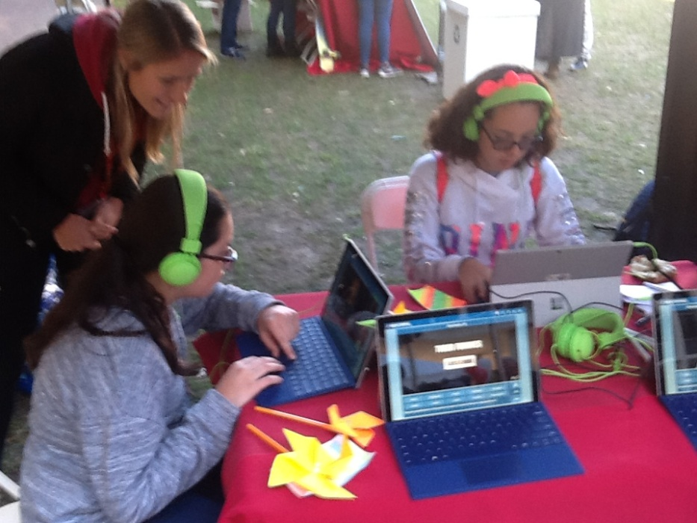
A Conversational Teacher/Professor
Impact of virtual conversationally capable teachers or mentors
  MentorPal and Sim Coach Projects
  Not only effective, could be trainable
  Collect sensor data
High Marks from surveys
High involvement from users
Very non-judgmental
Available and pacing variable
Instruct and measure progress
Training possibilities via Neural Nets

Slide 15
Conclusions
Rating teachers could be improved
Necessary for good Education
Used to assess
Capabilities
Areas for improvement
Hiring and retention decisions
Many personal and ethical issues
M&S Standards community would be a good source of counsel
Similarly, advances may be applicable to DoD education issues

