Slide 1

Inculcating Metacognition and Critical Thinking:
Standards for Implementing Virtual Humans
2021-SIW-Presentation-006
Dan M. Davis, JD, ICT – University of Southern California, USA
With Frederica J. Stassi, EdD, Mark C. Davis, PhD
and Karen J. Ristuccia, DMin.

Slide 2
Major Theses
The major thesis of this paper is that technologies are emerging that will enable expansion of critical thinking and metacognition skills so that innate intellectual capabilities can better be made manifest. This approach is vital to the optimal pursuit of defense organizational goals. There are constraints that hinder inculcating such skills in DoD personnel and these constraints are not easily ameliorated. An effort to define the term critical thinking is presented, along with the results of an informal small ethnographic survey.

Slide 3
Background
  Populations have been at war for all of history.
Combat: an unforgiving environment for the irrational
US paid in blood: ignoring more accurate Civil War rifle
These lessons were forgotten; which led to WW I losses.
Torpedo Eight at Midway battle: all were shot down
A fifth of the losses in Vietnam did not die in combat
Virtual reality and virtual humans are emerging
They can be used to improve selection and training

Slide 4
Critical Thinking
Capabilities and analytical reasoning needed by warfighters.
Good g-factor tests can measure intellectual capabilities
These tests have been extant for millennia
Courage can be tested to some degree.
Testing “critical thinking”; need of an independent study
Characterize the concept and quantify magnitude and potential.
Capabilities are susceptible to stress and fatigue

Slide 5
Metacognition
Thinking about thinking
First advanced by Flavell late in the 20th Century
How critical thinking is developed and sustained
Warfighters may wonder what applicability it has for them
Discussion about when metacognition is not productive
It is a vital skill for the warfighter
Operational defense experience & scholarly study support

Slide 6
Natural Language Processing
Computers can be used to understand and manipulate Natural Language (either in text or in speech)
Natural Language Processing is an effective series of computational methods for analyzing and manipulating naturally occurring text in “real time”
One or more strata of linguistic techniques are used
Human-like language processing is useful for a range of tasks
Creation of realistic conversations exchanges are possible
Observations support that these often create realism
Notes:
Tell story of PhD giving out K&R at IBM and the story of Probst’s giving out Strunk and White at EA

Slide 7
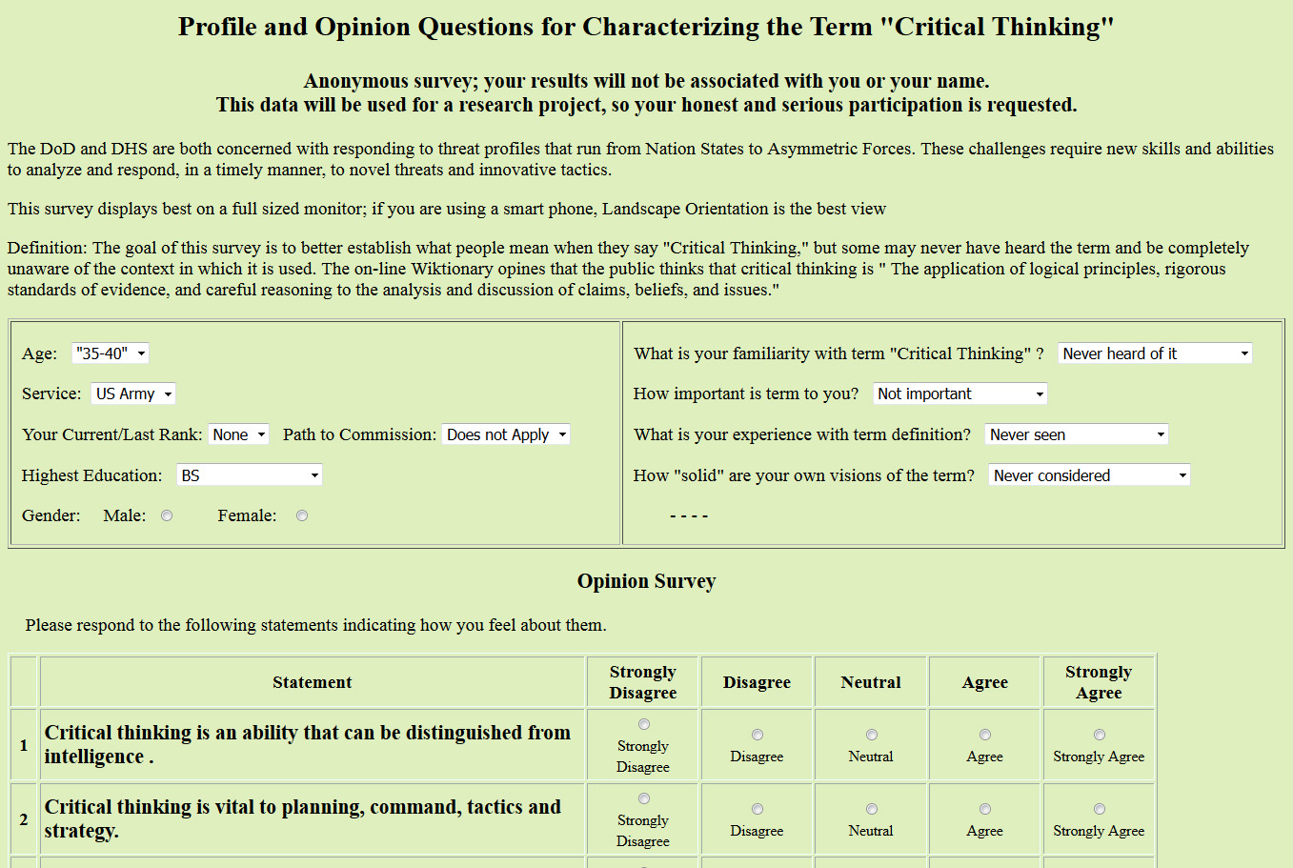
Definitions
Establishing what the DoD Personnel envision what Critical Thinking means
An informal survey to help baseline further study

Slide 8
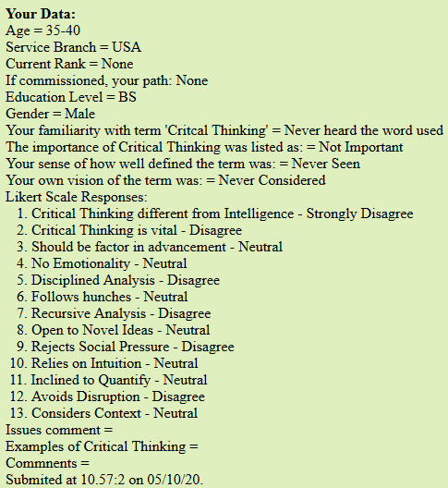
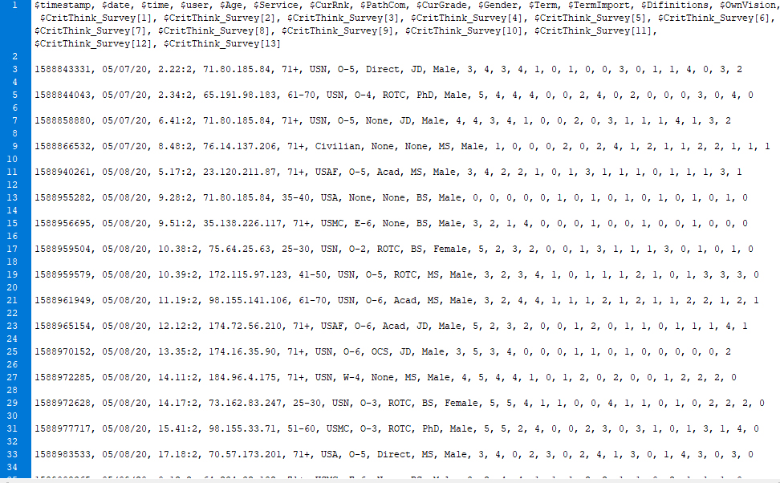
Polling the DoD
Feedback response to the poll participants and the format for the flat file used to collect the data
Important goal in research was to follow the leads of and respond to the needs expressed by the warfighters
Standards should reflect their needs

Slide 9
Early Preliminary Results
Familiar with term: | Term Importance: | Definition experience: | Own vision of term:
4 Never heard the word used 4 Have heard others use it 16 Have used it a little 20 Used it and am interested 6 Deeply Involved 10 Participated in Discussion | 11 Not Important 0 Interesting 24 Useful Concept 0 Important to Others 15 Important to me 10 Vital to all | 10 Never Seen 4 No Consensus 19 Competing Definitions 27 Mine Evolving 0 Well defined consensus 0 Universal Term | 4 Never Considered 2 Nebulous 23 Open to new 11 Will Adopt Others 20 Comfortable with mine 0 Committed to mine

Slide 10
Current Pedagogies
Three principle way to improve
Equally effective in both critical thinking and meta-cognition
Didactic – train use of rubrics
Socratic – drive critical thought by challenging
Constructivist – establish stimulating environment
Need very adaptable teachers
Constrained by classroom disorder

Slide 11
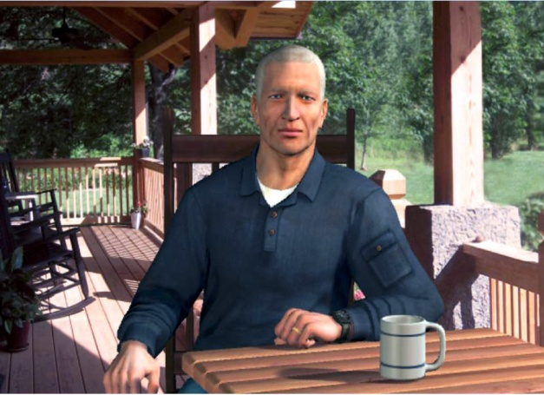
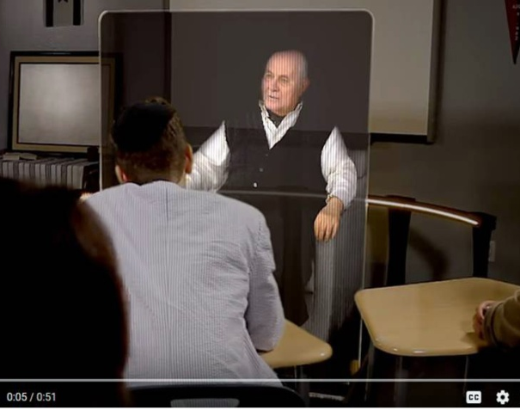
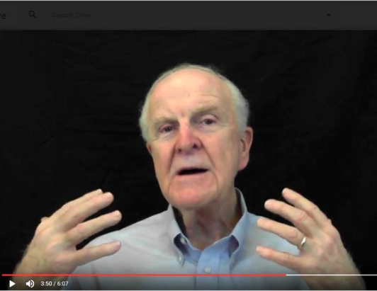
State of the Virtual Computer Agent Art

Slide 12
Emerging Technologies
Computer advances in AI and NLP
Various formats and interfaces available
  Animated avatars
  Video clips of instructors and interactive tutors
  Holographic 3D displays
  Voice recognition and conversational agents
AI and Deep Learning
Can produce self-learning
Requires human monitoring
Careful establishment of figures of merit
Deep Learning should produce more realism
Challenge: develop questioning AI agents

Slide 13
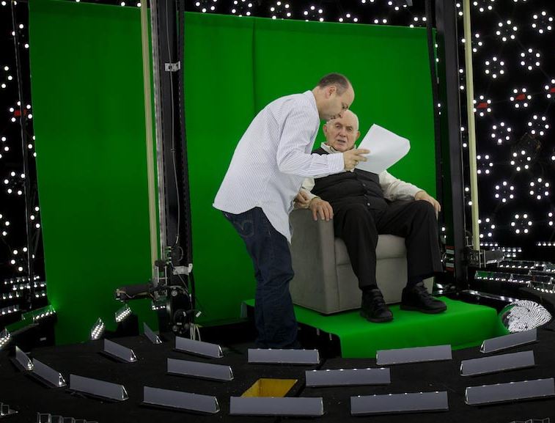
Ongoing Research
SimCoach for VA patients
New Dimension in Testimony to archive “survivors”
MentorPal to advise High School STEM students
Scalability, training, consistency, and compliance
Entertainment industry arts and skills used

Slide 14
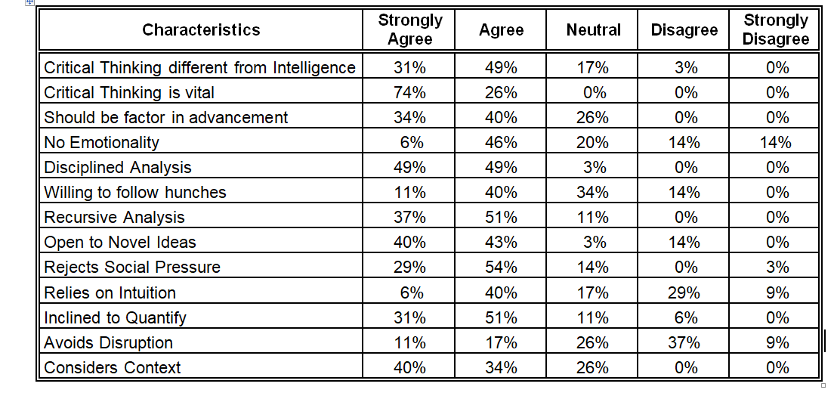
Preliminary Results

Slide 15
Metrics
Major issue in this area is the lack of metrics
Without metrics, it is difficult to recognize the impact.
Lack of consensus on what critical thinking means hinders this
SISO specializes in creating standards and psychometrics
Concerted effort is required
Some of the emerging technologies discussed may enable analyses that will facilitate this metric creation and validation
SISO has a role in pursuing this.

Slide 16
Implementing a Practicable Methodology
 | Individualization | 24 X 7 Access | Teacher Charisma
Didactic | Classroom Size of 1; self paced | Open class scheduling | 1 hero teacher, but scalable to all
Socratic | Focus questions on 1; others not idled | Mentor available globally | Private forum for challenge
Constructivist | Different environment for each student | Pause button on situation | Different levels of coach’s support

Slide 17
Benefits of Approach
Emerging capabilities are enablers of powerful set of A/I programs to deliver mentors, tutors and instructors 24 by
Anywhere there is network connectivity.
This capability has the real potential to improve battlefield success
Technical feasibility of these programs has been shown
NLP interfaces, and high-production value videotaping can deliver
Effective assessment and training of Critical Thinking and Meta-cognition are within the reach of the DoD and the Nation

Slide 18
Acknowledgements
Much of this work was supported by grants from the Office of Naval Research's STEM Program (ONR N00014-16-1-2820) and by students supported by the National Science Foundation Research Experience for Undergraduates program (NSF 1560426). Nevertheless, the positions taken in the paper are the authors’ own and do not represent in any way the views of the Department of Defense or the US Government.

Slide 19
Questions

