Slide 1
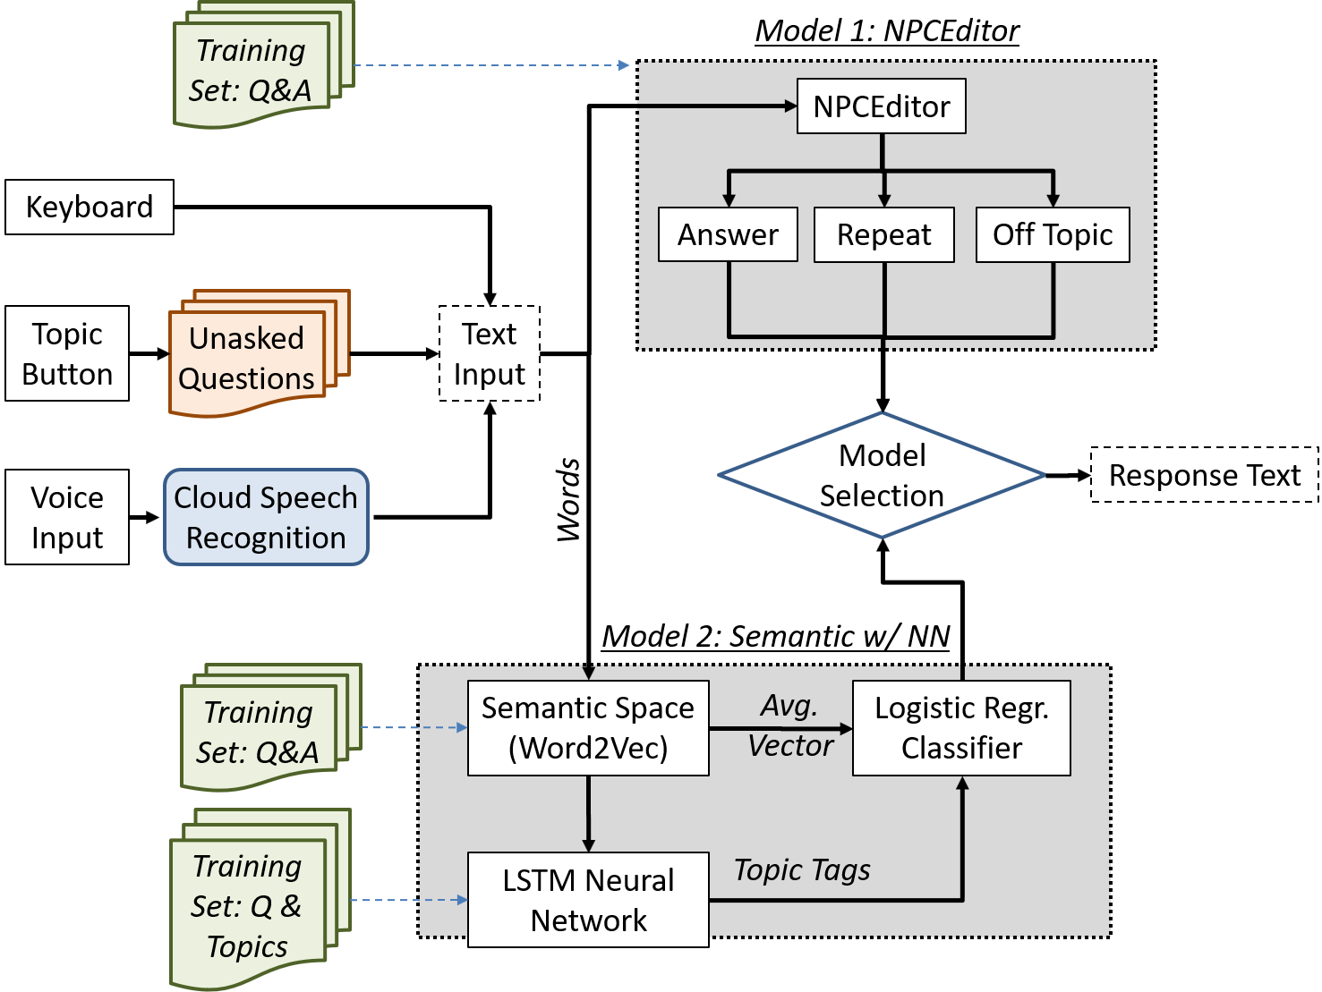
Learning Analytics
Personal Demographics
Body Language
Voice Tone
Scheduled progress
Response delays
Session length
Previous performance
Average user data
Verbal input today
Needs of organization
Pedagogical options
Logging functions
Alternate topics
Staff input
Response to critiques
Available alternates
Urgency of needs

Slide 2


